Slide 1
SENTENCE BUILDING
words
complex sentence
phrases
compound sentence
clauses
simple sentence
Using sentences to interest and engage the reader

Slide 2
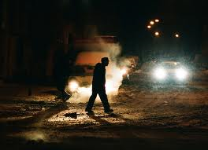
Words that show and tell
ADJECTIVES | NOUNS | VERBS | ADVERBS
iron-hard icy echoing cold | man road heartbeats feet sweat night headlights cars | ran sounded poured swept | desperately bitterly past
Who? Where? When?
What? How?

Slide 3
Words that show and tell
The man ran desperately along the road. His heartbeats sounded in his ears in time with his echoing feet on the iron-hard, icy ground. Sweat poured into his eyes though the night was bitterly cold. The headlights of cars going the other way swept past him. No cars seemed to be going his way. His desperation grew.
From Faces © Dennis Hamley

Slide 4
Building interesting detail in a simple sentence
The man ran.
Use an adverb to show how he ran:
The man ran desperately.
Use an adverbial phrase to show where he ran.
The man ran desperately along the road.
Use adjectives to show what the road was like:
The man ran desperately along the iron-hard, icy road.
Experiment by changing the order of words for emphasis:
Desperately, the man ran along the iron-hard, icy road.

Slide 5
Simple sentence game
A man went down the road.
Make the verb more interesting.
Choose more interesting nouns.
Show more by using adjectives.
Add more information with adverbials (words or phrases that tell you when, where or how something happens)
Experiment by changing the order of words.
Insert: Rain, 1945 by Arthur Leipzig:
www.arthurleipzig.com/photofolder/rain.html
One cold November night, the detective hurried anxiously through the rain-swept streets of New York.

Slide 6
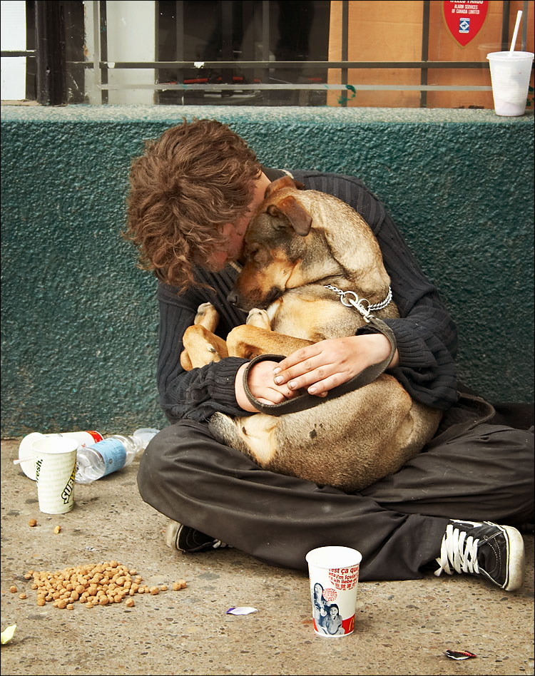
Can you add more detail to this sentence so that we have a clearer picture of the setting, characters and events?
Use only one verb.
Choose more interesting nouns
(e.g. teenager, pavement)
Choose a more interesting verb
(e.g. crouched, were curled up)
Add more information to the verb with an adverb
(e.g. despairingly, together)
Add more information to the noun with an adjective
(e.g. hungry, exhausted)
Add more information with an adverbial phrase that tells you when, where or how something happens
(e.g. outside the supermarket, on a cold winter’s day, in despair)
Change the order of words for emphasis (e.g. by moving the adverb to the start of the sentence)
A boy and his dog sat in the road.
The house was near a road.
©2006 Sam Javanrouh

Slide 7
Sentence variety: what choices do writers have?
You can vary the length of sentences:
That was when Iorek moved. Like a wave that has been building its strength
over a thousand miles of ocean, and which makes little stir in the deep water,
but which when it reaches the shallows rears itself up high into the sky,
terrifying the shore-dwellers, before crashing down on the land with irresistible
power – so Iorek Byrnison rose up against Iofur, exploding upwards from his
firm footing on the dry rock and slashing with a ferocious left hand at the
exposed jaw of Iofur Raknison.
It was a horrifying blow. It tore the lower part of his jaw clean off, so that it flew
through the air scattering blood-drops in the snow many yards away.
(Description of the bear fight in Northern Lights © Philip Pullman)

Slide 8
How did Philip Pullman do that?
Iorek Byrnison rose up against Iofur
Like a wave that has been building its strength over a thousand miles of
ocean, Iorek Byrnison rose up against Iofur
Like a wave that has been building its strength over a thousand miles of
ocean, and which makes little stir in the deep water, but which when it
reaches the shallows rears itself up high into the sky, terrifying the
shore-dwellers, before crashing down on the land with irresistible power –
so Iorek Byrnison rose up against Iofur, exploding upwards from his
firm footing on the dry rock and slashing with a ferocious left hand at
the exposed jaw of Iofur Raknison.

Slide 9
Sentence variety: what choices do writers have?
You can vary the structure of sentences:
simple sentences have only one clause:
The man ran desperately along the road. His desperation grew. No cars stopped.
Join clauses together to make compound sentences: and/but are
useful for this.
The man ran desperately along the road and his desperation grew.
The man ran desperately along the road but no cars stopped and his desperation grew.

Slide 10
Sentence variety: what choices do writers have?
Join clauses together to make complex sentences:
Main clause:
the man ran along the road
Subordinate clauses: while cars streamed past him
his desperation growing
His desperation growing, the man ran along the road, while cars streamed past him.
While cars streamed past him, the man ran along the road, his desperation growing.
Which version do you think creates the most tension for the reader?

Slide 11
How well does this writer vary sentences to interest and engage the reader?
I was just pushing the lower half of the ladder back up when I heard it. There was someone at the front door. I held my breath. It was OK. They couldn’t get in. I slid my hand into my pocket to make sure the key was still there. It wasn’t. I’d left it in the front door. I could hear it turning in the lock now. I raced back up the ladder and hauled it after me. When I reached down to pull the hatch back up, I could hear someone coming up the stairs. I quickly pulled the hatch back into place and scrabbled over to the water tank, holding my breath.
(From Millions © Frank Cottrell Boyce)

Slide 12

How many different ways can you join the main clauses to the subordinate clauses? Which sentences sound the scariest?
the house seemed empty
slowly decaying
its windows boarded up
covered with ivy
smiling
a woman stood in the doorway
holding a flickering candle
beckoning me to follow her
©Mornixuur.nl

Slide 13
. full stop | , comma | ! exclamation mark | ? question mark | ; semi colon | : colon | .... ellipsis
Tap she jumped it was the window someone must be out there
hidden by the curtains she hurried to the phone picked it up and
started to dial 999 then put it down this was stupid the tap wasn’t
regular it might not be a person at all it might be something trivial what
would Dad say if she called the police out for nothing she strode to the
window pulled back the curtain and burst out laughing it was nothing
after all a chain from the hanging baskets had broken loose and gusts
were throwing it up at the window so that every so often the metal ring
at the end struck the glass tap there it was again she chuckled and
reached out to close the curtain then froze in horror reflected in the
glass was a figure standing behind her in the doorway

Slide 14
. full stop | , comma | ! exclamation mark | ? question mark | ; semi colon | : colon | .... ellipsis
Tap! She jumped. It was the window. Someone must be out there, hidden by
the curtains. She hurried to the phone, picked it up and started to dial 999;
then put it down. This was stupid. The tap wasn’t regular. It might not be a
person at all; it might be something trivial. What would Dad say if she called
the police out for nothing? She strode to the window, pulled back the curtain
and burst out laughing.
It was nothing after all. A chain from the hanging baskets had broken loose
and gusts were throwing it up at the window so that every so often the metal
ring at the end struck the glass. Tap! There it was again. She chuckled and
reached out to close the curtain; then froze in horror.
Reflected in the glass was a figure standing behind her in the doorway.
(From Storm Catchers © Tim Bowler)

