Slide 1
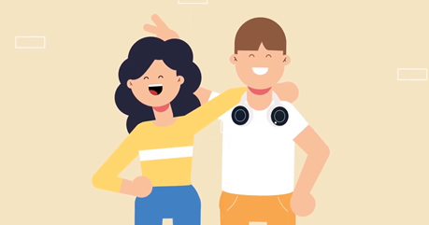
Working out relationships – LESSON 1
Learning Objectives:
To learn about healthy and unhealthy one-to-one intimate relationships and strategies to build healthy lasting relationships including accessing support where needed
Notes:
Introduce the topic and run through the learning objectives:
The objective of the lesson is to learn about healthy and unhealthy one-to-one intimate relationships and strategies to build healthy lasting relationships. This will include learning how to access support for unhealthy relationships.

Slide 2
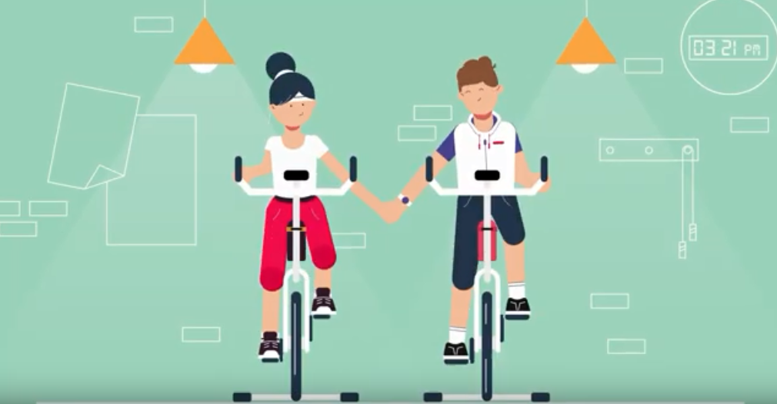
Working out relationships – LESSON 1
Learning Outcomes
Pupils will be able to:
Evaluate whether a relationship is healthy or unhealthy
Identify strategies to build a healthy lasting relationship
Explain how to access support in relation to unhealthy relationships
Notes:
Introduce the topic and run through the learning outcomes:
After the lesson pupils will be able to:
Evaluate whether a relationship is healthy or unhealthy
Identify strategies to build a healthy lasting relationship
Explain how to access support in relation to unhealthy relationships

Slide 3
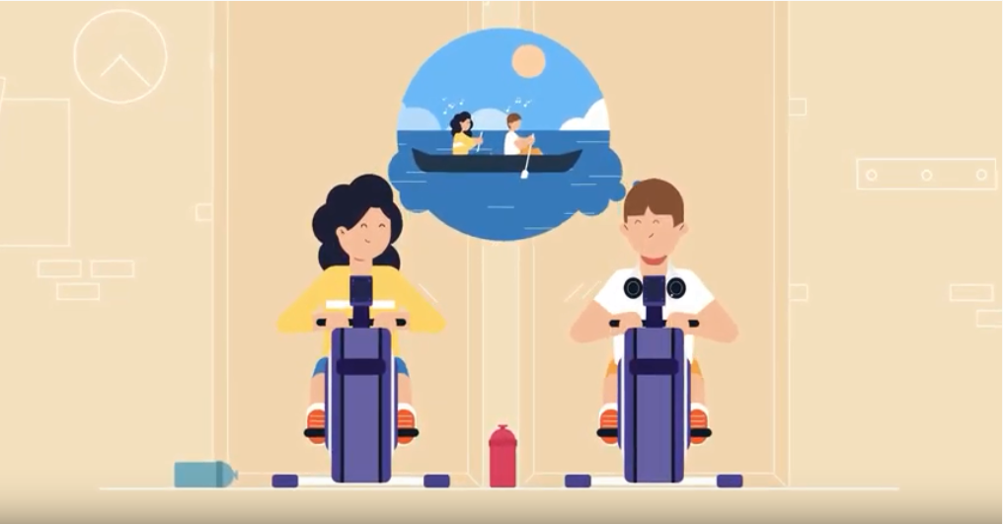
Working out relationships
Think of a key word that you would associate with a healthy relationship
Notes:
Ask the whole class to think of a key word they would associate with a healthy relationship (safe, respectful, equal, kind, supportive, fun). Without conferring they should write this on a post it note and put it on the board. The teacher will gather the post-its into groups.

Slide 4
Task
Read the scenario
Discuss the following questions on your tables
Feedback
Sarah and Paul are both 16. They met at a train station 6 months ago when they were both waiting for the same late train. Paul asked Sarah for her number and they started seeing each other straight away. Paul is Sarah’s first boyfriend. Paul was very attentive at first and often told Sarah that she was pretty. This made Sarah feel special, especially because her home life is not very happy (her parents divorced and her dad moved to Spain so Sarah doesn’t see him much. Sarah’s stepdad is always shouting at Sarah and her mum and telling her mum what to do).
Lately Paul has been getting moody. He says that Sarah’s friends aren’t good enough for her and don’t understand her like he does. He doesn’t like Sarah hanging out with her close friend Greg, who lives in Sarah’s street and who Sarah has been friends with since Year 5. Paul has also said that he doesn’t like Sarah playing netball as the skirts the players wear are too short. Sarah has agreed to stop playing netball and to see less of Greg so that she can see more of Paul. She knows that Paul only says these things because he cares for her and in any case she thinks Paul is right, why do they need anyone else when they are so happy together and their relationship is so perfect?
Does this relationship sound healthy? Why?
Write down three things that make the relationship sound unhealthy
Sarah doesn’t think she is in an unhealthy relationship. Why does she not view the relationship as unhealthy?
Notes:
Give pupils five minutes on their tables to read the Sarah and Paul scenario, noting down three things that make the relationship sound unhealthy then five minutes to feedback and to suggest why Sarah does not recognise that the relationship is unhealthy.
As a support activity, consider writing on the whiteboard a word bank of healthy/unhealthy features of a relationship, from which pupils select 3 that they feel best describe the relationship between Paul and Sarah. Such phrases could include:
(Healthy) Supportive/ caring/ trusting/ kind/ accepting
(Unhealthy) Controlling/ isolating/ manipulative/ inconsistent/ jealous
Alternatively ask three ‘higher ability’ pupils to give their answers here, write them on the board and thus create a word bank of characteristics of unhealthy relationships to which lower ability pupils can then refer.
As an extension activity, consider asking the pupils whether Paul thinks the relationship is healthy and why. (First/one of his first serious relationships. Perhaps he has not had good role models for relationships. He seems insecure and this is causing him to be jealous and controlling).

Slide 5
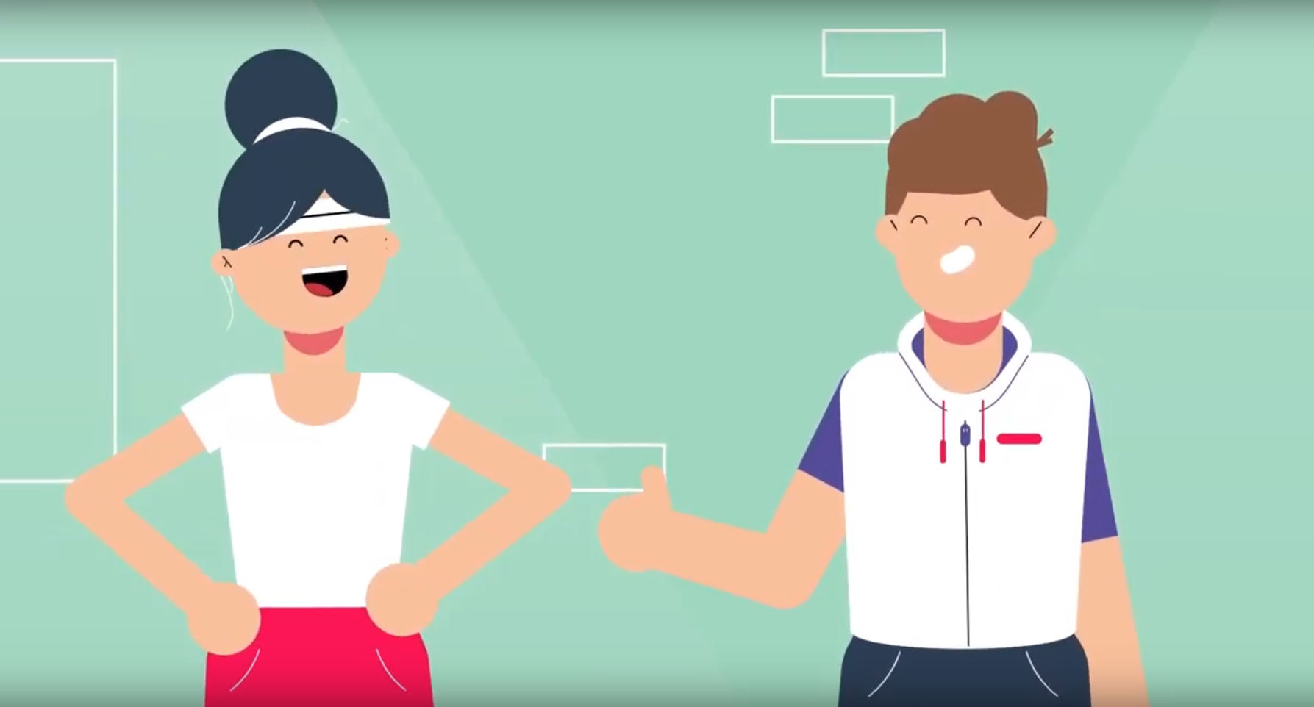
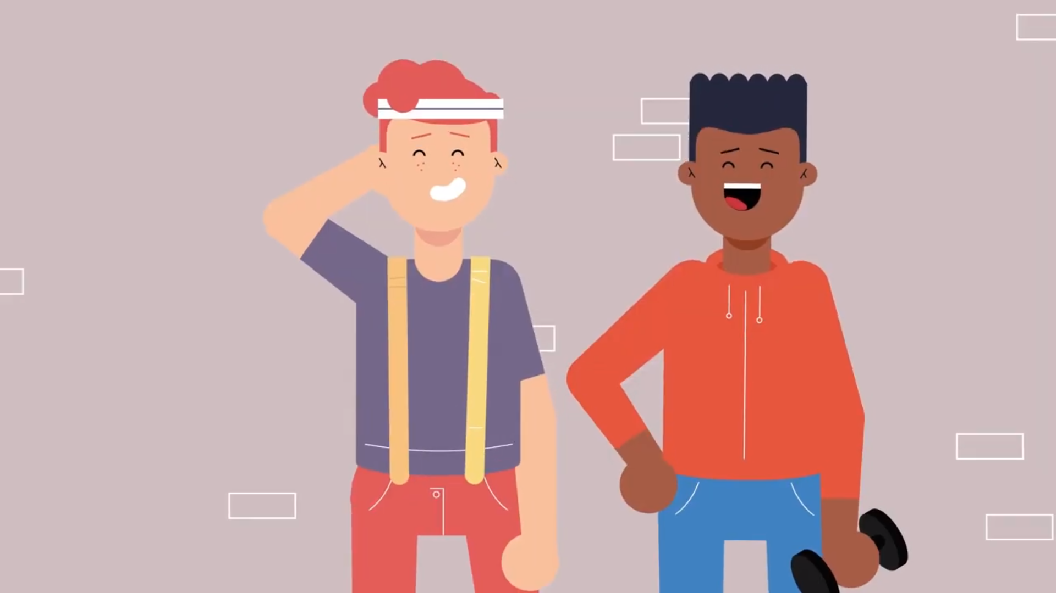
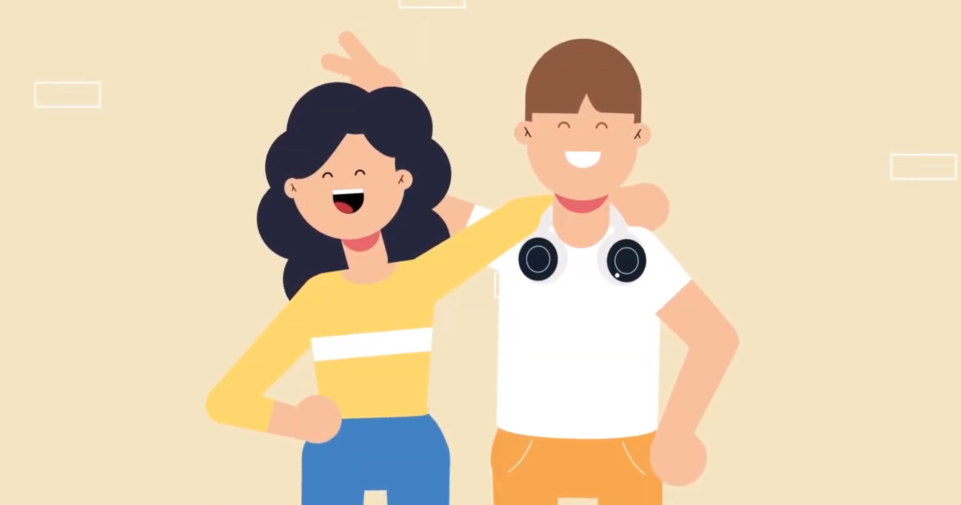
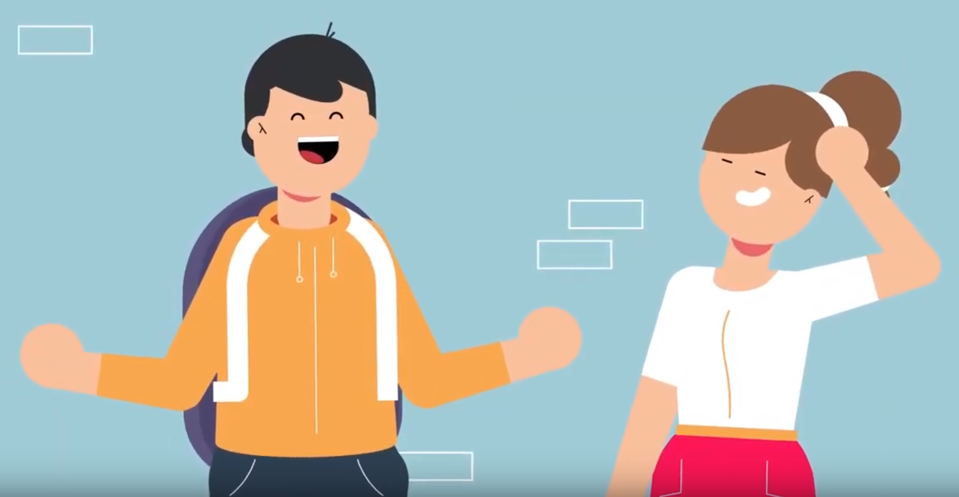
Working out relationships – video
What are the key strengths of a healthy relationship? How do you keep your relationship ‘fit’? As you watch this video make a note of the four things that it suggests are needed to keep a relationship strong.
Working Out Relationships?
Notes:
Lesson 1 introduces this video on the key components of healthy, lasting relationships drawn from the Shackleton Relationships project findings. Show the class the ‘Working Out Relationships?’ video asking pupils, as they watch, to make a note of and then feedback the four things that it suggests are needed to keep a relationship strong: Building friendship and a strong team; having realistic expectations; communicating constructively and having a good support network. Deal with possible misconceptions around the fact that if relationships require work they are not the ‘right‘ relationship.
Press control, click on the ‘Working Out Relationships?’ link to play video.
Support activity: Consider suggesting that pupils pull out 1-2 points from the video only.
Extension activity: Consider asking students to rank the 4 features in order of priority.

Slide 6
Working out relationships
Researchers at the University of Exeter have come up with ten questions it is important for partners to ask themselves and then their partner before committing to a serious relationship. The ‘Working Out Relationships?’ video brings some of these key questions together.
Task
Read the 10 questions on the next slide.
On your table, discuss what would Sarah say if she asked herself these questions about her and Paul’s relationship?
Notes:
Give pupils 5 minutes on their tables to consider the ten critical questions, applying them to the Sarah and Paul relationship, asking them to nominate one pupil to feed back. Allow 10 minutes for feedback from all tables. (Questions on slide 7 below).

Slide 7
HOW DOES Sarah and Paul’s relationship MEASURE UP?
Are they a ‘good fit’? (Can they work well as a team? Do they have similar values and outlook on life?)
Do they have a strong basis of friendship? (Do they have fun together? Share interests and humour? Appreciate each other?)
Do they want the same things in their relationship and out of life? (Do they each feel that they can jointly agree a plan for their lives together? Can they negotiate?)
Are their expectations realistic? (Do they accept there will be ups and downs? Understand the need to make an effort?)
Do they generally see the best in each other? (Can they accept each other’s flaws? Respect their differences?)
Do they both work at keeping their relationship vibrant? (Do they make time to spend together and time apart? Each show the other that they care?)
Do they both feel they can discuss things freely and raise issues with each other? (Do they deal with issues promptly and constructively? Enjoy talking and listening to each other?)
Are they both committed to working through hard times? (Do they both ‘give and take’? Work on themselves? Look to a positive future together?)
When they face stressful circumstances would they pull together to get through it? (Can they each adapt well to change? Would they seek professional help if needed?)
Do they each have supportive others around us? (Do they each have a good support network they can turn to or call on for help if needed?)
Notes:
See notes on slide above for how to run this exercise.

Slide 8
Working out relationships
You are a member of a group chat for young people aged 14-18. You notice the following posts.
On your tables suggest how you might respond to each post.
  Sarah: I am 16 and have been with my 16 year-old boyfriend for 6 months. He’s my first proper boyfriend and I really like him except for one thing. He can be very caring one minute then gets moody the next if I talk to any friends who are boys or wear a short skirt. He says its because he loves me and can’t bear to think of me with anyone else which I think is really cute but my friends say is not right. Are they just jealous?
  Paul: I am 16 and have been with my girlfriend for 6 months. She’s the same age. I really like her but I get jealous when she hangs out with her friend Greg or if she’s wearing a short skirt. I hate feeling like this but I can’t help it and I don’t want to lose her. What should I do?
Notes:
Give pupils 5 minutes on their tables to come up with advice to the two group chat posts – one from Sarah and one from Paul (Slide 8). Nominate half the tables to respond to Sarah’s post and half to respond to Paul’s post. There are suggested answers on slides 9 and 10.

Slide 9
Working out relationships
You are a member of a group chat for young people aged 14-18. You notice the following posts.
On your tables suggest how you might respond to each post.
  Sarah: I am 16 and have been with my 16 year-old boyfriend for 6 months. He’s my first proper boyfriend and I really like him except for one thing. He can be very caring one minute then gets moody the next if I talk to any friends who are boys or wear a short skirt. He says it’s because he loves me and can’t bear to think of me with anyone else which I think is really cute but my friends say is not right. Are they just jealous?
  Reply: No they’re not jealous! Your boyfriend is too possessive. It’s up to you who you see and what you wear. He’s trying to control you and it’s not right. Tell him that if he doesn’t stop then you can’t go out with him. If he doesn’t change then dump him, you are worth more than that! Speak to someone from pastoral support at your school if you need help.
Notes:
A suggested answer to Sarah’s post will appear on a click. The key thing for pupils to get across is that the behaviour is controlling and unacceptable.

Slide 10
Working out relationships
You are a member of a group chat for young people aged 14-18. You notice the following posts.
On your tables suggest how you might respond to each post.
  Paul: I am 16 and have been with my girlfriend for 6 months. She’s the same age. I really like her but I get jealous when she hangs out with her friend Greg or if she’s wearing a short skirt. I hate feeling like this but I can’t help it and I don’t want to lose her. What should I do?
  Reply: Just because you feel jealous doesn’t give you the right to try to control who your girlfriend sees or what she wears. If you carry on like this you are going to lose her. Have you been cheated on before? Why do you think that you are feeling jealous? When you feel jealous try to think through why you are feeling like that and talk to your girlfriend honestly about your feelings. It might help to speak to a member of pastoral support at your school.
Notes:
A suggested answer to Paul’s post will appear on a click. Again, the emphasis is on confirming that the behaviour is controlling and unacceptable and on getting Paul to consider his responses.
If there is time you may wish to take the pupils through the stop acronym in response to jealousy: S (slow down ); T (think things through); O (open up ); P (personal responsibility).

Slide 11
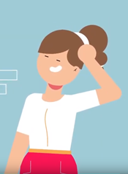
Working out relationships: leaving safely
You are Sarah’s best friend. She tells you she has spoken to Paul about his jealousy but he doesn’t think there is a problem. Sarah has decided to break off her relationship with Paul but is concerned how he might respond as he has told her that ‘he can’t live without her’. What should you do?
ADVICE:
  Be supportive: Let Sarah know that you are there for her. Don’t criticise her or Paul.
  Tell Sarah that it’s her decision: She should try to let Paul down gently but it is up to her whether she continues in the relationship and her decision should not be swayed by how Paul responds.
  Get help if needed: If you are worried about how Paul will react or if he reacts negatively advise Sarah to tell a trusted adult – a parent, teacher or professional e.g. call Childline. If she’s not prepared to do so you may need to tell her that you will.
Notes:
Give pupils 5 minutes to consider what, as Sarah’s friend, they would do to support her if she decides to break off the relationship: (offer non-judgemental support; impress upon her that it is her decision and advise he to tell a trusted adult if she is concerned about how he might react ( and say that you might have to if she won’t)).

Slide 12
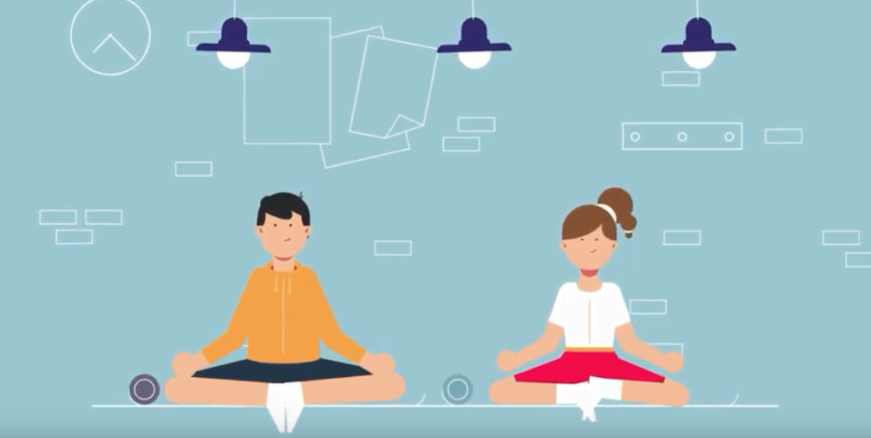
Working out relationships
Task
Write down 3 things that would have to change about Sarah and Paul’s relationship for it to be healthy.
Notes:
Give pupils 5 minutes on their tables to suggest 3 things that would need to change about Sarah and Paul’s relationships for it to be healthy (not trying to distance her from her friends; not getting jealous over having platonic friendships with other boys and not dictating what she wears).
Finish by asking the pupils to refer back to the post-its on the whiteboard from the baseline task and identify which three facets of a healthy relationship are most lacking in Paul and Sarah’s relationship/which 3 things from the post-its they most need to work on.

Slide 13
Working out relationships: HOMEWORK TASK
Before your next PSHE lesson:
Create an information leaflet aimed at your year group to highlight the ‘warning signs’ that indicate that a relationship is unhealthy.
Notes:
HOMEWORK TASK: To finish, ask the pupils to create an information leaflet aimed at their year group to highlight the ‘warning signs’ that indicate that a relationship is unhealthy. They should bring this to their next PSHE lesson.

