Slide 1






The Rights Idea? Lesson 1:
Young people’s rights under the United Nations Convention on the Rights of the Child
Notes:
This is the first of two lessons, ‘The Rights Idea?’ Lesson 1 introduces young people's rights under the UNCRC generally, including their right to have their voices heard under Article 12. In lesson 2 young people’s Article 12 rights are considered In the context of parental separation.

Slide 2




TEACHER SLIDE – PREPARING TO TEACH
Preparing to teach and using these slides:
The slides headed ‘teacher slides’ assist the teacher in setting up and running the lesson
Slide 9 onwards are for the pupil facing lesson
Please read the Lesson Plan 1 Teacher Guidance for ‘The Rights Idea?’ before teaching
Have slides in presenter mode – notes are available under each slide to aid teaching
Support:
and extension:
activities are suggested where appropriate (icons on bottom right corner of slides)
Resources:
Post-it notes
An ‘ask-it-basket’/ question box for pupils to ask questions confidentially and anonymously, if they wish
Save for the above, no additional teaching resources are needed to teach this lesson
Timing:
The lesson is designed to be taught
over 55 minutes
Notes:
This two-part lesson plan has been devised for Upper Key Stage 3 and Key Stage 4 pupils. This teaching is aimed at both PSHE and Citizenship teaching.
This slide gives an overview of the lesson. It should be read in conjunction with the Teacher Guidance for ‘The Rights Idea?’ lesson 1. Teachers are reminded to review and address any questions submitted in the anonymous ask-it-basket’/ question box, to ensure they are answering all pupils’ questions.
This is lesson one of two. In lesson 1, pupils will learn about the key rights that children and young people have under the United Nations Convention on the Rights of the Child (‘The UNCRC’). This includes the right to express their opinion and for adults to take that opinion seriously (Article 12). In lesson 2, Article 12 will be considered further with respect to young people's rights to information, consultation and (when needed) representation when their parents separate.

Slide 3
TEACHER SLIDE – PREPARING TO TEACH: PSHE
This 2-part lesson plan for upper Key Stage 3 and Key Stage 4 PSHE aims:
in lesson 1, to outline key rights under the United Nations Convention on the Rights of the Child (UNCRC) to equip pupils to be clear on their rights (KS4, R5)
in lesson 2, to discuss children’s Article 12 right to express their views on arrangements to be made if their parents separate to help pupils learn about ‘the effects of change, including loss, separation, divorce and bereavement; strategies for managing these and accessing support.’ (Programme of Study 2020 KS3, R22/ KS4, R13)
DfE Guidance on RSE states that RSE teaching should:
equip pupils to be clear on their rights and responsibilities as citizens (para 76)
be based on knowledge of pupils and their circumstances… [with] no stigmatisation of children based on their home circumstances (para 59)
and that
Teachers should be aware of common ‘adverse childhood experiences’ (such as family breakdown…) and when and how these may be affecting any of their pupils and so may be influencing how they experience these subjects (para 102)
Notes:
For PSHE, this teaching is aimed to meet the requirements of The Programme of Study for PSHE Education 2020-2021 for upper Key Stage 3 and Key Stage 4 which states that pupils should learn:
the effects of change, including loss, separation, divorce and bereavement; strategies for managing these and accessing support (KS3, R22/KS4, R13).
In discussing young people’s Article 2 right not to be discriminated against, lesson 1 touches on the legal rights, responsibilities and protections provided by the Equality Act 2010 (Programme of Study for PSHE Education 2020-2021, KS4, R5).
This table refers to the DfE statutory guidance for RSE which was first published in 2019. These lessons also meet the following aspects of the new, revised guidance, published in 2025 for introduction by 1 September 2026:
Schools should cover the following content by the end of secondary:
Families
How families and relationships change over time, including through birth, death, separation and new relationships.
Respectful relationships
The characteristics of positive relationships of all kinds, online and offline, including romantic relationships. For example, pupils should understand the role of consent, trust, mutual respect, honesty, kindness, loyalty, shared interests and outlooks, generosity, boundaries, tolerance, privacy, and the management of conflict, reconciliation and ending relationships.

Slide 4
TEACHER SLIDE – PREP. TO TEACH: CITIZENSHIP
This 2-part plan for upper KS3 and KS4 Citizenship meets the overarching aims of the Citizenship Programme of Study:
… to ‘develop’ (KS3) and ‘deepen’ (KS4) ‘pupils’ understanding of… the rights and responsibilities of citizens’ (page 2)
In lesson 1, by considering how some young activists are ‘getting their voices heard’ pupils will learn how to:
‘evaluate different ways that citizens can act together to solve problems and contribute to society.’ (KS4)
In lessons 1 and 2, by outlining some of key rights under the UNCRC it covers:
  local, regional and international governance and the UK’s relations with… the United Nations and wider world
  human rights and international law (KS4)
  In lesson 2, by outlining the law relating to relationships and relationship breakdown it covers:
  rules, laws and the justice system… courts and tribunals (KS3)
  the legal system in the UK, (and) different sources of law (KS4)
Notes:
This slide relates to Citizenship and how the teaching meets the Citizenship Programme of Study 2013.
The lessons meet the overarching requirement of the Citizenship Programme of Study to ‘develop’ [KS3] and ‘deepen’ [KS4] ‘pupils’ understanding of… the rights and responsibilities of citizens’ (page 2).

Slide 5
TEACHER SLIDE – PREP. TO TEACH: CITIZENSHIP
The GCSE Citizenship curriculum 2015 is met as follows:
In lessons 1 and 2, by outlining some of key rights under the UNCRC it covers:
Right and responsibilities
the role of the … UNCRC
The UK and its relations with the wider world
the UK’s role and relations with the rest of… the wider world, including the UN
In lesson 2, by outlining the law on relationship breakdown it covers:
The legal system (England and Wales)
The operation of the justice system… and… civil dispute resolution
Citizenship skills – By considering the UNCRC in both lessons and young activists in lesson 1, pupils demonstrate an ability to:
understand the range of methods and approaches that can be used by governments, organisations, groups and individuals to address citizenship issues in society, including practical citizenship actions
critically evaluate the effectiveness of citizenship actions to assess progress towards the intended aims and impact for the individuals, groups and communities affected
Notes:
This slide relates to Citizenship and how the teaching meets the GCSE Citizenship curriculum 2015

Slide 6
TEACHER SLIDE – ABOUT the uncrc
The United Nations Convention on the Rights of the Child 1989 (UNCRC) is the global “gold standard” for children’s rights and sets out the fundamental rights of all children. It is the most widely and rapidly ratified human rights treaty in history. It sets out the civil, political, economic and cultural rights of every child. Governments agree to safeguard the rights and ensure that adults and children know about them.
It has been signed by 196 countries of which all but the USA have ratified it. (It was ratified in the UK in 1991.)
It has 4 guiding principles (non-discrimination; the best interests of the child; the right to life, survival and development; and the right of children to express their views freely and to be heard) which apply to all under 18s.
It consists of 54 Articles which include protecting children’s rights to life; healthcare; education; protection from discrimination, harm or exploitation (including violence, abuse, neglect, kidnapping, child labour and child soldiers) and to live with their family (where possible).
Article 12 gives children the right to have their voices heard and their opinions listened to and taken seriously by adults. This includes the right to information, consultation and representation (if needed) when their parents separate. However, despite research that indicates that children cope better when they are consulted about arrangements for them when their parents separate, they are seldom consulted.
Notes:
This slide gives some details about UNCRC, some of which are reproduced in a more simplified version on the pupil facing slide, slide 15.
Slides 17 to 22 outline some of the key articles of the UNCRC and highlight the extent to which these commitments have been met. For further details see:
https://www.unicef.org/media/62371/file/Convention-rights-child-at-crossroads-2019.pdf

Slide 7
TEACHER SLIDE – ABOUT the young activists
Greta Thunberg: Born 03.01.03 in Stockholm, Sweden. She is a climate change activist. She spoke at the UN Climate Action Summit while still staying carbon neutral by traveling in a solar-powered yacht. She has also been very vocal about her Asperger’s syndrome and OCD helping to normalise neurodiversity and mental health conditions. Thunberg was the youngest ‘Time Person of The Year’ and was nominated for the Nobel peace prize in 2019.
Malala Yousafzai: Born 12.07.97. She is an activist for female education. Growing up in Pakistan, she campaigned for education for girls. On 9 October 2012, Malala and two other girls were shot on a bus by a Taliban gunman as retaliation for her activism. She was treated in Birmingham and fully recovered. She lives in England, founded the Malala Fund and wrote, “I am Malala”, which became an international best-seller. In 2014, she became the youngest person ever to win a Nobel Peace Prize (aged 17).
Marcus Rashford: Born 31.10.97. He is a prominent, male British activist and England Football player. Campaigned successfully for the extension of free school meals over the summer holidays and has set up the Child Food Poverty Task Force. On 8 November 2020, it was announced that, because of Rashford's campaign, the government would be providing funding of almost £400m over the next 12 months to support the cost of food and household bills to poor families. He was awarded an MBE in 2020.
Eltayeb Bashar: A racial justice campaigner. At just 19, alongside his sister Khadija, Eltayeb co-led one of the city’s largest campaigns for racial justice leading to initiatives like Worcester’s first Black History Month and Windrush Day. He won the Young Activist of the Year award 2025, and is also a member of the European Youth Parliament. He founded a charity that helps empower young human rights leaders across 18 countries.
Notes:
This slide gives some details about 4 young activists, some of which are reproduced in a more simplified version on the pupil facing slide, slide 23.

Slide 8
TEACHER SLIDE – LESSON OUTLINE AND TIMINGS
Activity | Description | Timing
Baseline activity | Learning objectives and outcomes; then pupils will suggest key words associated with ‘rights’ | 5 minutes
Introduction | Introduction to the United Nations and the UNCRC | 5 minutes
Pictionary game | Pupils will play a drawing game to guess rights | 5 minutes
Ranking rights | Pupils will then be shown 6 rights and, on their tables, will rank them | 10 minutes
Key rights | Pupils will learn about some of the key rights under the UNCRC and the extent to which these rights are being upheld globally | 10 minutes
Getting your voice heard | Pupils will consider Article 12 and three young people who are making their voices heard | 10 minutes
Endpoint assessment | Pupils will revisit and revise the baseline answers as appropriate | 5 minutes
Homework/extension | Pupils will be reminded about sources of support before the lesson is wrapped up and homework (or extension) task set | 5 minutes

Slide 9
GROUND RULES
We will:
not disclose personal information about ourselves or others
keep anything that others say confidential
not judge others
not put anyone on the spot and we have the right to pass
comment on what is said, not who has said it
not ask personal questions or try to embarrass someone
speak to a trusted adult in school/encourage friends to speak to a trusted adult in school if additional support is needed
Notes:
Pupils will be discussing young people’s rights under the UNCRC. The subjects raised have the potential to be distressing for some e.g. Article 2, protection form discrimination. Teachers should refer to the Handling complex issues safely in the PSHE Classroom guide (https://20248256.fs1.hubspotusercontent-na1.net/hubfs/20248256/Guidance/Documents/Handling%20complex%20issues%20safely%20in%20the%20PSHE%20classroom.pdf?hsCtaTracking=c2552fae-621f-4b9e-bb0e-3f8d0a57a351%7C3661ba81-9241-436d-8299-e2c468e27f75) before teaching. It is important that ground rules are established to minimise the potential for distress to any pupil. If a teacher already has established ‘class ground rules’ then these can be substituted. Pupils can also be asked to add to the ground rules as appropriate.
Teachers should also:
have an ‘ask-it-basket’/ question box for pupils to ask questions confidentially and anonymously, if they wish
review and address any questions submitted in the anonymous ‘ask-it-basket’/ question box
work within the school’s policies on safeguarding and confidentiality
link PSHE and Citizenship education into the whole school approach to support pupil wellbeing
make pupils aware of sources of support, both inside and outside the school
explain to pupils that while confidentiality is important, if something is said or a behaviour causes concern, teachers may speak to another member of staff.

Slide 10
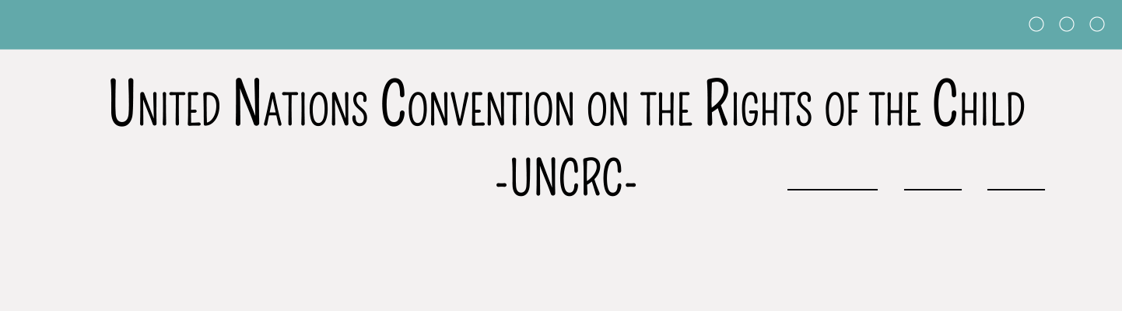

The Rights Idea – LESSON 1
Learning Objectives:
To learn about the key rights that children and young people have under the United Nations Convention on the Rights of the Child (‘The UNCRC’) and how some of these rights are protected in the UK e.g. under the Equalities Act 2010
To learn about different ways that young people are acting to solve problems and contribute to society
Notes:
Learning Objectives:
To learn about the rights that children and young people have under the United Nations Convention on the Rights of the Child (‘The UNCRC’).
To learn about different ways that young people are acting to solve problems and contribute to society

Slide 11
The Rights Idea – LESSON 1
Learning Outcomes
Pupils will be able to:
Explain the 4 guiding principles of the UNCRC
Explain some of the key Articles of the UNCRC and the UK legislation protecting some of these rights
Analyse how young activists are able to ‘get their voices heard’
Notes:
Introduce the topic and run through the learning outcomes:
After the lesson pupils will be able to:
Explain the 4 guiding principles of the UNCRC
Explain some of the key Articles of the UNCRC and the UK legislation protecting some of these rights
Analyse how young activists are able to ‘get their voices heard’

Slide 12

BASELINE ACTIVITY –WHAT ARE RIGHTS?
What are rights?
What key words might be associated with ‘rights’?
Why do rights need to be protected?
Notes:
As a baseline exercise, ask the whole class to think about:
What are rights? (Rights are standards that recognise and protect the dignity of all human beings.)
What key words might be associated with ‘rights’? (Fairness, equality, respect, benefits, support, entitlements).
Why do rights need to be protected? (To ensure that human dignity and equality is given to all.)
Either ask pupils to get up and move around the room, adding to graffiti walls which have these questions as headings. Or, if you would prefer, you could hand out post it notes for pupils to complete in response to these questions, that they then stick on each ‘wall’.
Here the emphasis is on ensuring that the pupils understand what is meant by rights rather than discussing specific rights. Alternatively, hand out post-it notes and ask the pupils to write down a word they would associate with rights then stick them on the whiteboard grouping them around words that emphasise ‘fairness’ and words that emphasise ‘entitlement’.
Do not give any further hints or tips, even if pupils ask questions. They should not share their ideas with classmates during the activity. This will give you the opportunity to see what pupils’ own beliefs and ideas are on ‘rights’ before the lesson begins.

Slide 13

INTRODUCTION - The UNITED NATIONS
What is the United Nations?
What is a Convention?
Notes:
Ask pupils: Has anyone heard of the United Nations? What do you think it might do? Is it an organisation relevant for children to know about? If so, why?
The UN was formed in 1945, after World War 2 to try to prevent further wars. It has 193 member states and the UK Is one of the five permanent members of the UN Security Council (as well as the USA, France, China, and Russia).
The UN’s aims are:
To keep peace throughout the world
To develop friendly relations between countries
To work together to help improve the lives of the poor
To remove poverty, disease and illiteracy in the world
To stop environmental destruction
To encourage respect for each other’s rights and freedoms
[These goals apply equally to young people as adults and arguably issues such as environmental destruction will have more of an impact on young people’s futures.]
Also ask pupils, what is a convention? What does it do? Do you think a convention might be helpful to children?
A convention is a formal agreement between countries on matters that concern them all.
The UN established a series of conventions to promote human rights internationally and to enable it to perform its functions. [Note to teacher: Article 68 of the United Nations Charter enabled it to set up various commissions which then led to the drafting and ratification of various conventions].
There are UN human rights conventions on protection against discrimination for women, the disabled and children; and to protect against racism or forced labour [and as we will see some of these aspects of protection specifically for children are included in the UNCRC]. Explain that in this lesson pupils will be looking at one particular Convention, the United Nations Convention on the Rights of the Child 1989.

Slide 14
INTRODUCTION TO THE UNCRC
The Convention:
Is the global “gold standard” for children’s rights and sets out the fundamental rights of all children
Was signed in 1989 and officially accepted (‘ratified’) by the UK in 1991
Is the most widely and rapidly ratified human rights treaty ever. Ratified by 196 countries- USA has signed but not ratified
Has 54 Articles covering protection of rights with 4 guiding principles:
  non-discrimination
  the best interests of the child
  the right to life, survival and development; and
  the right of children to express their views freely and to be heard
Notes:
Use this slide to spend 5 minutes outlining to pupils the key dates for the UNCRC and the four guiding principles:
non-discrimination;
the best interests of the child;
the right to life, survival and development; and
the right of children to express their views freely and to be heard
Further subject knowledge is outlined on slide 6 above. Slides 17-22 consider these four guiding principles in further detail.

Slide 15

Guess the rights under the uncrc
Article 24
Article 31
Article 16
Article 28
Article 2
Article 12
Article 24: The right to good healthcare
Article 31: The right to relax and play
Article 16: The right to privacy
Article 28: The right to an education
Article 2: The right not to be discriminated against
Article12: The right to give your opinion, and for adults to listen and take it seriously
1. Relationship built mostly on FRIENDSHIP
2. BOTH PARTNERS SHOULD EXPECT IT TO BE PERFECT – IF IT’S NOT MOVE ON
3. CONFLICT DEALT WITH AT AN EARLY STAGE
4.
Notes:
Print out (double-sided) then cut out the ‘Pictionary’ cards found at the end of the Teacher Guidance. Give pupils 5 minutes working in small groups to try to draw a picture that represents Articles 24, 31, 16, 28, 2 and 12, taking it in turns to draw each article while their group guesses the correct answer. In slideshow mode, each statement in the left-hand box is followed by a statement in the right-hand box indicating the relevant right under the UNCRC. Once pupils have finished guessing, they should be asked to decide what the right is, and the answer given, before moving on to the next right.

Slide 16

Task
Read the selection of rights under the UNCRC below
On your tables, rank the rights in what you think are the order of importance
Feedback why you chose the rights that you listed as ‘the top three’
Right | Right
1. Right to good healthcare and a clean and safe environment (Article 24) | 11. Right to give your opinion, and for adults to listen and take it seriously (Article 12)
3. Right not to be discriminated against (Article 2) | 6. The child’s best interests shall be a primary consideration in all decision-making (Article 3)
7. Right to life (Article 6) | 12. Right to an education (Article 28)
Notes:
Give pupils 10 minutes on their tables to read the selection of rights under the UNCRC, rank the rights in what they think are the order of importance and to feedback their top (and, if time) bottom 3.
As a support activity, consider asking pupils to select what they think is the ‘top’ right or ‘top 3’ rights only.
As an extension activity, consider asking the pupils to consider what some of the challenges might be in ensuring that every child has these rights (e.g. not all children in the world live in areas that are free of conflict).

Slide 17

PROTECTION AGAINST DISCRIMINATION
ARTICLE 2
All children have the right to protection against discrimination. This means that nobody can treat others badly because of their colour, gender or religion, if they speak another language, have a disability, or are rich or poor.
Notes:
Take 10 minutes to run through slides 17 to 21 (which give the pupils an overview of some of the key articles of the UNCRC and the extent to which these have been upheld, in the UK and globally) then slide 22 which is about getting your voice heard. This final right, contained in Article 12, will then be the focus of Lesson 2. Depending on time available and the level of pupil engagement, there is some key information in the notes section on each slide, with the most important parts highlighted for ease of teaching.
The notes for the next 5 slides outline some key statistics on the key rights discussed.
Protection against discrimination: Despite this, globally girls are far more likely to marry early, miss out on education and do unpaid work than boys. For example, girls are six times more likely to be married before age 18 than boys.
Explain to pupils that In the UK, the Equality Act 2010 also provides protection against discrimination for children and young people on a number of grounds. Ask pupils what rights of young people they think are protected under the Equality Act 2010. Answer: race, gender reassignment, disability, sexual orientation and religion or belief. Point out that ‘religion or belief’ is also protected by the ‘British Values’ of mutual respect and tolerance of those with different faiths and beliefs.
The following are equality issues into adulthood so only cover if time and the pupils are particularly engaged.
Colour: Parliament is becoming more representative : in 1987 there were four non-white MPs. In the 2024 election there were 90 ethnic minority MPs, which is more or less reflective of the UK population.
Despite the prominence of the ‘Black Lives Matter’ campaign, someone who is black is still over 4 times more likely to be stopped and searched by the police than someone who is white. In the year ended March 2023, there were 6 stop and searches for every 1,000 white people, compared with 25 for every 1,000 black people https://www.ethnicity-facts-figures.service.gov.uk/crime-justice-and-the-law/policing/stop-and-search/latest/
Gender pay gap (UK): When young women reach the workforce, they then need to contend with the gender pay gap. The good news is that the gender pay gap has dropped over time. In the UK in 1997, men’s gross hourly earnings were 27.5% higher than women’s (see: https://www.ons.gov.uk/employmentandlabourmarket/peopleinwork/earningsandworkinghours/bulletins/genderpaygapintheuk/2020). In April 2024, the gender pay gap stood at 7.0% (see https://www.ons.gov.uk/employmentandlabourmarket/peopleinwork/earningsandworkinghours/bulletins/genderpaygapintheuk/2024).

Slide 18

The Child’s best interests
ARTICLE 3
When adults make decisions, they should think about how their decisions will affect children. All adults should do what is best for children.
Notes:
The child’s best interest is an overarching principle of the UNCRC – whenever adults, be that parents, teachers or the government make decisions, then those decisions must be guided by what is in the best interests of the child.
[Pupils will consider this in further detail in lesson 2.]

Slide 19

The Right TO LIFE, SURVIVAL AND DEVELOPMENT
ARTICLE 6
All children have the right to life, survival and development.
Notes:
THE GOOD NEWS: Global child deaths have more than halved since the Convention was signed: In 1990 1 in 11 children did not reach age 5; by 2022 the ratio was 1 in 27 (UNICEF, 2024).
HOWEVER, in 2022, an average of 13,400 children under 5 died every day with children born in the poorest households twice as likely to die, on average, as those in the richest.

Slide 20

The Right TO HEALTHCARE
ARTICLE 24
All children have the right to the best health care possible, safe water to drink, nutritious food, a clean and safe environment, and information to help them stay well.
Notes:
The next two slides relate to two critical rights linked to life, survival and development: the right to healthcare and education
Advances in access to safe water, sanitation and hygiene have been a major reason for historical progress on preventing child deaths. Despite these gains, though, more than 1000 children still die every day from diseases linked to inadequate water supply and poor sanitation and hygiene (UNICEF, 2023).

Slide 21

The Right TO EDUCATION
ARTICLE 28
All children have the right to a good quality education. They should be encouraged to go to school to the highest level they can.
Notes:
THE GOOD NEWS: The number of out-of-school children of primary education age fell by 35 per cent between 2000 and 2020, with 53 per cent of these out-of-school children being girls (UNICEF, 2022).
HOWEVER, in 2020, 60 million primary school-age children were not in school (UNICEF, 2022), and the reductions in numbers not in school have stalled in the last decade.
To end this section and to check pupils’ understanding, ask pupils if the information they have just heard about different rights has changed their minds about their original rankings, and ask pupils, based on what they have just heard, what they think the most important right is today that needs addressing globally.

Slide 22

The right for your views to be respected
ARTICLE 12
All children have the right to give your opinion and for adults to listen, and take it seriously.
Look back at the original rankings which you gave to the different rights. ‘Would you change the order of these now? Why, or why not?’
Notes:
The right of children to express their views freely and to be heard is the fourth guiding principle of the UNCRC and is contained in Article 12.
The Programme of Study for PSHE Education 2020-2021 for Key Stages 3 and 4 states that pupils should learn:
Ways to manage grief about changing relationships including the impact of separation, divorce and bereavement; sources of support and how to access them (KS4, R13 see also KS3, R22).
To end this section and to check pupils’ understanding, ask pupils if the information they have just heard about different rights has changed their minds about their original rankings, and ask pupils, based on what they have just heard, what they think the most important right is today that needs addressing globally.
In lesson two of The Rights Idea? pupils will explore the sources of support available to them when their parents separate and how to access this support. This will be discussed as part of young people’s Article 12 right to give their opinion and for adults to listen and take it seriously. To set this up, pupils will therefore be considering different young activists who have been making their voices heard on the world stage.

Slide 23
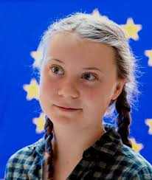
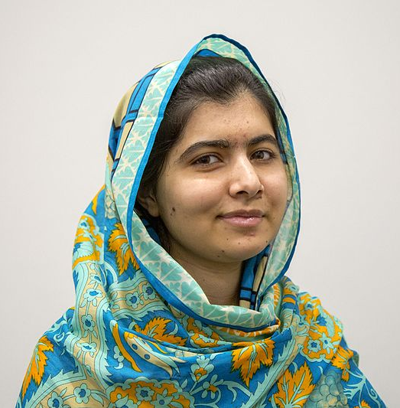
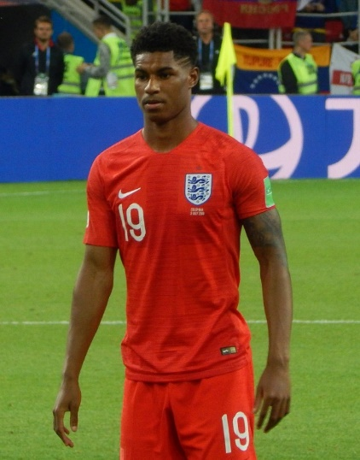
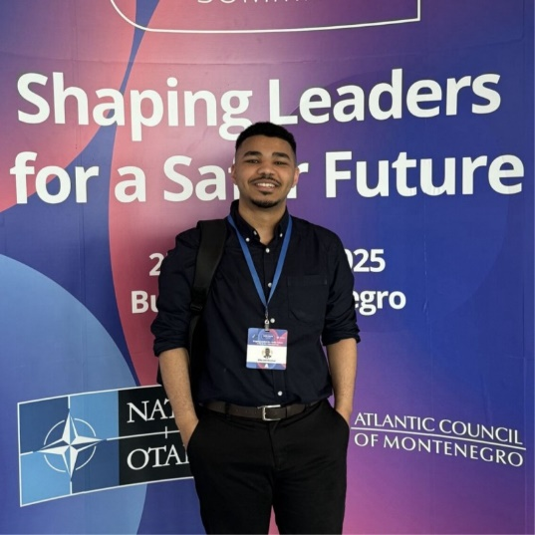
Getting your voice heard
Greta Thunberg - a climate change activist. She spoke at the UN Climate Action Summit and was nominated for the Nobel peace prize in 2019.
Malala Yousafzai - an activist for female education. In 2012 she survived an assassination attempt. In 2014, she became the youngest person ever to win a Nobel Peace Prize (aged 17).
Marcus Rashford – plays football for England and anti-poverty campaigner. He set up the Child Food Poverty Task Force. He was awarded an MBE in 2020.
Eltayeb Bashar a racial justice campaigner. He won the Young Activist of the Year award 2025. He founded a charity that helps empower young human rights leaders across 18 countries.
Notes:
[Image of Greta Thunberg: Source – European Parliament (free to use under the Creative Commons Attribution 2.0 Generic license.
Image of Malala Yousafzai: Source – Simon Davis/Department for International Development (free to use under the Creative Commons - Attribution Licence,]
Image of Marcus Rahford: Source - Oleg Bkhambri (Voltmetro) - Own work, CC BY-SA 4.0, https://commons.wikimedia.org/w/index.php?curid=71213067
Image of Eltayeb Bashar: Personal photograph, used with the permission of Eltayeb Bashar.
On slideshow mode show the class each of the 4 activists and the short bios for each. Acknowledge that pupils may not recognise Eltayeb Bashar as he is not a household name but at the age of 19, he won the Young Activist of the Year award 2025 for his work on racial justice.
Greta Thunberg (born 03.01.03) in Sweden. She is a climate change activist. She spoke at the UN Climate Action Summit and was nominated for the Nobel peace prize in 2019. You could also mention that she has also been vocal about her Asperger’s syndrome and OCD helping to normalise neurodiversity and mental health conditions.
Malala Yousafzai (born 12.07.97) She is an activist for female education. She survived an assassination attempt in 2012. In 2014, she became the youngest person ever to win a Nobel Peace Prize (aged 17).
Marcus Rashford (born 31.10.97) England Football player and anti-poverty campaigner. He set up the Child Food Poverty Task Force. He was awarded an MBE in 2020.
Eltayeb Bashar a racial justice campaigner. At just 19, alongside his sister Khadija, Eltayeb co-led one of the city’s largest campaigns for racial justice leading to initiatives like Worcester’s first Black History Month and Windrush Day. He won the Young Activist of the Year award 2025. He founded a charity that helps empower young human rights leaders across 18 countries.
[For fuller details see teacher slide 7].
Next, ask pupils to think-pair-share:
What rights have they campaigned for and how have they effectively campaigned for these rights? [It may help to show the class Slide 16 (the ranking exercise) here to remind them of the various rights to help them answer this question and to reinforce learning].
Greta Thunberg – Article 6 (Right to life) and Article 24 (right to a clean and safe environment). She has campaigned effectively through school strikes, social media, and speaking at the UN.
Malala Yousafzai – Article 28 (right to education) and Article 2 (right not to be discriminated against, including on the grounds of gender). She has campaigned effectively through writing a blog and featuring in a documentary prior to the attempt on her life and by setting up the Malala Fund, co-authoring a best-seller. ‘I am Malala’ and addressing parliaments since.
Marcus Rashford – Article 26 (the right to help from the government if you are poor or in need) and Article 3 (the best interests of the child shall be a primary consideration in all decision-making). He has campaigned effectively by lobbying the government for change.
Eltayeb Bashar – Article 2 (the right not to be discriminated against) and Article 12 (the right to give your opinion, and for adults to listen and take it seriously). He has influenced his community to acknowledge the importance of racial justice and inspired young activists across the world.
What skills and attributes might these, and other, young activists have in common?’
(knowledge and understanding of their rights and the rights of others, persistence, resilience, self-belief, determination, confidence.)
As a support activity, consider asking ask the pupils who these individuals are, if they know of any other young activists, or whether they can identify any issues young people have recently campaigned about.
As an extension activity, consider asking the pupils to consider how these activists might continue ‘getting their voices heard’ for years to come. How could they ensure that they have a lasting impact on protecting these rights?

Slide 24
END POINT ASSESSMENT ACTIVITY
Do you want to change or add anything to the ideas on the graffiti wall? Write your own definition of what rights are and why they are important, based on your learning this lesson.
Notes:
Endpoint assessment - summarise the ideas written on the original graffiti walls/on post-it notes on the graffiti walls and ask the class if they now have anything to add. Independently, ask pupils to write their own definition of what rights are and why they are important, based on their learning from this lesson.

Slide 25
Further help and support
For further help and support in school contact:
Your form teacher/ PSHE teacher
Your Head of Year
The pastoral support team
For further help and support outside of school:
ChildLine: https://www.childline.org.uk
Relate: https://www.relate.org.uk
Notes:
Remind pupils who they can talk to in school, e.g. teacher or head of year, or the pastoral support team (you may wish to personalise this slide with names of contact staff) or outside of school, e.g. Childline and Relate. Some pupils may have heard of Relate as a relationship counselling service but point out to them that Relate also offer counselling for young people.

Slide 26

HOMEWORK or extension TASK
Before your next PSHE lesson:
Write about an issue that you would like to campaign about and why you think it is important.
What ‘right’ under the UNCRC does your chosen issue address?
As part of this task, research prominent activists who campaign for your chosen issue and consider what actions you could take yourself to campaign on this issue in the future.
Notes:
HOMEWORK OR EXTENSION TASK: For homework or as an extension task, ask pupils to write about an issue that they would like to campaign about and why. Ask them to note down what ‘right’ under the UNCRC their chosen issue addresses. As part of this task, ask them to research prominent activists who campaign for their chosen issue and consider what actions they could take themselves to campaign on this issue in the future.
Extension task: Ask pupils to consider how they might campaign for their chosen issue within their school community.
Support task: Consider giving the pupils the name of a young person who is ‘getting their voice heard’. Examples might include:
Amy and Ella Meek - Set up Kids Against Plastic in 2016 when aged just 11 and 13 to campaign against the use of single use plastics (Article 6: The right to life, survival and development and Article 24: The right to healthcare as this includes the right to ‘a safe environment’).
Amika George - successfully campaigned for free sanitary products in secondary schools to end period poverty in 2017 when aged 17. She been honoured on the Time Magazine’s ‘Most Influential Teens of 2018’ list. (Article 24: The right to healthcare)
Heba Ahmed a human rights and anti-racist activist who was responsible for 15,000 people attending the Black Lives Matter protest in Manchester in June 2020 when aged 16. (Article 2: Protection from discrimination)
Jamie Windust a non-binary writer, editor, model, and public speaker. They made headlines in 2018 (when aged 21) for calling out the staff of Fantastic Beasts: The Crimes of Grindelwald for alleged misogyny, homophobia and transphobia, and in 2019 for petitioning the UK Parliament for gender-neutral passport options. (Article 2: Protection from discrimination and Article 6: The right to life, survival and development)
Shiden Tekle- in 2018 aged 18 he and three friends aged 17 recreated famous movie posters, including Titanic, Harry Potter and The Inbetweeners, with black people taking the leading roles, to put black faces in the big movies, and challenge people’s perceptions and assumptions. He set up ‘Legally Black’ whilst attending the Advocacy Academy – which trains young activists. (Article 2: Protection from discrimination)
(All of the above would also encompass Article 3 – The child’s best interests and Article 12: Getting your voice heard).
At the end of the lesson explain to pupils that in lesson 2 they will be learning about how young people can ‘get their voices heard’ when parents separate, the different sources of support available to young people when parents separate and the topic of divorce more generally and that, if they wish to, pupils can let the teacher know/put a note in the ‘ask it basket’ if that is an issue for them.
.

