Slide 1


Policing vulnerable people: Screening for Traumatic Brain Injury provides an opportunity for behaviour change….
Sarah Carlsen -Senior Manager Criminal Justice D&C Police
Prof Huw Williams - Clinical Neuropsychology
Hope Kent – PhD Candidate

Slide 2
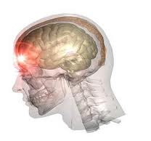
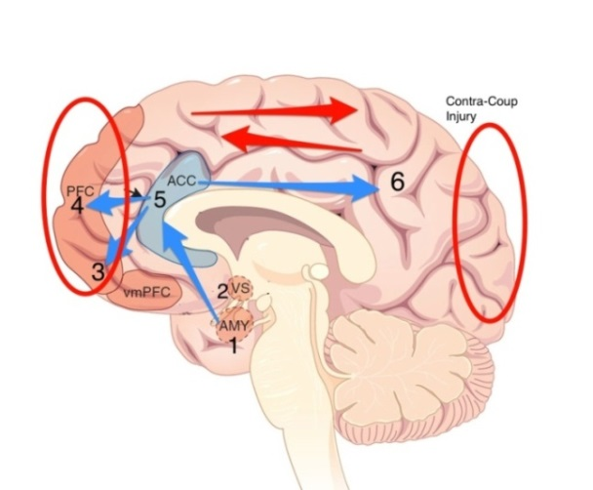
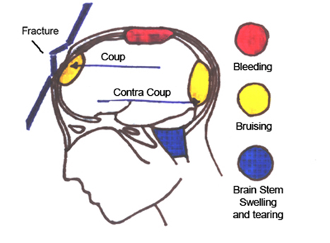
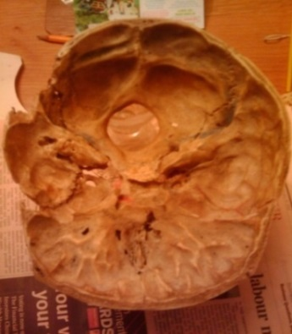
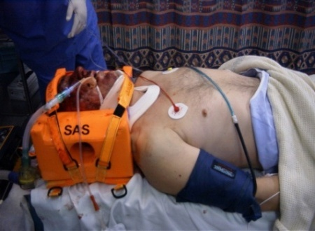
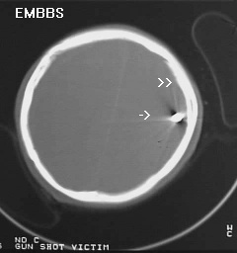
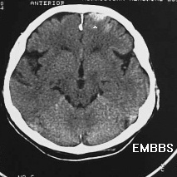


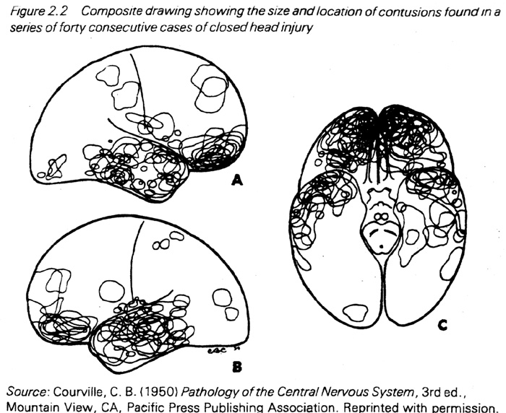
Traumatic Brain Injury mechanism
Moderate-Severe TBI
(30 mins Loss of Consciousness)
  • insult to the brain from an external mechanical force…
  with ROTATIONAL SHEAR FORCES important
  e.g. blow to the head - “fast-stop” in a crash, assault, fall. Leading to: Contusions, lacerations, diffuse injury (eg diffuse axonal shearing)
  • frontal and temporal most common sites of injury
MILD TBI – same mechanisms
with more “dosage” (e.g. repeated injury, or longer LOCV 10-30) = more likely problems (SEE Erin Bigler ***)

Slide 3
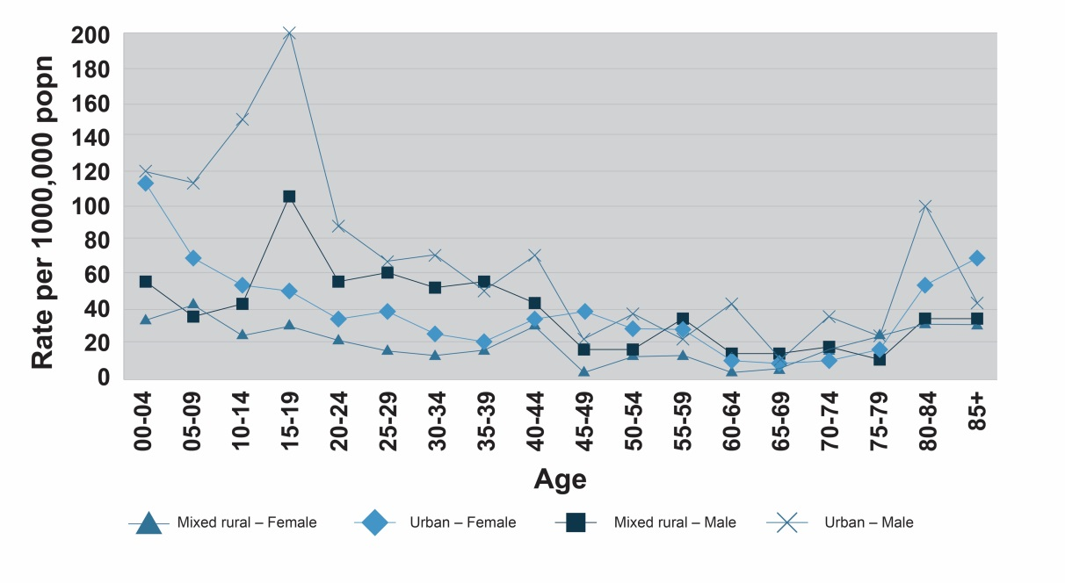
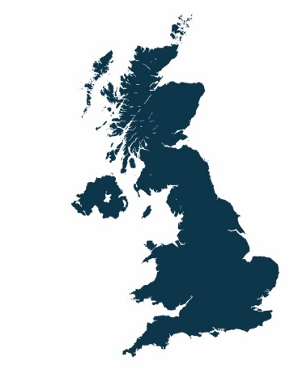


Rates of Traumatic Brain Injury:
Injury & Violence –
the two leading causes pf death in 10-24 age group
Neuropsychiatr Dis Treat. 2013; 9: 449–461.doi: 10.2147/NDT.S39776
Maturation of the adolescent brain
Mariam Arain, etal
TBI (RTAs, Falls, Assaults) –
- biggest causes of death and disability in children & young people WORLDWIDE
12% (adults) may have had a TBI with a LOC (Frost et al, 2013)
2/100 moderate to severe 8-10/100 milder forms
5-5-5
Under 5 years
In poorest 5%
5 times more likely to be injured
Yates, Williams et al: Attendance rates for moderate to severe head injury per 100,000 population Age, gender, urban location and social deprivation as key risk factors

Slide 4
TBI & “Personality Change” in children and young people
Moderate to Severe TBI: (20% approx)
Mild TBI: (80% approx)
“complicated”, or cumulative, injury may be linked to: problems in attention and inhibitory control
(Williams, Potter & Ryland, 2010; Wall, Williams et al, 2006; Williams et al, 2012)
Cognition – attention, memory, executive, social cognition
Behaviour – dis-inhibition, anger, etc
Mood – depression, anxiety…
(Hawley, 2003; Anderson et al 2006; Max, 2001; Tonks et al, 2010)
Difficulties considering alternative behaviours & controlling impulses
(Fishbein 2009 et al; Pontifex 2009)1
  94 children with TBI aged 9 at time of injury:
  Organic Personality Change (OPC)
  In 57% of severe & 5% mTBI
  labile and aggressive OPC subtypes most common – 3-4 x more.
  141 kids, 22% (6 months) had PC – assoc. w. dorsal prefrontal lobe injury (Max, 2005)
Novel Psychiatric disorders (NPD)
70 children with MTBI
6 months post injury
36% : NPD
ADHD, PC, Oppositional Defiant
(Max et al, 2013)
  Therefore
  3 or 4 in 10 affected
Injury = impulsivity, poor social skills, and externalising behaviours – therefore:
  disrupt development of prosocial life role
  underlie drift from classroom to the courtroom.
    NOTE: EFFECTS MAY BE DELAYED
Notes:
4

Slide 5
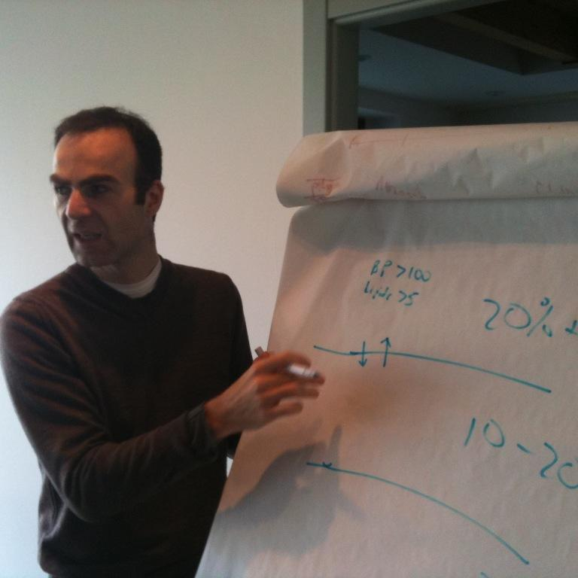
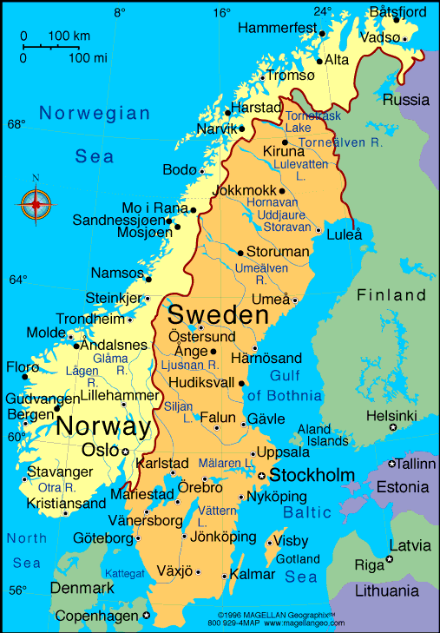
Risk of Crime after TBI:
Fazel S, Lichtenstein P, Grann M, Langstrom N (2011) Risk of violent crime in individuals with epilepsy and traumatic brain injury: A 35-Year Swedish Population Study. PLoS Med 8: e1001150
Swedish population registers from 1973 to 2009, and examined associations of epilepsy (n = 22,947) and traumatic brain injury (n = 22,914) with subsequent violent crime (convictions for homicide, assault, robbery, arson, any sexual offense, or illegal threats or intimidation)”
  “Among the major strengths of the study are..very large sample size…entire population of Sweden, and the follow-up of 35 years…findings are of major public health importance and provide inspiration for further research” J Volavka (Commentary)
traumatic brain injury cases, 2,011 individuals (8.8%) committed violent crime after diagnosis
compared with population controls (n = 229,118 (5,504 controls – 2.5%)),
corresponded to a substantially increased risk (adjusted odds ratio [aOR] = 3.3, 95% CI: 3.1–3.5)
Risk was attenuated when cases were compared with unaffected siblings (aOR = 2.0, 1.8–2.3)

Slide 6
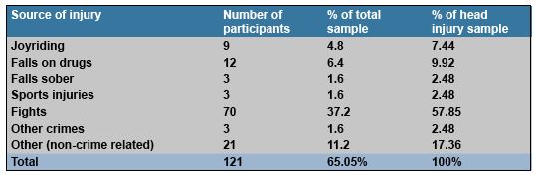
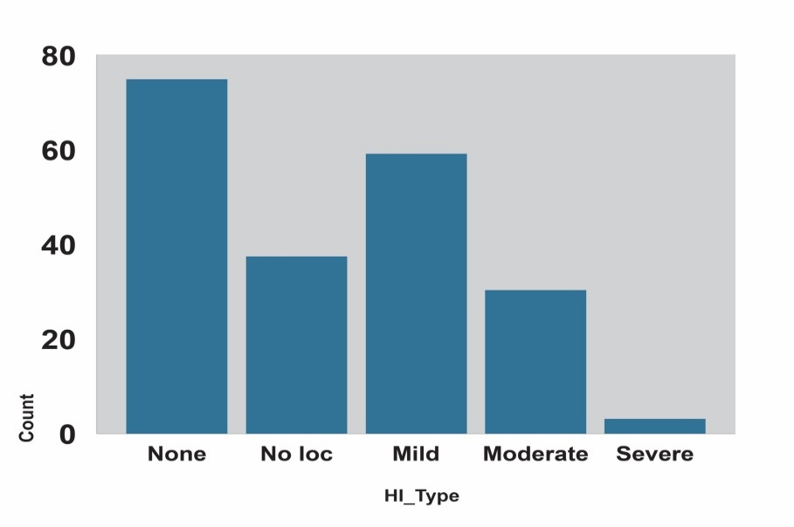
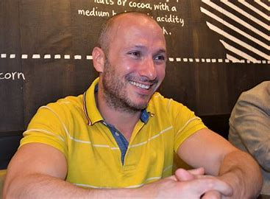
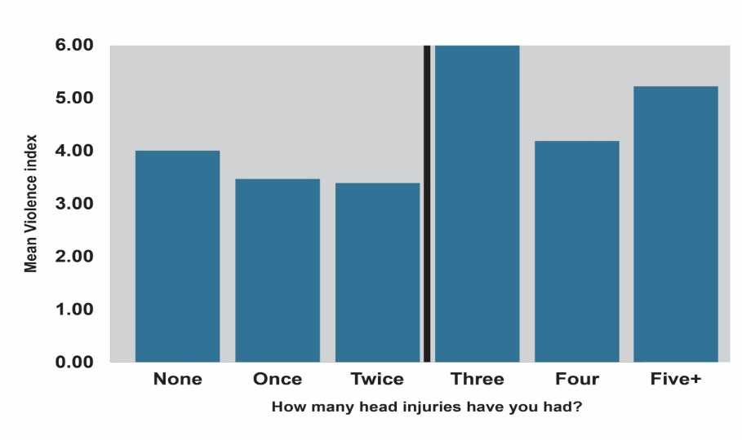
TBI in Young Offenders in UK
TABLE 2 Causes of TBI
Williams, (Giray) Cordan et al (2010) :
Youth offenders (YOI) (n = 192; 16 years of age)
- 65% history of “head injury”
  MTBI with LOC up to 10 minutes & moderate-severe TBI = 46% of overall sample
  16.6% moderate to severe injury
  (LOC over 10 minutes)
  Those with TBI = more convictions
  3+ TBIs = more violence
Notes:
6

Slide 7

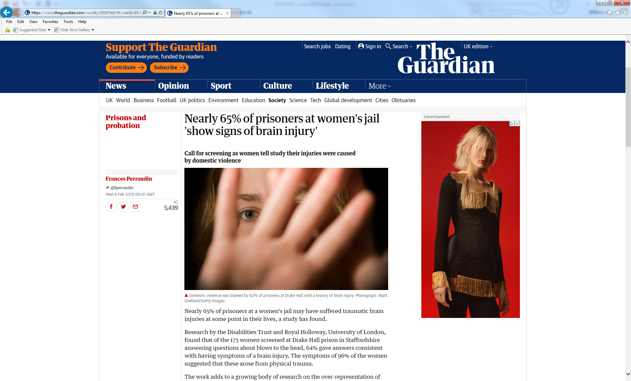
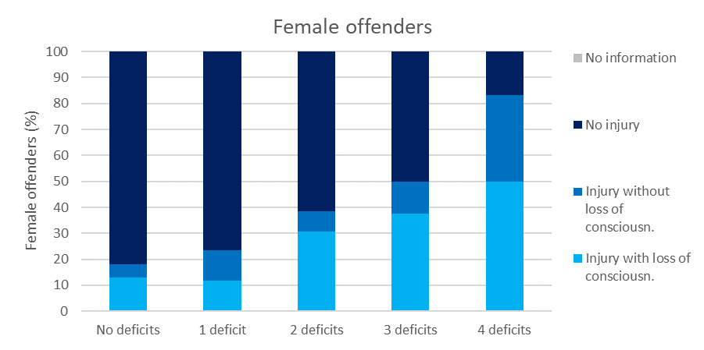
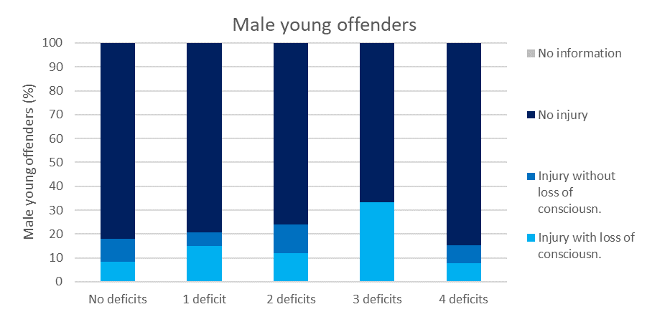
Girls & Women in prison…
62% of the women…had sustained their brain injury through domestic violence.
33% had sustained their first injury prior to their first offence.
female offenders, there is a
  dose-response between rate of head injury with loss of consciousness and the number of skills deficits. (attention/conc./ social skills etc.)
female offenders with TBI
    Can misjudge social situations.
    Have difficulty in group settings.
    HEIGHTENED risk of suicide (x3-4) – Kirby et al 2021

Slide 8
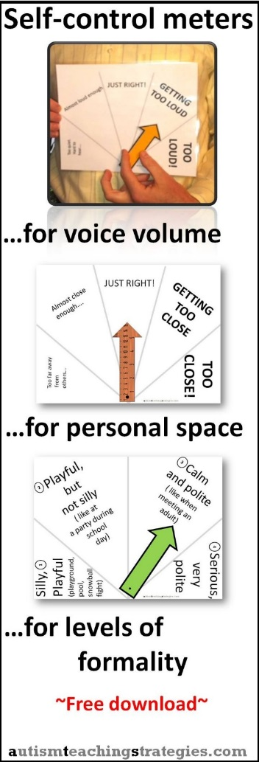
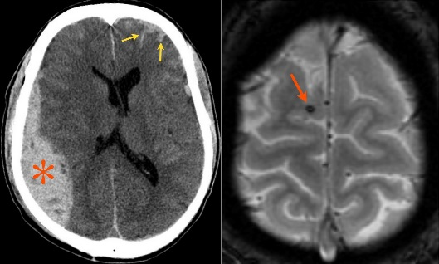
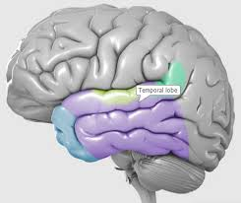
Young Person in YOI: Link-worker service – with Disability Trust – Funded by BCT
Explore & Manage effects of brain injury - AMNESTIC
  develop self-control & consequential thinking
  use visual CUES to remind of time spent/ rewards
  written guidelines and accessible reports for staff
  Liaise with substance misuse worker, caseworker, mental health nurse etc
Enable to engage in education
Behaviour “reversed”
on track for release
REMINDERS needed
“John 17, Assault = ?TBI”
  Notes = fractured skull, left side
  Impulsive, poor concentrating
  not engaging in regime
  threatening & abusive to staff & other inmates
  lowest privilege level due to poor pattern of behaviour
  NPsych Tested:
    eg poor verbal memory (5%) – visual intact
    co morbid ADHD, dyslexia, communication disorders

Slide 9
Project Overview
Pathfinder Team: Deferred Caution & Charge
IOM Team: Integrated Offender Management
Project delivered in three key parts:
Three online training workshops about TBI delivered by Prof. Huw Williams
Introduction of the BISI to screen for TBI
Qualitative staff interviews to collect feedback on training and screening
https://www.thedtgroup.org/foundation/brain-injury-screening-index-bisi

Slide 10
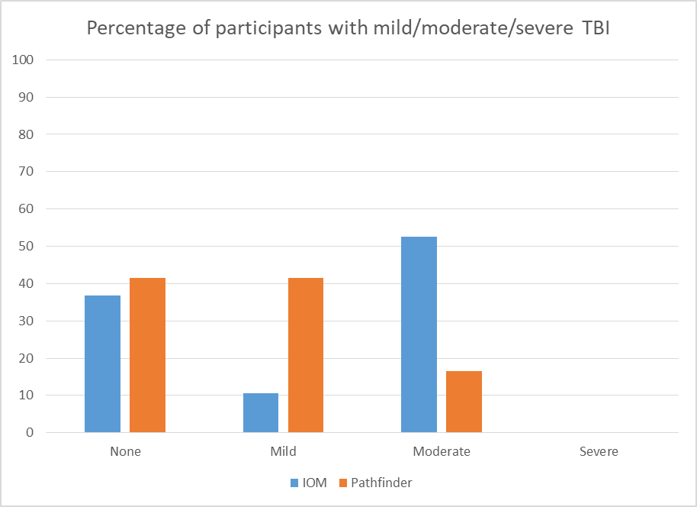


Key findings
54 out of 91 people screened had a mild or moderate TBI at some point in their lifetime (59.3%)
People in contact with the IOM team had significantly more moderate TBIs than people in contact with the pathfinder team, but those in contact with the pathfinder team had significantly more mild TBIs (as shown in the graph opposite).
Having). a higher score on the BISI (Brain Injury Screening Index) was linked to having higher numbers of identified needs (e.g. housing needs, education needs, victim of domestic violence
There was no significant difference in TBI profile by gender
Demographics
94 BISI collected, 3 excluded for incomplete data, 91 total analysed
74 male, 16 female, 1 non-binary
88 White British, 1 Black African, 1 Black Carribean, 1 British Asian
Ages ranging from 18 – 65
Various crime categories including assault, acquisition, threatening behaviour, and drug/substance related crime
Staff Feedback
Interviews with staff showed that they found the training interesting and helpful, and that using the BISI helped them to understand the people they were working with better. Staff reported an increased awareness of the lifetime debilitating impact of TBI, and how TBI could impact on ability to engage with rehabilitation programmes. The BISI was a useful way to open conversations and gain insight into a persons history.

Slide 11
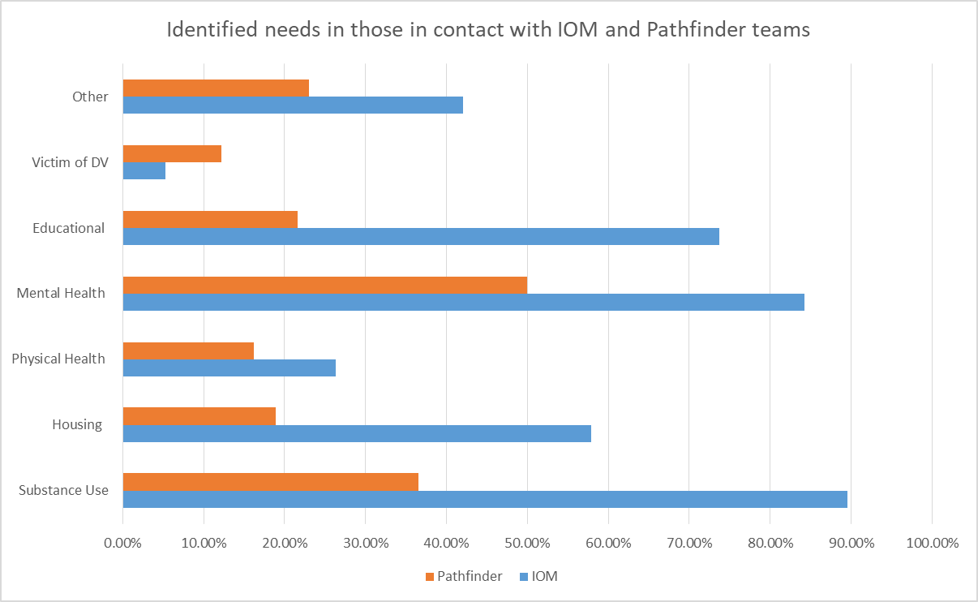
Identified needs profiles

Slide 12
Key takeaways
High prevalence of TBI in those in contact with both Pathfinder & IOM
More severe TBI associated with identified needs across more areas, indicative of complex social needs associated with ongoing TBI symptoms
BISI is a useful screening tool for police staff, and increasing awareness can help staff feel more confident working with neurodiverse groups
Further support in this area for both teams could help to reduce impulsive behaviour, improve rehabilitative outcomes, and ensure those with TBI are referred for proper assessment and diagnosis where necessary

Slide 13
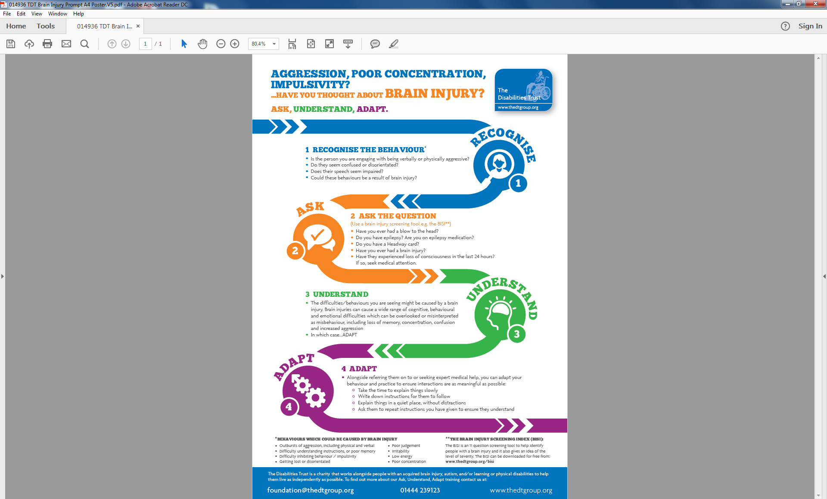

Slide 14


Paragraph 21 states that:
‘Children with developmental delays or neurodevelopmental disorders or disabilities… should not be in the child justice system at all…[there needs to be] more effective support of education, health, family and social services to offer the support needed to prevent the onset of offending or the criminalisation of children with such disabilities⁴.
https://tbinternet.ohchr.org/_layouts/15/treatybodyexternal/Download.aspx?symbolno=CRC%2fC%2fGC%2f24&Lang=en

Slide 15
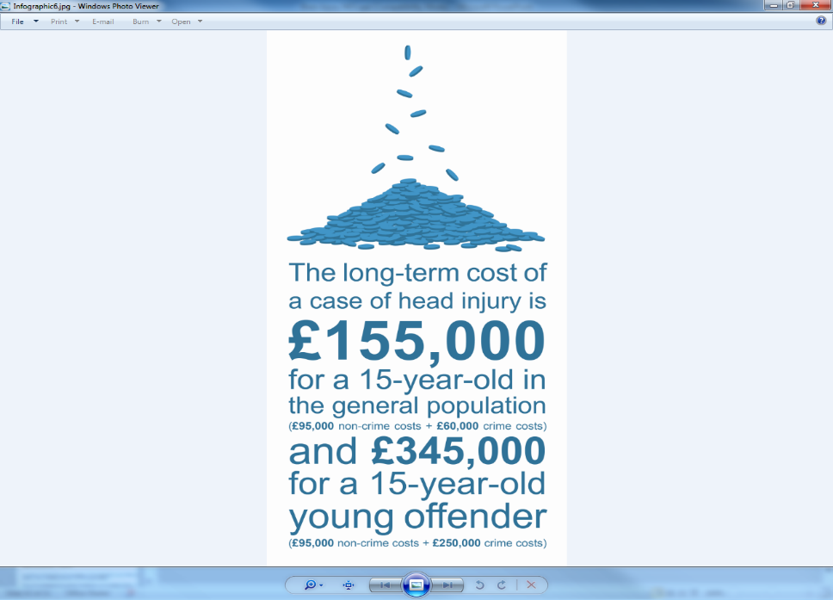

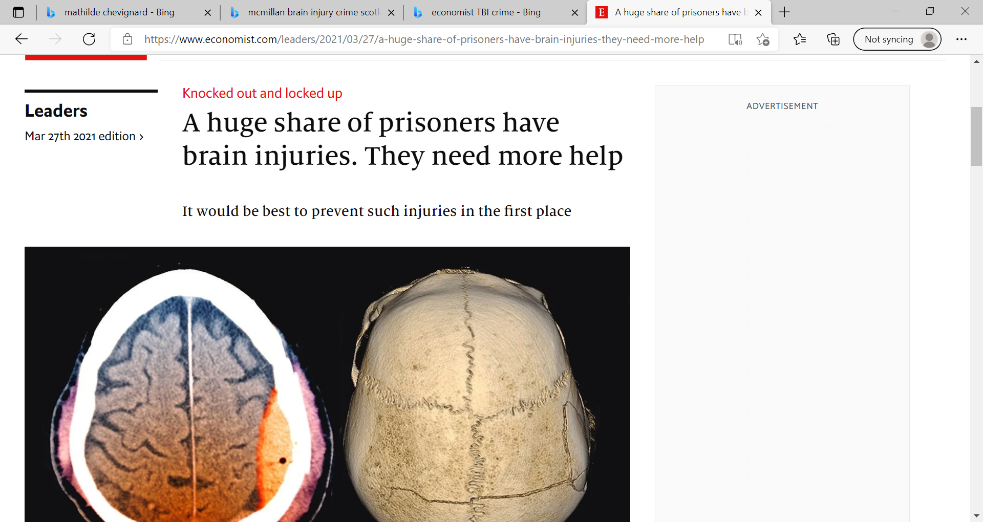
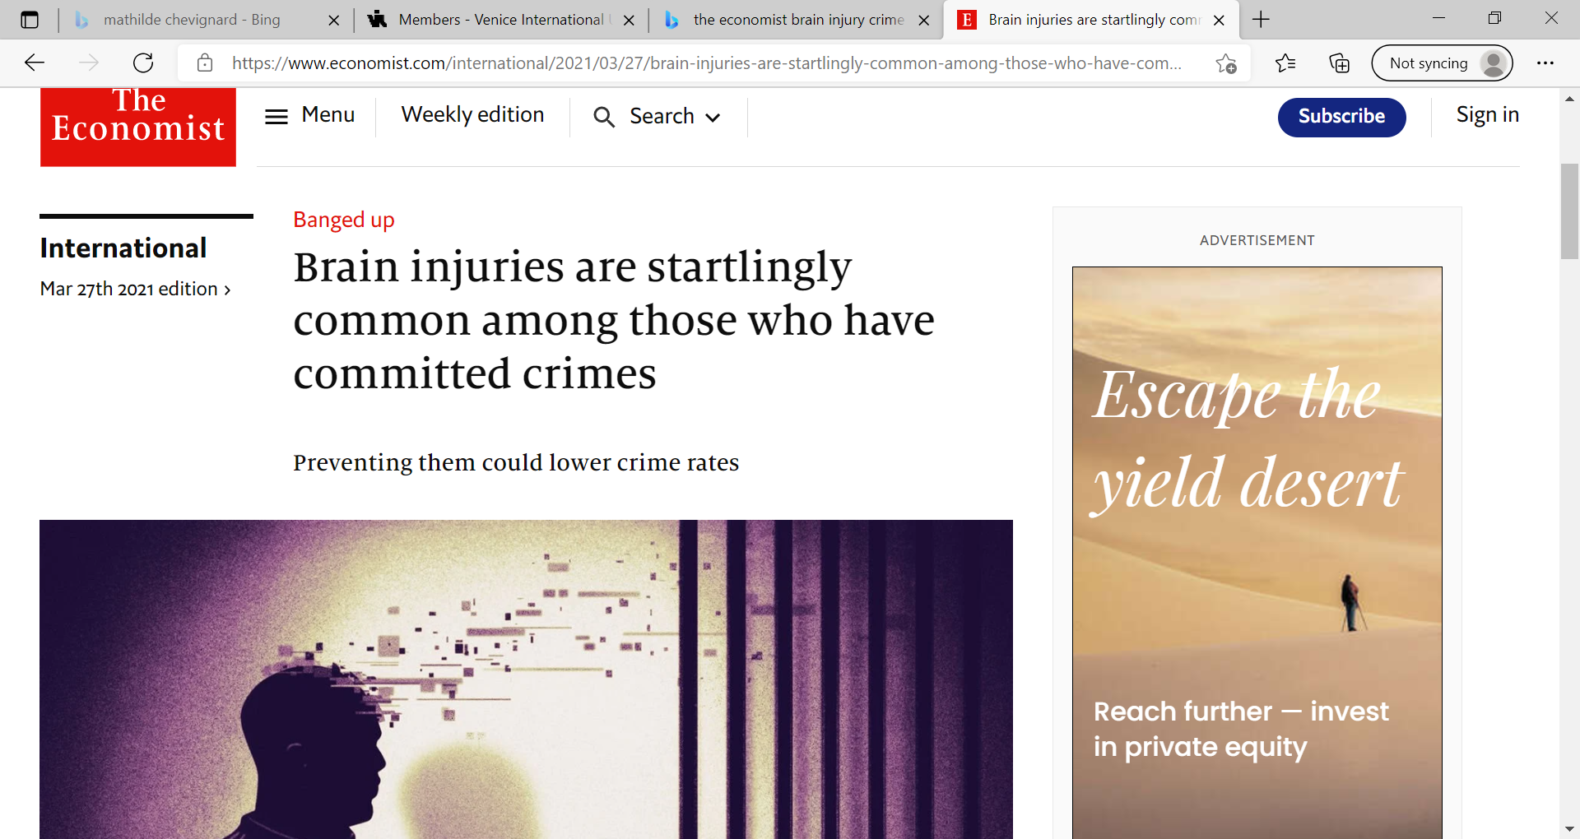
Economic analysis of TBI & Crime
  Reoffending costs the UK…between nine and 13 billion pounds a year. The taxpayer has so far got a poor return for the money invested in rehabilitation..need a new way of approaching the problem…”
  (ex.Secretary of State for Justice: Chris Grayling MP)
      www.gov.uk/government/speeches/crime-in-context-speech
      * Ministry of Justice 8/12 Analytical Services Prisoners Criminal Backgrounds and Re-offending report
Analysis of UK National Audit Office (NAO) study:
costs to the criminal justice system of a cohort of 83,000 young offenders who committed their first offence in 2000
Each YO cost the criminal justice system £8,000 ($12,400) a year
Each of the 10% most serious offenders cost £29,000 ($45,000) a year
Prolific offenders (6+ offences – from early years) cost £1.3 to 2.3 Million
“even if interventions are only moderately effective in reducing re-offending, they are still likely to be good value for money”
Williams, McAuliffe, Cohen, Parsonage & Lord Ramsbotham (2015)

Slide 16
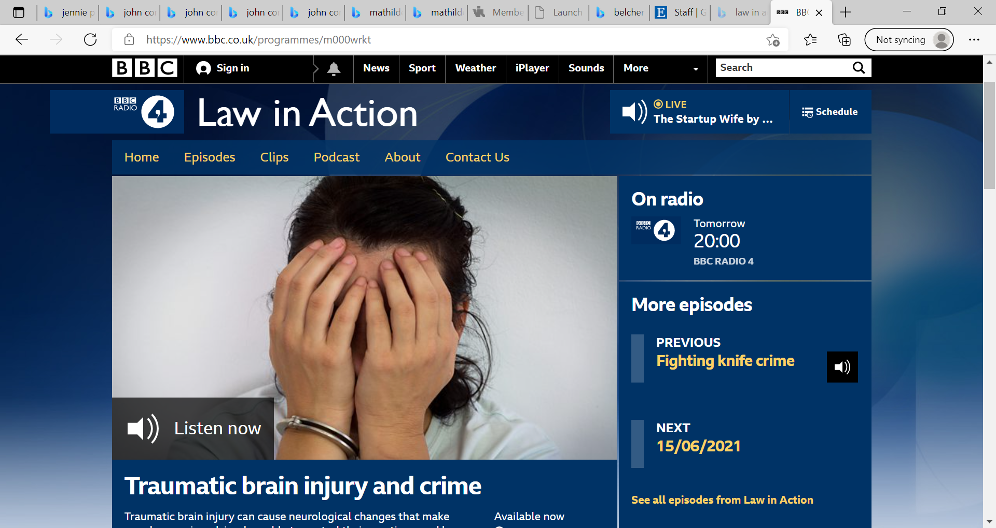
Useful overview on what judicial changes needed 12-25 years (NZ) and in police custody (UK)
BBC Radio 4 - Law in Action, Traumatic brain injury and crime

Slide 17
Invest in development: Spending to save…community capital
Children and young adults MOST likely to get a TBI least likely to get support
  They do NOT grow out of their problems, BUT probably into them...especially when in adverse environments….and drugs
Parent/Social-Care-giver support important….
School inclusion with diversion/liaison processes vital…
Screening for TBI (Neuro-disability) is possible (
  Pre-custody + DEFLECTION ….DIVERSION
  Custody + DIVERSION
  Sentencing + COMMUNITY ORDERS
    (see new Sentencing Guidelines UK)
  entry & exit from secure estate - PLAN FOR SOCIAL RE-ENTRY (NHS Justice RECONNECT)
Multi-agency working is vital
Notes:
17

