Slide 1
7 Step Emergency Spill Response Guide
Only Spill Response Trained Personnel should complete 2-7
1
Immediately Report(location, incident description, pollutant & quantity):
Campus Services Helpdesk (Mon –Fri 0800-1800) on 01392 72 4552
Estate Patrol (out of hours) 01392 73 3999
Call 999 in the event of risk to life
Secure spill area, cordon roads / area, evacuate as needed
REPORT
and SECURE
Assess risks to health and Environment complete RA as appropriate
Select appropriate personal protective equipment
Select spill control equipment to manage spill
Do not use detergents or hose the spill down drains or water courses.
2
SELECT Spill Equipment
3
Deploy equipment to prevent spill entering receptors such as drains, water courses, roads & other vulnerable areas
CONTAIN Spill
Stop first if possible
Turn off valves/taps, plug holes, realign barrels/containers, stop delivery, etc.…to stem flow of spillage
Isolate all sources of spill.
4
STOP Leak at Source
5
Assess Impact of spill on environment, human health & property
Determine whether specialist contractor required. Obtain authorisation.
Develop action plan & commence clean up process
Commence Clean Up
6
Remove and dispose of contaminated materials
Decontaminate responders & affected area.
Refill Spill Kit as appropriate
DECONTAMINATE & Dispose
7
For all incidents complete GEP014B incident form and send to: campusservices@exeter.ac.uk
sustainability@exeter.ac.uk
Replenish Spill Kit, identify new apparatus required to manage future spills.
REPORT & Replace
Emergency Containment and Clean up Contractor
SEED Environmental
0844 3815650
SEED Enironmental hold the ISAS international Spill Accreditation
Surface Water: Environment Agency Hotline 0800 807060
Foul drains: Southwest Water 0344 346 2020
EDWG:25 Version F Released Feb 24

Slide 2
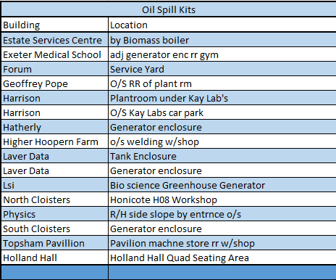
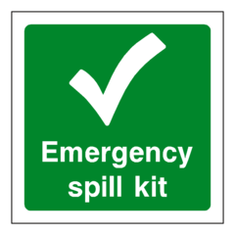
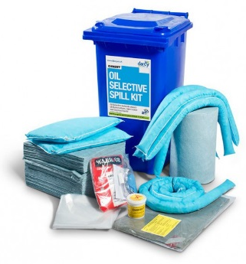

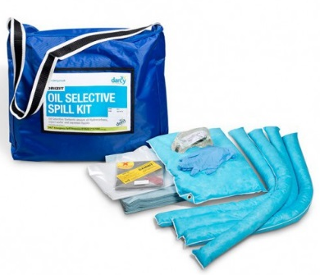
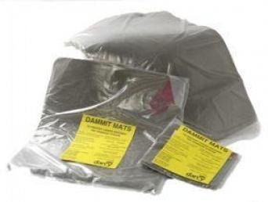

Spill Kit Locations:
EDWG:25 Version F Released Feb 24
50 litre Grab Bag Spill Kits
Gas Team Vans – coming soon
Adapted with permission from Paulex Emergency Oil Spill Response Guide

Slide 3


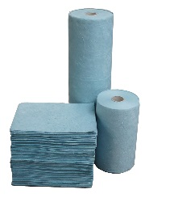
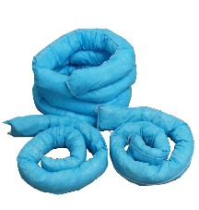
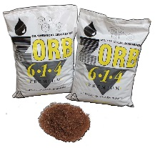
What spill kits do we have?
Tamper Tags
Wheelie bin kits should have tamper tags. Please report broken tags to Campus Services Helpdesk
240 litre Wheelie Bin Spill
50 Litre Grab Bag Spill Kit
Contains
7.5 x 125 cm sock (5)
7.5 x 300 cm sock (1)
55 x 35 x 10 cm cushion (2)
50 x 42 cm pad (150)
65 cm x 45 cm drain mat (1)
800 g clay plugging compound (1)
waste bag & tie (3)
PPE (gloves & goggles) (1)
Contains:
7.5 x 125 cm sock (3)
50 x 42 cm pad (50)
65 cm x 45 cm drain mat (1)
800 g clay plugging compound (1)
waste bag & tie (1)
PPE (gloves & goggles) (1)
Do NOT:
! Do not hose down with water
! Do not use detergents to disperse oil
Spill products and how to use them
Absorbent roles and pads
Absorbent socks / booms
Absorbent pads and rolls for cleaning and absorbing oil spills on land and water. The pads work by absorbing the oil without taking up any water. Simply place onto the spill.
Oil absorbent socks contain highly absorbent polypropylene material. They are ideal for creating a barrier around machinery to prevent the spread of an oil spill or to skim the oil off the water surface.
Loose absorbent
Drain Plug Mats
Loose absorbent is used for clearing up small quantities of oil or petrol. Lighter than Clay alternatives.
Clay drain provide an instant seal to a drain and prevent spilled oils/chemicals flowing into storm drains and out to controlled waters
EDWG:25 Version F Released Feb 24

