Slide 1


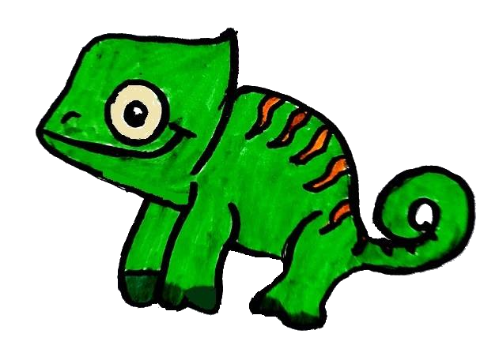
Improving Access for Hard to Reach Groups…
Adesoye Des Kuye, Ayana Douglas,
Catherine Xia, Christopher O’Rouke, Tristan Bracegirdle

Slide 2
Children
A Hard to Reach group?

Slide 3
Children: A Hard-to-Reach Group?
51% of teens are afraid of talking to their parents about personal problems¹.
This number climbs to 54% for the percentage of teens who are afraid to talk to their teachers about personal problems¹.
The WHO has identified a discrepancy in adult’s perception of adolescent needs and an adolescent’s perception of their own, leading to children feeling uncomfortable in sharing information with a parent or guardian².
Additionally, some problems could receive a hostile response, such as problems with coming to terms with sexuality or if they are struggling with family conflicts.²
1) What Do Teens Fear?. (2018). Stageoflife.com.
2) Barker, G. (2007). Adolescents, social support and help-seeking behaviour: An international literature review and programme consultation with recommendations for action. WHO discussion papers on adolescence.

Slide 4
Children: A Hard-to-Reach Group?
The WHO has also reported that the awareness of support for children and early adolescents was very low to medium.¹
Yet despite this, half of all mental health disorders in adulthood start by age 14. ²
Not only are children a hard-to-reach group, but improving their access to mental health support can help them throughout their adulthood
Barker, G. (2007). Adolescents, social support and help-seeking behaviour: An international literature review and programme consultation with recommendations for action. WHO discussion papers on adolescence.
Adolescents: health risks and solutions. (2018). World Health Organization.

Slide 5
Children: What problems do they face?
Puberty
Changing from Primary to Secondary education
Exam stress (even with just progression related tests)
Increased peer pressure
Sex and relationships
Part-time work
Future careers

Slide 6
Children: A Hard-to-Reach Group?
There is evidence to suggest that young people are more likely to seek help should they have knowledge about mental health issues and sources of help¹.
Further, not feeling emotionally competent and able to talk about feelings is another barrier for help seeking^{1, 2}.
Emotionally competent = Being able to identify their own emotions (and the emotions of other peoples).
When and how do young people seek professional help for mental health problems? Med J Aust. 2007 Oct 1;187(7 Suppl):S35-9.
Gulliver, A., Griffiths, K., & Christensen, H. (2010). Perceived barriers and facilitators to mental health help-seeking in young people: a systematic review. BMC Psychiatry, 10(1). doi:10.1186/1471-244x-10-113

Slide 7
Our Solution
A Mobile App

Slide 8

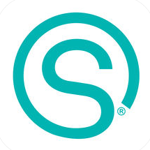
Our Solution: A Mobile Phone App
Our solution to this problem was a mobile phone application (as well as a physical toy version that serves similar functions)
The average child uses a smartphone at the age of 10, with some children using them as young as 7¹.
Additionally, at this age, there is a focus on gaining independence, mainly due to puberty and the transition to secondary education
Despite this, most mental health apps for children and early adolescence are designed to be used with parents.
Kids & Tech: The Evolution of Today’s Digital Natives | Influence Central. (2016). Influence-central.com.

Slide 9
Our Solution: A Mobile Phone App
The app is NOT a treatment programme
Its also not an alternative to communication with peers or family, but can be used to give support
It is, however, intended as a tool to allow children to communicate thoughts and feelings and gain the confidence to express these thoughts.
However, its primary goal is to improve a child’s emotional competence and raise awareness of where they can go if they have an issue

Slide 10
Meet Kenny
The Chameleon Companion

Slide 11
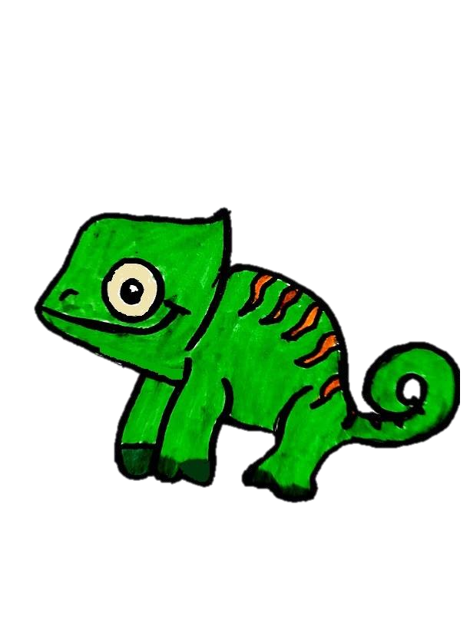
Meet Kenny
Kenny is designed as a cartoon chameleon, who acts as a friend and mentor to help adolescents to recognize and tell their emotions.
Like Panther chameleons, he will change his color with his mood (e.g. Green represents happy, blue represents sad etc.)
Adolescents are guided by Kenny to correctly recognize their feelings, to identify emotions in their peers, and learn to control their emotions.

Slide 12
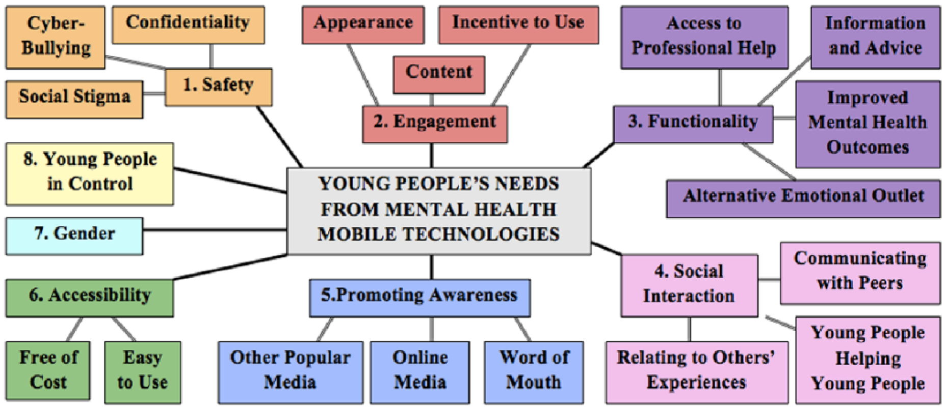
Kenny, R., Dooley, B., & Fitzgerald, A. (2014). Developing mental health mobile apps: Exploring adolescents’ perspectives. Health Informatics Journal, 22(2), 265-275. doi: 10.1177/1460458214555041

Slide 13
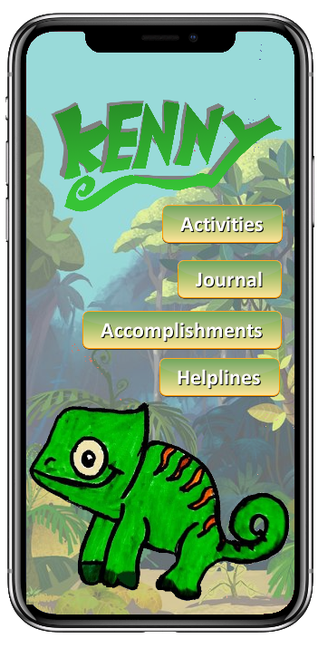
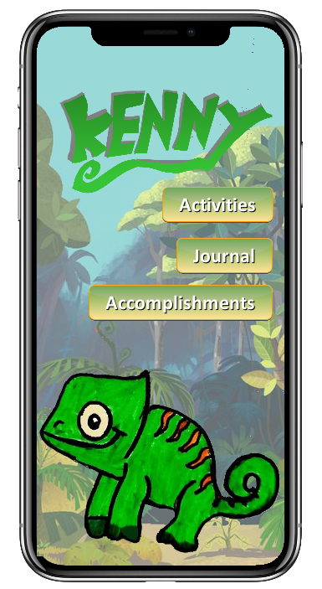
The App
"There's simply no better way to learn about your thought processes than to write them down." - Dr. B. Markway, 2014

Slide 14
The App
Activities: A variety of fun activities, providing psychoeducation will be provided to 11-14 aged teenagers. Kenny, as a mascot, will teach children about different emotions through pictures, stories, and games.
Journal: Encourage teenagers to use what they have learned to write a journal every day. Unlike conventional journals, Kenny asks the user specific questions to encourage them to actively think about the day and their feelings.
Further, the app would use word recognition (as well as recognising common typos) so that if specific trigger words are mentioned (e.g. ‘anxious’ can lead to Kenny directing the user to different sources of help for anxiety).
Accomplishments: Completing activities and writing in the journal results in the user obtaining rewards (such as clothing items for Kenny).

Slide 15
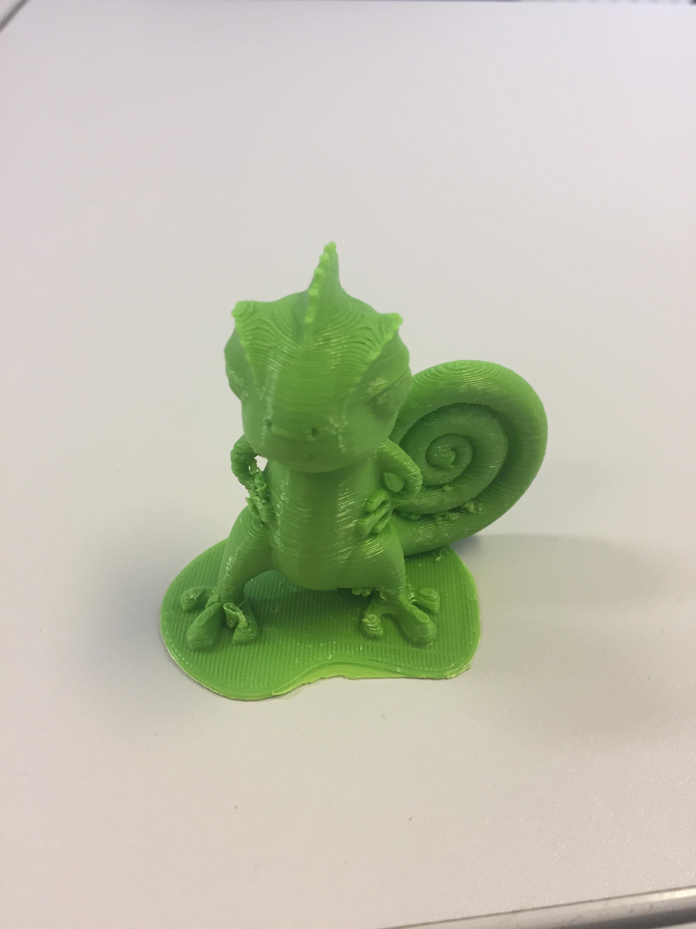
Kenny: More than just a toy
We also felt that we wanted a more approachable version for children under 11.
But we wanted it to be accessible for all ages, for instance if their parents place restrictions on mobile phone use
We decided on having a toy version of Kenny for younger audiences that would serve the same purpose as the journal element of the app

Slide 16
Limitations
Safety considerations
Extent of social interaction
No guarantee of use

Slide 17
Safety
No data is uploaded or exchanged to maintain confidentiality
We believe that it is better that there is trust there with helplines available than discouraging young people to communicate by reducing confidentiality
Risk of this maintenance of confidentiality could be potential negligence of more serious cases or confessions
We believe that these measures will reduce the social stigma and foster trust in others through the use of the app

Slide 18
Social Interactions
Although teenagers thought that social interaction would be a good idea, we believe that a feature of this nature could undermine the safety of the users due to the lack of supervision
  There have been blogs containing ‘help’ for teenagers to hide their anorexia from their parents
  There could be vulnerable children on the app, who could be targeted
At the same time, there is a risk that the app could become taboo if too much secrecy and confidentiality is encouraged
  Instead, this app should encourage users to speak to friends and family

Slide 19
Can we guarantee use?
Unlikely, because of…
  Lack of material incentive
  Lack of supervision
Studies into the use of apps saw a high level of non/poor compliance
  Reflective of potentially high dropout/ non-committal rates
This could be combatted through…
  Online advertising campaigns
    E.g. 75% of teens seek advice through YouTube channels/videos on important topics (Stage of Life)
  Healthily competitive game modes to encourage some interaction and motivation for using the app
    92.2% of teens say they are motivated by competition (Stage of Life)

Slide 20
Thank you for watching

