Slide 1

Lean In circle
Introductory meeting

Slide 2

Agenda
Welcome
Introduction
Check-in – introduce yourselves
Key themes
Circle fundamentals
Wrap-up

Slide 3
Introduction
What is Lean In?
What are Lean In circles?
Structure of meetings
Focus on different themes
Guest speakers

Slide 4
Check-in
Introduce yourselves:
My name is…
At work I spend most of my time…
I joined this Circle because…
Outside of work I enjoy ..

Slide 5
Key themes
In 2 groups discuss the main themes you would like to cover. Some ideas as a starter:
Work-life balance
Economics of well-being
Power and Influence
Connecting
Peer Support

Slide 6
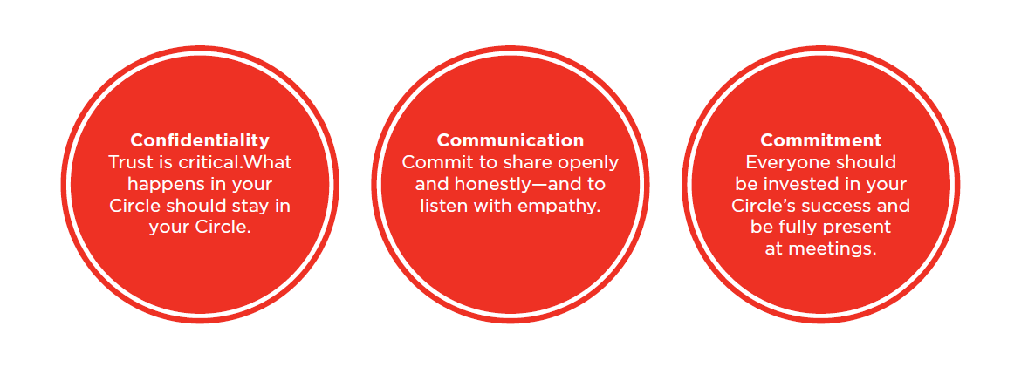
Circle Fundamentals
Any others?

Slide 7
Wrap-up
Next session: consider circle goals – personally and collectively
Homework: think about what you would personally like to get out of the circle
Timing and frequency
Circle leaders

