Slide 1
Leading and managing hybrid teams
Slideshow with notes pages
People Development August 2023

Slide 2
Using this resource pack
The slides work best in slideshow mode as there are builds that present the information in a digestible format.
Most slides have further information, explanations and references to academic studies, discussion articles and thought pieces in the relevant notes page.
Slides with such notes are marked with this symbol on the bottom right of the slide.
At the end of the first section there are more slides and notes that explore some of the key topics in more detail.
This resource pack is updated on an annual basis so some items may be unavailable or out of date.
We hope you find this pack useful.
N

Slide 3
What are the issues still?
People continue to:
deal with multiple, significant changes
function from cultures, norms, relationships, and practices that were in place prior to the pandemic^{b}
be unfamiliar with working in a hybrid fashion^{c}
experience coming and out of multiple crises^{a,e}
be fearful^{d}
You may already be leading and managing your hybrid teams effectively: this resource pack, therefore, is a handy reminder!
N
Notes:
Notes
The pandemic has changed our working world considerably in the short and medium term, but remote working has been around for decades and there are some issues that have been well researched over the years that we are now encountering more commonly as we are thrust into this way of working.
Significant business changes not just new ways of working but also Big Conversations outcomes, Strategy 2030, Digital, EA Review, FoW, new EDI initiatives, EP, EL, new Global strategy etc…
Many of us are still functioning from cultures, norms, relationships, and practices that were in place prior to the pandemic. If we wish to change or adapt any of those factors in the future, it will be difficult without some degree of physical presence. This means the office is not going to disappear - but it will require a fresh, new approach. People will still need places where they can come together, connect, build relationships, and develop their careers (HBR, 2021)
Lockdown and the pandemic has been traumatic for some, uncomfortable for many and
disturbing for others. Some experts have gone so far as to suggest that modelling from
within the field of disaster medicine might be broadly transferable to the pandemic situation
in the UK. Certainly, the findings illustrated by the above diagram paint a disturbingly bleak
picture when applied to the pandemic situation. However, it should be noted that the diagram
is based on theoretical assumptions as there is no direct precedent with which to compare
the impact of the Covid-19 pandemic.
Based on modelling from the field of disaster medicine, experts have suggested that three
out of four (75%) individuals are more likely to have transient normal distress. This would
be manifested through normal feelings of being worried and upset, without being attributable
to a clinically diagnosable disorder, nor requiring any active psychological treatment.
Furthermore, it has been suggested that one in five people (20%) may develop mild-to moderate
disorders, and therefore require standard psychological support. Such support
might include some short-term pharmaceutical treatment with phased return to work and job
role adjustments (either temporary or permanent).
Experts relying on the assumptions derived from the field of disaster medicine have claimed
that one in 20 (5%) may go on to develop severe disorders requiring more prolonged
combination pharmaceutical/psychological treatments with prolonged time away from work.
There are ongoing mental health studies that have begun in health and social care
occupations which may shed further light on these perceptions of how the the population at large
may respond when trying to reset and get back into normal routines. (UCEA, 2020).
Finally, the pandemic has influenced how we will want to work in the future with more requests for flexibility. The balance for these may be challenging (Heejung et al, 2021).
References
ªUCEA (2021) Managing staff return to campus guidance for members. www.ucea.ac.uk/library/publications/managing-staff-return-to-campus-guidance/
^{b}Harvard Business review (2021) Thriving in the future of work means focusing on your people. https://hbr.org/sponsored/2021/04/thriving-in-the-future-of-work-means-focusing-on-your-people. Accessed Dec 2021.
^{c}CIPD (2020) Embedding new ways of working. Implications for the post-pandemic workforce. CIPD Report September 2020.
^{d}Sloan, K. (2021) Nothing to Fear. Journal of the Institute of Leadership and Management Summer 2021: 48-49.
^{e}Heejung, C., Hyojin, S., Forbes, S., Birkett, H. (2021). Working from home during the COVID-19 lockdown: changing preferences and the future of work. University of Birmingham and University of Kent. [PDF] Working from home during the COVID-19 lockdown: changing preferences and the future of work | Semantic Scholar. Accessed 21/11/2022.

Slide 4
What does Hybrid mean….The Place-Time Axes
The old “Homeworking”
Anywhere, 9-5
Anywhere, anytime
In the office, 9-5
In the office, anytime
The new “Hybrid working”
Unconstrained
The old “work”
The old “Flexible working”
PLACE
Constrained
Constrained
TIME
Unconstrained
Lynda Gratton (2021) In “This hybrid future” The Edge, Autumn 2021
N
Notes:
Gratton (2021) captures the evolution of working practices over time to a point where, pretty much, ‘anything goes’…well, for some people in some jobs at least. In the University, at the moment (2023), many Professional Services roles operate in a hybrid fashion while many others have to be on campus flexibly or at least working mostly in an office or elsewhere (eg many campus and student services). The majority of meetings still operate online which does increase accessibility for many but also allows for “extreme back-to-backness”, not possible if you are having to physically travel between rooms.
The “anytime, anywhere” feature of hybrid working also brings with it issues around confidentiality (eg working in a public space like a café but dealing with highly sensitive issues which could be overheard or overlooked) and interference (eg from parcel deliveries, pets, children, partners etc). None of this used to be a consideration with the old working location of “in the office”.
Does any of this matter? Is this affecting my team, their function as a team and/or their work output? If so. What can I do about it? Worth asking yourself these questions…

Slide 5
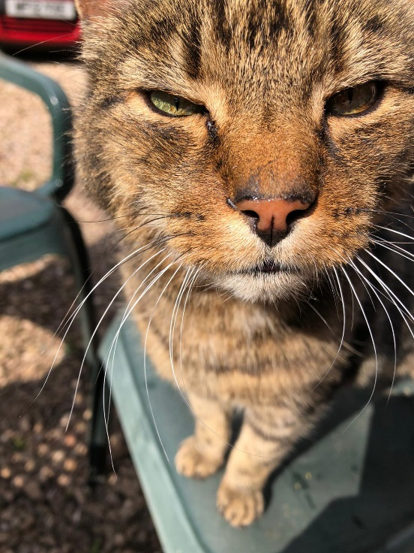
So…what are the known challenges with Hybrid Working?
Evidence suggests:
Managers are less likely to engage in hybrid working, preferring more traditional office-attendance, than the people they manage^{h}
There can be problems with the balance of working from home*/working in an office^{a,b,f}
…and also with logistics (who is working where and when)^{f}
We need to be aware of ‘equity’ (facilities, career opportunities^{c}, “perks”): the “second-class citizen trap”^{d}
There may be problems with disconnect and loneliness^{e}
Pets (and other interruptions) can be an issue
A new phenomenon has emerged: “Quiet quitting”^{g}
*this could of course also mean a café or other location
N
Notes:
Notes
There’s no consensus on the optimal balance of work days at home vs. in the office (reference a). Over half of employees (55%) would prefer to be remote at least three days a week once pandemic concerns recede — little changed from the 59% who said the same in June. For their part, while most executives expect options for remote work, they are also worried about the effects: 68% say a typical employee should be in the office at least three days a week to maintain a distinct company culture.^{b}
Least experienced workers need the office the most. Respondents with the least amount of professional experience (0-5 years) are more likely to want to be in the office more often. Thirty percent of them prefer being remote no more than one day a week vs. just 20% of all respondents. The least experienced workers are also more likely to feel less productive while working remotely (34% vs. 23%). They’re more likely to value meeting with managers or company training programs than their more experienced colleagues.^{b}
Digital exhaustion and burnout (reference c): A study last year of 3.1 million workers in North America, Europe and the Middle East found “significant and durable increases” in both the average number of emails sent internally, and the number of recipients. By measuring the time between the first and last emails sent (or meetings attended) in a 24-hour period, the researchers concluded that, since the pandemic, the average workday had extended by 48.5 minutes.
….disconnecting is more than just a perk – it is “one of the big health and safety challenges of this new era,” says Pakes. Even pre-pandemic, in 2019, 18m workdays were lost in the UK to work-related stress, depression or anxiety. And the true toll is only just becoming clear. A landmark study by the World Health Organization (WHO) and the International Labour Organization (ILO) last month found that working 55 hours a week or more was associated with a significantly elevated risk of stroke and fatal heart disease. Long hours were responsible for one-third of all workplace deaths, a risk factor entirely overlooked until now.
The second-class citizen trap (reference d): Have you ever been in a meeting with six people sitting around a boardroom table and one poor participant on the speaker phone? I’m betting it didn’t take many minutes before the six people at the table forgot he or she existed; all they managed to contribute was random soundbites: “Yeah, I agree” and “Mike’s right”.
This ‘connectivity imbalance’ must be recognised and fixed before going hybrid. Adopt an office design with vertical screens to give off-site participants a solid physical presence, allocate funds for high-quality sound, and place everyone, virtual or not, at eye height.
Whether we’re willing to admit it or not, unspoken work-codes will have a profound impact on the success of your hybrid model. Recent studies show that working in a physical environment is perceived as being more committed than appearing virtually. Even the tiniest signal – a remark from senior management, a promotion, KPI favouritism, or org structures – can amplify or muffle this narrative.
The message is simple. Viewing a hybrid environment as a temporary strategy can be disastrous, but jumping straight in can be fatal, too. Hybrid work requires solid consideration and preparation. Only then will it help your organisation go ‘forward’ to work. (Management Today, 2021).
Disconnect (reference e)
Nearly three quarters of workers (73%) believe their employers should take action to mitigate against the loneliness they experience while flexible working, new research has revealed.
In a survey conducted by Survation, Silicon Reef reached out to over 1,009 people in the UK in February and found that employees see it as the responsibility of their leaders to take action to support them with the challenges of remote/flexible working, including mental health challenges. 44% of those surveyed said this support should come in the form of opportunities for mental health breaks and support, while 41% thought more social media interaction with employees would be helpful.
Quiet quitting (references g)
Dionne Maxwell (Head of Diversity, Belonging and Talent at Jungle Creations) suggests that we should avoid the term completely and concentrate on getting to know what our workers need and engaging in conversations with them.
Korn Ferry’s article extract (Another recession? Leading through today's economy (kornferry.com)) [Ronald Porter and Sheila O’Grady contribute from the Korn Ferry global team].
The challenge of keeping employees engaged remotely.
….Porter thinks one possible solution is to be more intentional about gatherings. Hybrid working practices will force organizations to be more thoughtful and deliberate about when and how they pull people together, which can only be a good thing.
Another paradox: in a flexible working environment, driving engagement is more important than ever, but it’s much harder to achieve. Quiet quitting has become a new buzzword, denoting workers who use working from home as an opportunity to fade into the background and not put the effort in.
O’Grady is clear: it’s incredibly difficult to get the culture right and keep your team connected in a remote working environment. You have to be an exceptional leader, and most are struggling with it.
What should leaders do next?
It's clear there’s a lot going on right now and it’s not surprising that leaders are looking for guidance.
Guarino thinks it’s important to keep a sense of perspective: “This is actually nothing new. Throughout history there have always been paradoxes and contradictions, challenges where it’s not clear what the leader should do. The rules haven’t changed: leaders still need to lead. Which means they need to make decisions – that’s what they get paid to do. Don’t let all the perceived contradiction paralyze you, you’ll be able to figure it out”.
References
ªCIPD (2020) Embedding new ways of working. Implications for the post-pandemic workforce. CIPD Report September 2020.
^{b}PWC (2021). Its time to reimagine where and how work will get done. https://www.pwc.com/us/en/library/covid-19/us-remote-work-survey.html Accessed Sept 2022.
^{c}CIPD (2021), Making sure hybrid working is inclusive. https://www.cipd.co.uk/Community/blogs/b/katie-jacobs/posts/making-sure-hybrid-working-is-inclusive#gref Accessed 6/8/2021.
^{d}Management Today (2021) How your culture needs to change for hybrid working. https://www.managementtoday.co.uk/culture-needs-change-hybrid-work/hybrid-working/article/1718387. Accessed 5/5/2022.
^{e}Vilestrata, A. (March 2022). 'Disconnected' | 7 in 10 office workers demand action against loneliness. HR Grapevine Live. https://www.hrgrapevine.com/content/article/2022-03-23-three-quarters-of-office-workers-demand-action-against-loneliness?utm_source=template-pardot-2108&utm_medium=email&utm_campaign=hr-23-03-22&utm_content=news&utm_term=%27Disconnected%27. Accessed 23/3/2022.
^{f} CIPD (2021) Hybrid Working – practical guidance. https://www.cipd.co.uk/knowledge/fundamentals/relations/flexible-working/effective-hybrid-working. Accessed 5/5/2022.
^{g}CIPD (2022) Quiet quitting has an easy fix – employers just need to know how. People Management Oct/Nov 2022 edition p.19.
^{h}Bloom, N., Han, Ruobing, Liang, James (2023). How Hybrid working from home works out. National Bureau of Economic Research. Working paper 30292. http://www.nber.org/papers/w30292. Accessed 20/2/2023.

Slide 6
Concerns as managers and leaders*
1. Communication: people not staying in touch/not knowing what they are doing vs extreme email/message overload
2. Work/life balance, on and off campus and differences for individuals (eg carers, parents)
3.Boundaries around new ways of working: what’s acceptable and what isn’t
4. Balancing different needs of individuals (working place/time/equipment/reasonable adjustments)
5. Finding time to switch off (you and your team) – related to increased workload and back-to-back meetings
6. Back to the office – finding and booking space and/or equipment, having meetings in shared spaces, challenges around hybrid meetings etc; making teams time on campus effective
*most recent feedback (2022) from University sources

Slide 7
What people* say are their top needs
1. Greater support with digital aspects of working
2. Greater support for staff with career development
3. Preventing isolation for remote and hybrid team members
4. More support needed for team cohesion, participating, collaborating, working with others and socialising with the team in a hybrid environment
* Findings of a “New ways of working” project conducted on campus in 2022

Slide 8
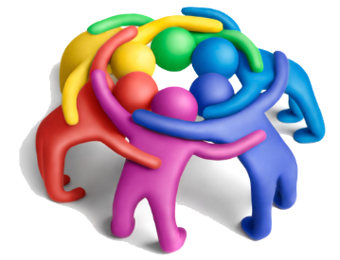


Four tips for effective hybrid leadership
1. Build team spirit
2. Foster (and model) a caring culture
3. Set clear expectations based on outcomes
4. Use technology effectively
Outcomes!

Slide 9
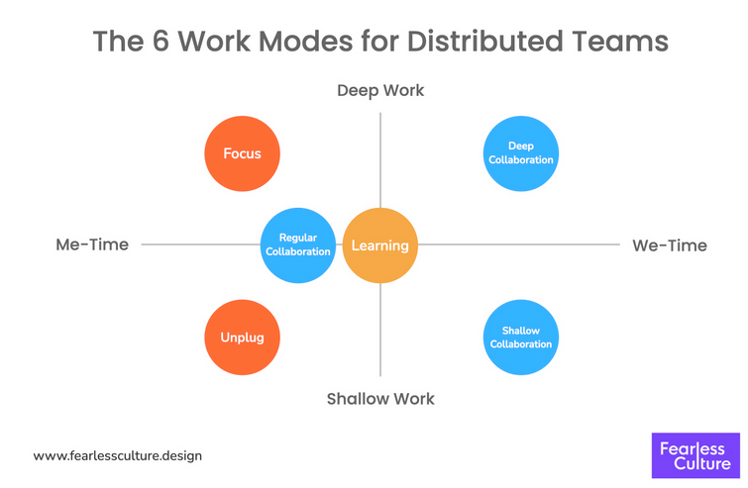
1. Build Team Spirit
  Foster the belief we are a team not a group of individuals
    Create “Anchor days” where you will all meet in person on a regular basis (monthly/Termly?) to encourage belonging
  Find opportunities for collaborative working
    This may include using appropriate technology to work across
    physical boundaries (SharePoint, One Drive, Yammer, Teams,
    Padlet, MURAL etc)
    Consider how you make meetings or workshops more
    inclusive and increase engagement and connection.ª
    Use the 6 modes of working to structure working and
    collaboration time. ^{b}
    Work digitally first and asynchronously (where possible) ^{b,c}
    Ensure team feel represented, able to fully participate and
    highlight teams shared responsibility to each other.^{d}
  Look after yourself and your team
    Keep considering your own wellbeing.
    Set realistic hours and prioritise tasks, so that your workload is sustainable.
    Stay in touch regularly.
https://www.fearlessculture.design/blog-posts/how-to-collaborate-effectively-if-your-team-is-remote-or-hybrid
N
Notes:
ªhttps://miro.com/blog/hybrid-collaboration-field-guide/ Accessed 16/02/2023 (good resource that can individuals can work through)
^{b}https://www.fearlessculture.design/blog-posts/how-to-collaborate-effectively-if-your-team-is-remote-or-hybrid Accessed 16/02/2023. (PDF version available if want a handout).
^{c} https://www.mural.co/blog/why-hybrid-collaboration-is-harder-than-you-think Accessed 16/02/2023
^{d}https://www.forbes.com/sites/googlecloud/2022/02/14/how-to-build-collaboration-equity-in-your-hybrid-workplace/?sh=23446a5c198d Accessed 16/02/2023
Additional resources on Learn Smart:
Virtual Collaboration playlist: https://app.goodpractice.net/#/e-develop/s/76lyo0ibfl
Creating a culture of collaborative: https://app.goodpractice.net/#/e-develop/s/xt4n88dx5d
Ten tools for effective collaboration: https://app.goodpractice.net/#/e-develop/s/knl4e6no4o

Slide 10
2. Foster and model a caring culture
Foster (and model) a caring culture
Recognise the wellbeing and mental health challenge arising from the pandemic and other factors such as workload^{f}
    High Anxiety levelsª
    Mental health^{b}
    Depression^{b}
Be open and honest about your own situation and vulnerability^{c}
Ask ourselves, as leaders, how can we foster and model a caring culture?^{d,e}
N
Notes:
Recognise the mental health challenge
During the pandemic 37% of people in the UK reported suffering ‘high anxiety’ (sickness, rapid breathing, pounding heart, trembling, fatigue, trouble sleeping, panic attacks and headaches) ª
1 in 5 adults with no previous experience of mental health problems reported their mental health as ‘poor’ or ‘very poor’^{b}
2 in 3 adults who has a pre-existing mental health problems reported this has become worse
People under 40, women, people with a disability and those who said they would struggle to meet an unexpected cost of £850 were the groups most likely to show symptoms of depression^{b}
Be guided by some useful research
Vulnerability
Research^{c} tells us that modelling ‘vulnerability’, combined with empathy can have great positive impacts
Try - “I am finding this remote working challenging, how’s it working out for you?”, “I too experience stress”, “I am finding it very tiring”, “these are certainly demanding times for all of us”
Combine this with empathy, when we ‘open up’ it makes solutions much easier to find
Requires trust to be built and worked upon over time
The Concerns Right Now
Recent research^{d} highlighted three large concerns for people now:
Unplugging after work
Loneliness
Collaboration and communication
Psychological wellbeing
American psychologist Prof Carol Ryff states^{e} in order to experience psychological wellbeing the following are needed BUT are compromised right now:
You need to believe that your life has purpose and meaning
You should feel that you have autonomy
You should be experiencing personal growth
You should feel that you are managing your life well
You should have positive relationships
You should know yourself well
Recent Exeter research
Ilke Inceoglou’s recent research summarises the impact of the pandemic on wellbeing and its complex interrelationships with a variety of factors.^{f}
References
ª ONS ‘Coronavirus and anxiety, Great Britain: 3rd April – 11 May 2020
^{b} BBC – Depression doubles during pandemic
^{C} Daniels, D. et al. (2020). Work-life balance and the pandemic. Early findings communication
^{d} MIND ‘The Mental Health Emergency’ – June 2020
^{e} https://www.karger.com/Article/Abstract/353263
^{f}Wood SJ, Michaelides G, Inceoglu I, Hurren ET, Daniels K, Niven K (2021). Homeworking, Well-Being and the COVID-19 Pandemic: a Diary Study. International Journal of Environmental Research and Public Health, 18(14), 7575-7575.

Slide 11
3. Set clear expectations focused on outcomes
Outcomes!
  Clarity around place and time – who is where, when
    Make sure you are available when you say you will be
    Be clear about your team members availability, who’s working when and where
    It’s much more important with hybrid teams that diaries and location messages are kept up to date
Focus on outcomes and team deliverables ª –
  Need to set clear goals (SMART method)
  Have regular face to face check-ins, performance reviews and team meetings
  Work to prevent proximity bias
  Celebrate teams successes.
  Make it clear that colleagues can talk to you at any time with problems – be approachable
  Things change rapidly at the moment so remain flexible with your plans
N
Notes:
For reference a on slide:
Performance management in a hybrid working environment can no longer see productivity as hours spent at a computer screen but needs to be based on outcomes, contribution and value of the work.
Need to set clear goals (SMART method example to use): clear, short-term, adaptable and successful. Gives more purpose and fosters transparency if they can be linked to organisations goals. (1). Check-in on progress with team regularly to offer support and feedback (2) and make sure they have tangible outputs so it is clear what progress looks like. (3)
Face to Face support at critical stages: in the office or via video call for performance reviews and check-ins. Check-ins should be regular and casual where possible. Performance reviews should also be regular to discuss goals, growth and career ambitions. (1). More junior staff may benefit from more time spent in person with more experienced colleagues. Regular team meetings can help you to identify who has capacity and who needs support (4)
For performance reviews incorporate feedback from multiple sources, and those who work closely with team member as in a hybrid environment this may not be you. This can also help to prevent bias, with proximity bias being a key struggle for hybrid working – ensure you have regular checkins, one to one calls and encourage collaboration opportunities to voice concerns for all team members but in particular your more remote ones. (1)
Most importantly normalise mistakes as an opportunity to learn and improve and celebrate your teams successes. (5)
References
1 https://www.linkedin.com/pulse/how-conduct-performance-management-hybrid-work-environment-?trk=pulse-article Accessed 16/02/2023
2 https://www.cultureamp.com/blog/redesigning-performance-management-hybrid Accessed 16/02/2023
3 https://worknest.com/blog/how-to-manage-performance-in-the-world-of-hybrid-work/ Accessed 16/02/2023
4 https://www.peoplemanagement.co.uk/article/1794205/best-manage-performance-remote-hybrid-workers Accessed 16/02/2023
5 Edge Magazine (pg 13 Autumn 2022) – From good to great: How can we build more effective teams?

Slide 12



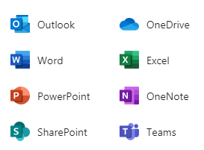


4. Use technology effectively
Collaboration & communication
Sharing & storing files
Major messaging
Audit trails
Replying in kind
Meta-tagged files
Replicated file structures
Meeting files
(Sits behind Teams…)
Quick contact
Bringing team in on topics
Exchange of information
Your own private space
You can share…
You can synch with Teams/SharePoint
Channelled information
File sharing
Channel threading
Linking to other team work
1-1 records
Quick notes
OneNote
N
Notes:
The last area to check-in on technology. Technology is simultaneously the cause of, and solution to, so many problems with remote working (like beer and life according to Homer Simpson).
Therefore as leaders and managers we need to be consistent in how we use it and how we encourage our teams to use it. This slide aims to offer some guidance. The links below are to some useful information about technology issues and solutions.
https://www.bbc.com/worklife/article/20200421-why-zoom-video-chats-are-so-exhausting
http://www.exeter.ac.uk/it/ourittransformation/digitalhub/
https://www.youtube.com/watch?v=OgIUq-EjqNA

Slide 13
In summary: to make hybrid working work for your team…
Develop effective behaviours
Positive and compassionate
People focused
Outcomes focused
Listen
Give feedback
Manage expectations
Set clear goals
Facilitate different opinions^{b}
Share information equitablyª
Be comfortable with delegation^{b}
Use technology effectively
Develop effective skills
Create a team plan (together)
Foster (and model) a caring culture
Be visible, be present
Make time for your team
Make time for yourself
Acknowledge and appreciate your team
Deliver effective actions
N
Notes:
a https://www.forbes.com/sites/googlecloud/2022/02/14/how-to-build-collaboration-equity-in-your-hybrid-workplace/?sh=23446a5c198d Accessed 16/02/2023
b Edge Magazine (pg 43 Autumn 2022) – The collaborative leader: To succeed in today’s world, it is vital to activate the power of the team

Slide 14
Further exploration of topics
The following slides further explore a range of topics introduced in the previous slides.

Slide 15
Leading hybrid teams is different^{a,b}
Performance management can no longer see productivity as hours spent at a computer but should be based on outcomes with clear goals. Also need to be conscious of proximity bias. ^{g}
Have a range of styles in your “leadership toolbox” ^{b}
Be fair, ensure staff who are working remotely are not excluded and have access to the same opportunities as those in the workplace (eg team-building activities and training)^{c}
Pilot new ways of working, check that it’s working, offer alternatives where possible^{c}
Be compassionate, “cultivate a sense of togetherness”^{d} and a “culture of belonging”^{e}, encourage collaboration^{f}
However, we seem to be skipping from one crisis to another so you will need to include direction and decision alongside coaching and democracy
Normalise a culture where team can be their authentic selves and where it is fine to make mistakes – supports development of a growth mindset. ^{h}
Gain perspective
Take control
Use opportunity
Leading in a crisis (from Noone & Forstner, 2020)
N
Notes:
Notes
From reference a on the slide: The leaders of virtual teams don't have the same powers of physical observation, and have to be creative in setting up structures and processes so that variations from expectations can be observed virtually. Leaders of virtual teams cannot assume that members are prepared for virtual meetings. Virtual team leaders have to sense when "electronic" silence means acquiescence rather than inattention. Leaders also have to ensure that the unique knowledge of each distributed person on the virtual team is being fully utilised.
From Reference d on the slide:
Look to yourself first.
Crises can result in a loss of a sense of agency, as in a loss of control over your own life.
Having a sense of agency is important for your resilience levels, your stability as a person and your capacity to deal with conflict or change. So, take ownership and take action:
Focus on critical problems
Pick problems likely to happen
Focus on what you can actually influence
Prioritise the risks
Brainstorm solutions
Make a plan
Nurture positive relationships which have a great impact on your wellbeing, mental health and longevity.
References
ªMalhotra A., Majchrzak A., Rosen B. (2007) Leading Virtual Teams. Academy of Management Perspectives 21(1): 60-70.
^{b} Rice, C. Lawrence, A.D. Keith, R. Young, K. (2020) Leading Remote Teams: New Trends and Challenges for Managers. PSI White Paper.
^{c}ACAS (2021). Supporting and managing staff in hybrid working. https://www.acas.org.uk/supporting-and-managing-staff-in-hybrid-working Accessed 23/7/2021
^{d}Noone and Forstner, 2020. Positive and mindful leader. https://www.positivemindfulleader.com/gain-perspective-take-control-use-opportunities/ Accessed: 5/1/2021
^{e}Foster a culture of belonging in the hybrid workplace. 2021. Harvard Business review. https://hbr-org.cdn.ampproject.org/c/s/hbr.org/amp/2021/08/fostering-a-culture-of-belonging-in-the-hybrid-workplace. Accessed 9/8/2021.
^{f}Levermore, K. The science of being an effective leader AND collaborator. https://www.linkedin.com/pulse/how-effective-leader-collaborator-kirsten-levermore/. Accessed 31/3/2022.
^{g}https://www.linkedin.com/pulse/how-conduct-performance-management-hybrid-work-environment-?trk=pulse-article Accessed 16/02/2023
^{h}Edge Magazine (pg 13 Autumn 2022) – From good to great: How can we build more effective teams?

Slide 16
CIPD (2021) tips¹
Ensure your team are familiar with organisational policies and procedures
Think about the design of jobs and the structure of weekly or daily tasks. Reflect on what needs to change in terms of systems, processes or activities to support hybrid work.
Encourage team members to think about where and when they are most productive and tailor their working days and time accordingly.
Provide clarity to the team on their level of autonomy relating to hybrid working. For example, are individuals allowed to schedule their own hybrid days or are there reasons why they may be required to work a specific number/pattern of days?
Talk to individuals about their working styles and preferences relating to remote and hybrid work. Have ongoing dialogue and keep arrangements under review if circumstances change.
Encourage workers to disconnect meaningfully when working remotely, taking proper breaks and managing their digital wellbeing.
Manage individuals' workload effectively through agreeing realistic objectives, providing constructive feedback and joint problem solving to resolve issues which might cause people stress or to work excessive hours.
Be clear about their own availability and hybrid working schedule, including when and how to schedule time with them.
Schedule regular 121 time with every team member – either virtually or face to face. Use this time for feedback, operational updates and checking in.
Encourage social connections between the team to support effective relationships.
Share team working patterns to provide clarity on who is working where and when.
N
Notes:
¹ CIPD (2021) Hybrid Working – practical guidance. https://www.cipd.co.uk/knowledge/fundamentals/relations/flexible-working/effective-hybrid-working

Slide 17
Challenges of hybrid working: evidence base and published discussions
Team mutual knowledge may be lackingª
Managers may be out of touch with individual needs^{b}
Family and home demands may impinge more directly on work at times^{c}
Team members may lack a sense of belonging/engagement^{d}
Need technology to work more consistently to connect people^{e}
Individuals may suffer digital “presenteeism”(“compensatory”)^{f} and digital exhaustion
Teams are more siloed^{g}
N
Notes:
References
ª Cramton, C.D. (2001) The Mutual Knowledge Problem and Its Consequences for Dispersed Collaboration. Journal of Organisation Science 12(3): 253-392
^{b} Timothy D. Golden, T.D. (2006) The role of relationships in understanding telecommuter satisfaction. Journal of Organisational Behaviour 27(3): 319-340
https://doi.org/10.1002/job.369
^{c} Kossek A.E., Lautsch B.A., Eaton S.C. (2006) Telecommuting, control, and boundary management: Correlates of policy use and practice, job control, and work–family effectiveness. Journal of Vocational Behaviour 68(2): 347-367. https://pubsonline.informs.org/doi/abs/10.1287/orsc.12.3.346.10098
^{d} Bartel C.A., Wrzesniewski A., Wiesenfeld B.M. (2011) Knowing Where You Stand: Physical Isolation, Perceived Respect, and Organizational Identification Among Virtual Employees. Journal of Organisation Science 23(3): 597-906.
^{e} Hollema, T.S. (2019) It's not just about technology: understanding virtual leadership. Training Industry online article. Accessed 30/7/2020.
https://trainingindustry.com/articles/leadership/its-not-just-about-technology-understanding-virtual-leadership/
^{F} https://www.executivegrapevine.com/content/article/2020-08-04-why-didigtal-presenteeism-is-your-biggest-threat. Accessed 15/8/2020.
^{g}The next disruption is hybrid work – are we ready? The Work Trent Index. https://www.microsoft.com/en-us/worklab/work-trend-index/hybrid-work
^{h}The Guardian (2021). It doesn’t just stop: do we need a law to ban out of hours emails?. https://www.theguardian.com/money/2021/jun/29/it-just-doesnt-stop-do-we-need-a-new-law-to-ban-out-of-hours-emails. Accessed 28/7/2021.

Slide 18
Thinking about being a positive and compassionate leader
It’s easier to connect more regularly
Lots of new ways to bring other parts of life into conversations
Meetings are more manageable
Opportunity for me to pause and reflect
Plenty of information available, regular updating
Chance to work more to people’s strengths

Slide 19

Compassionate and inclusive leadership
“Showing vulnerability is very powerful in the current context” ^{c}
“Leaders also have to understand themselves” ^{c}
There are four key behavioursª
Attending (the most important skill: “listening with fascination”^{b})
Understanding
Empathising
Helping (the most important task: helping those we lead to do the job they do)
Michael West who introduced the concept of compassionate leadership to the NHS.
N
Notes:
Notes
As well as the more “command and control” style that the advent of the COVID pandemic required (as in “crisis mode” in previous slide), leaders need to also be adaptable to the changing situation and flex their style accordingly. What we need now are people who are more able to cultivate a sense of togetherness (see reference c in the slide).
Compassionate Leadership has been brought into the spotlight in the NHS in the UK by Michael West (The Kings Fund) who’s mission has been to “make the NHS a better place to work” working to the NHS’s interim People Plan. He describes this in more detail in a series of presentations and Q&As on YouTube .
References
ªMichael West on Compassionate and Inclusive leadership: https://www.youtube.com/watch?v=RrPmMwg9X8s Accessed: 5/1/2021.
^{b}Nancy Kline and the Thinking Environment: https://www.timetothink.com/nancy-kline/ Accessed: 5/1/2021.
^{c}Hazlehurst, J. (2021). The path through uncertainty. Journal of the Institute of Leadership and Management, Summer 2021, 28-31.

Slide 20
Are you positive and compassionate?
Empathy
I sense others’ feelings and perspectives and take an active interest in their concerns.
Sometimes
Always
Never
Kindness
I am calm and I am generous with my attention and praise: I am mindful that people sometimes make mistakes and that this does not define them.
Making time for others
I make time in my busy life to be with the people I care about and I am honest and considerate of their needs.
Active listening
I make an effort to listen attentively to other people with genuine interest, making sure I am not distracted by external or internal “noise”.
Sometimes
Always
Never
Sometimes
Always
Never
Sometimes
Always
Never
Being inclusive and equitable
I am mindful that every individual is different and build my relationships accordingly, conscious that some people require more of me than others.
Sometimes
Always
Never
Appreciative
I am thankful for what I have and I remind others that I am grateful to have them in my life.
Sometimes
Always
Never
Positive outlook
I pursue goals despite obstacles and setbacks and believe the future will be better than the present.
Sometimes
Always
Never
N
Notes:
Notes
Clearly the more often you demonstrate each of these characteristics the more often you are acting positively and with compassion. Most of us will find that we are like this whenever we can be, so this is just a reminder of the things you can do to be more positive and more compassionate which are both more important during times of crisis.
If there are many areas where you have marked “sometimes” then try to move that score towards the “always” end of the bar, understanding that we are all human, have bad days, forget things and are under a different sort of stress at the moment.
Authenticity is important – there is nothing worse than reluctant appreciation or insincere kindness. There is no room for sarcasm or cynicism here either, despite a natural tendencyª to see the negatives now and in the future.
In terms of the style of leadership, “compassionate” is aligned with “affiliative” and “authentic”^{b}. However there have been challenges^{c} to the whole concept of definitive leadership styles so we must be careful of how much we pigeonhole ourselves. Better, then, to simply aspire to do more of what has been proved to work when developing, supporting and managing individuals and teams and indeed what you have found works best for you and those around you.
Be prepared to flex!
References
ªPlous, S. (1993) The Psychology of Judgement and Decision-Making. London: McGraw-Hill.
^{b}Fischer,T. (2018) Leadership: Processes and ambiguities Ph.D. thesis, University of Lausanne Press, Lausanne Google Scholar (p. 67)
^{c}Alvesson, M. (2020) Upbeat leadership: A recipe for – or against – “successful” leadership studies.
The Leadership Quarterly 101439. (online)
https://doi.org/10.1016/j.leaqua.2020.101439. http://www.sciencedirect.com/science/article/pii/S1048984320300667

Slide 21
Leading remotely: being positive and compassionate
Kindness and empathy come to the fore. Get to know your team. Think before you speak and act, especially if you are feeling frustrated or want to criticise something in your team. Consider the impact of what you want to say or do.
Make time for other people in your life. Create family time, friends time, as well as “me” and work time. Try and do something new or different with those who are important to you.
Actively listen. Set aside your own fixed ideas or need to respond and actually listen to what other people are saying and how they are saying it. Feeling heard is so important in socially distanced situations.
Be mindful of the need to be present. Minimise distractions when you are with someone else, whether remotely or in person: focus on you and them only.
Be aware of the differences in your team and be equitable. Be aware of your team members individual needs and situations and be mindful of how this may affect their approach to work; some people may require more of your time than others.
Be thankful and be grateful for what you have. Say it to friends, parents, partners, children, colleagues….and mean it.
See: Noone and Forstner, 2020. Positive and mindful leader. https://www.positivemindfulleader.com/gain-perspective-take-control-use-opportunities/

Slide 22
Other resources
The People Development Team has collated a range of resources that may be useful for those who are:
Working and leading in a hybrid team.

Slide 23
Useful reading/viewing
1. Recruiting, managing and developing people with a disability or health condition
2. Leadership: Denial, Salvation and Adaptation
3. Support your mental health while working from home
4. How to Actually Work When You’re Working from Home
5. Indistractable: How to Control Your Attention and Choose Your Life
6. Our online learning portal, LearnSmart, provides a wealth of information and development resources:
Top Tips for Leading Remote Teams
How to Make Virtual Meetings Work
Top Ten Challenges of Managing a Virtual Team
Virtual Collaboration
Creating a Culture of Collaboration
Ten Tools for Effective Collaboration

Slide 24
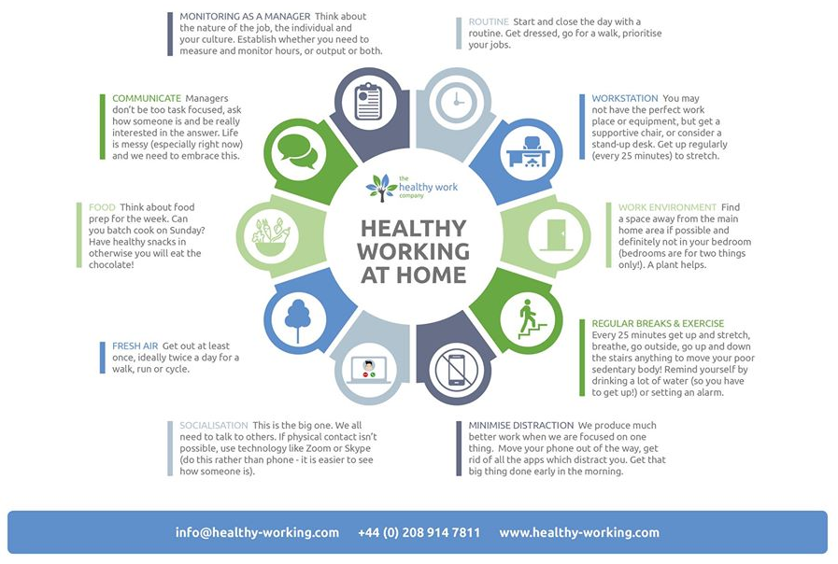

Slide 25

Further queries?
If you have questions or require further guidance on the support resources provided here, you can contact People Development at peopledevelopment@exeter.ac.uk
This is an evolving document, so please do send us any resources that you feel would benefit your colleagues and we’ll look to include them.

