Slide 1
Getting to know your campus (Penryn)
Presented By Natalie Battelle
Notes:
Hello, we will just wait for 5 minutes to give people time to login to the presentaiton

Slide 2
A few notes before we start…
Welcome!​
The presentation with links included will be made available on the International Welcome Programme website next week
You can ask questions at the end of the presentation​
Notes:
A few notes before we start, I will be uploading this presentation onto our website towards the end of next week, so please do not worry about making any notes, or if you miss any links.
I will be asking a few questions throughout the webinar, but we will also have a chance to ask questions at the end of the webinar.
You are welcome to keep your cameras on, but please keep your microphones muted, unless you would like to ask a question

Slide 3
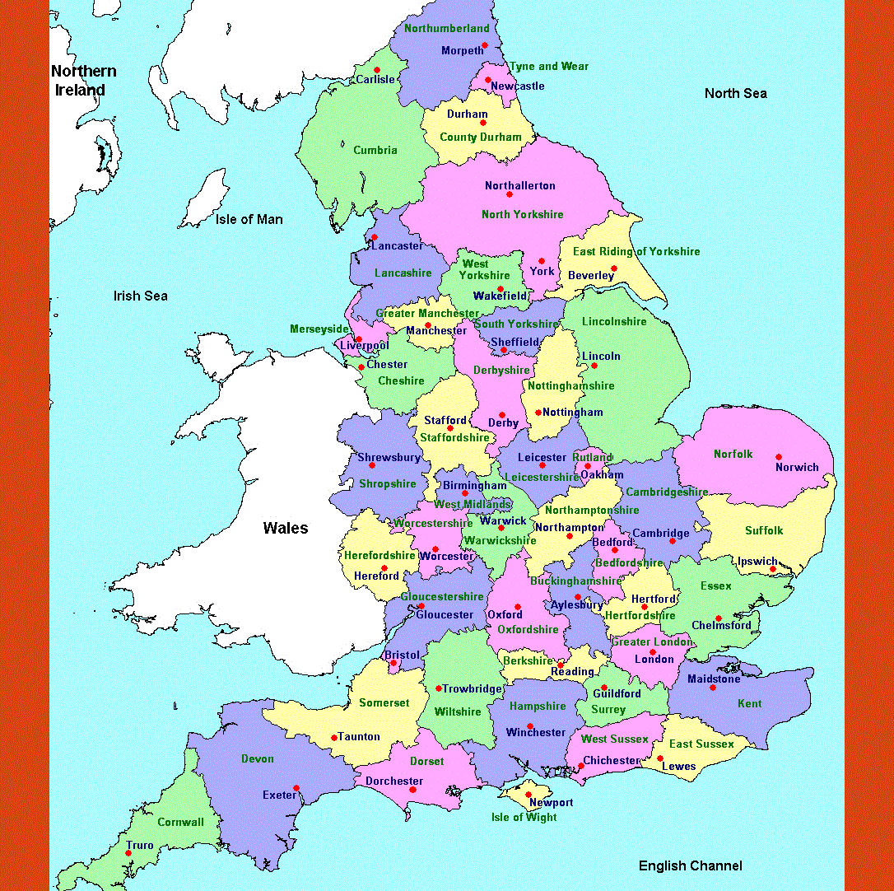
Where is Penryn?
Penryn campus
Exeter
London
Penryn to Exeter campus travel time 2.5 hours
Penryn to London travel time 5 hours.
Notes:
Ok, So firstly I want to let you know where you will be studying at Exeter Penryn, we are down in the south west of the UK, which I have highlighted with the star.
The City of Exeter, where the streatham campus is located, is aprox 2.5 hours drive, I have highlighted this with a triangle. Travel time to London, is aprox 5 hours drive.
Was anyone not aware of the location of our campus? Any thoughts?

Slide 4

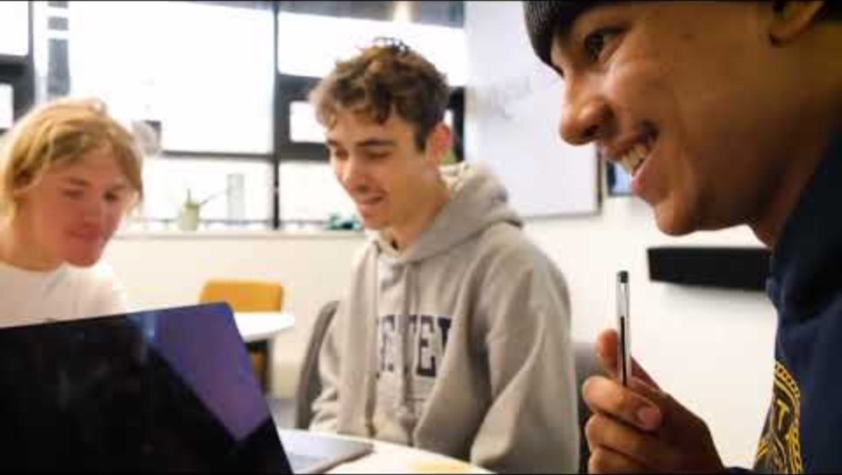
Shared campus with Falmouth University
We share our beautiful campus with Falmouth university
Falmouth and Exeter Plus manage all our services
You will find joint events on the Fxplus webpage
FX Plus – Delivering Higher Education services
Notes:
We share our campus with Falmouth University which is an arts university. It makes for a wonderfully diverse campus, and give you the opportunity to make friends with students across both campuses.
As we are a shared campus, we have a shared delivery services for areas such as accommodation, welfare, events and caterings. This shared services is called Falmouth and Exeter Plus. You will find joint events and activates on their website.
I will now play this short video that will show you our campus.

Slide 5
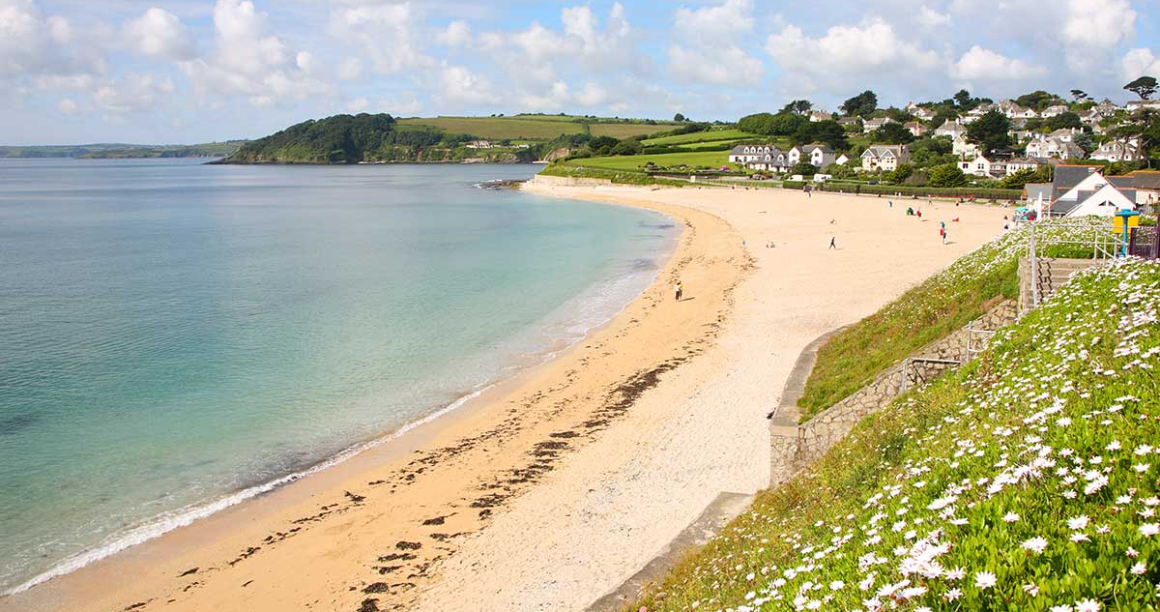
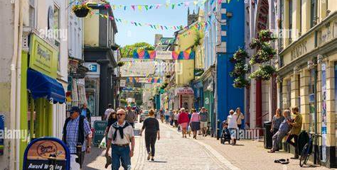
Falmouth
3 Beaches in Falmouth, all connected by costal path
Watersports
Sea swimming
Community meet ups
Restaurants
Nightlife
Coffee shops
Notes:
Althought our campus is in Penryn, we are next door to Falmouth which is our main town. Falmouth is a 5 min bus ride or 20 min walk away.
We have 3 fabulous beaches in falmouth, and a busterling town with resturants, shops, coffee shops and nightlife.
Falmouth is very community bases, so you will find lots of opportunities to meet with with other studnets and locals who will make you feel welcome.

Slide 6

Supermarkets
Big supermarkets
Asda - Big supermarket in walking distance from campus
Lidl – Budget supermarket, bus routes from campus
Mr Ragamuffins, Falmouth's independent greengrocer.
International shops
The corner shop, Berkeley Vale, Falmouth
Asian food store in Truro Thai & Asian food store 17 Kenwyn Street , Truro | Truro | Facebook
Notes:
If you ares staying in student accommodation, your closest big supermarket is Asda, its walking distance from campus, but there is also a bus that leaves from campus.
We have a Lidl on the bus route, along with local independent food markets, and international shops in Falmouth for Turo.
Truro is the closest City to us, it has all the highstreet shops you would expect to find in a city.

Slide 7
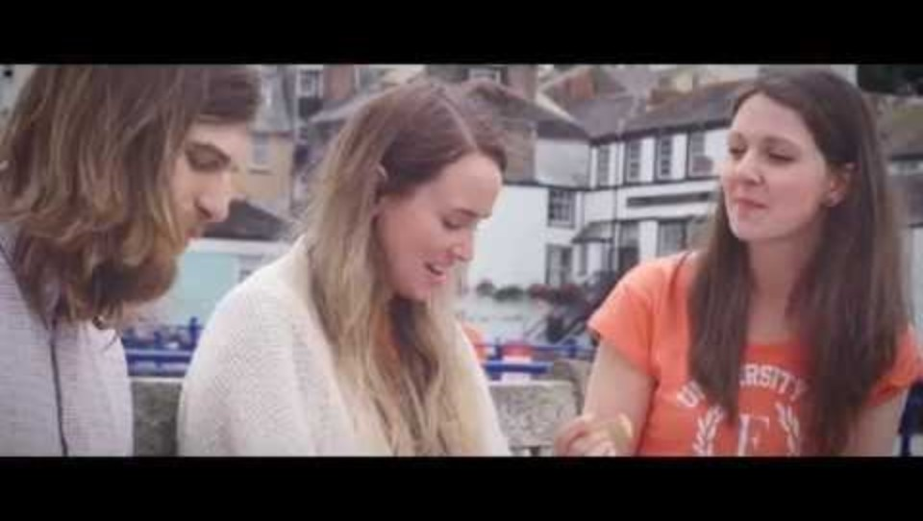
Life in Cornwall
Prepare for the seasons! You will need a good rain jacket and walking shoes.
Summer in Cornwall is the best time of the year! so much going on and the town comes to life.
Beach life!
Get connected, join groups and get out and see Cornwall.
Notes:
I think the best tip I can give new students who are going to be living in conrnwall, is to prepare for the seasons. You will be arriving at the end of summer, so although it is still reasonably warm (16 degrees – is that warm to you??) it starts to move into our rainy season. Cornwall is well know for having several seasons within a day, so one minute it will be throwing it down with rain, the next it will be bright sunshine! So please make sure you are prepared by carrying a decent rain jacket around with you!

Slide 8
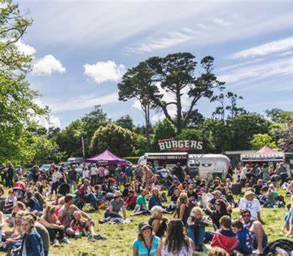
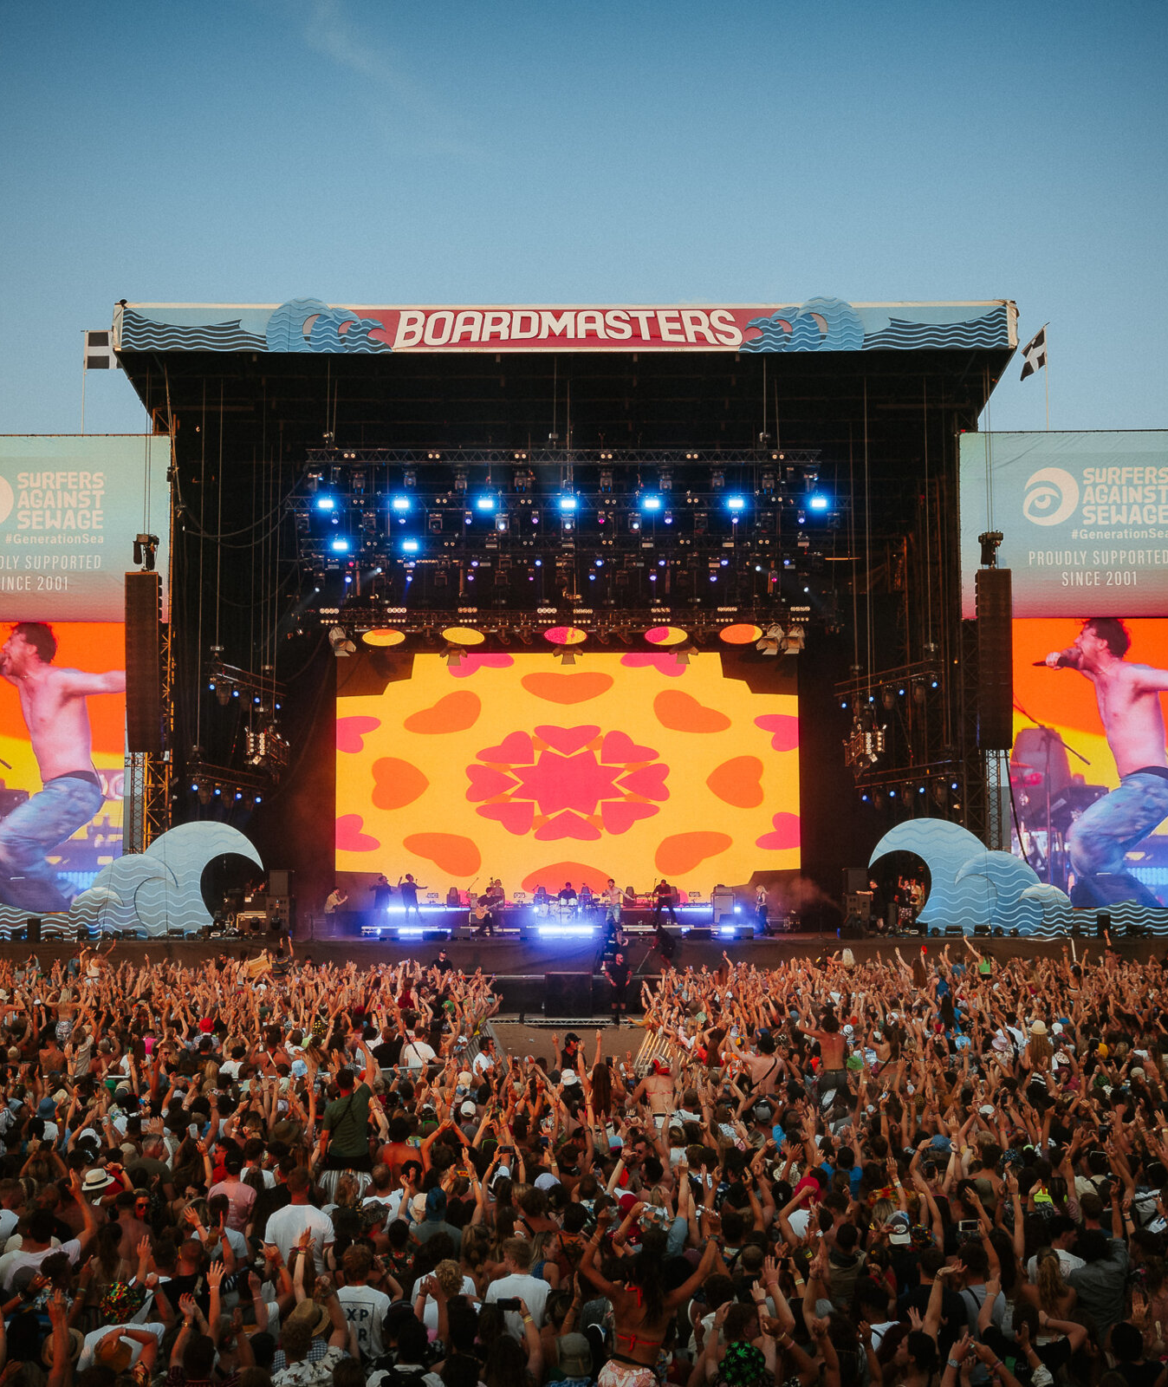
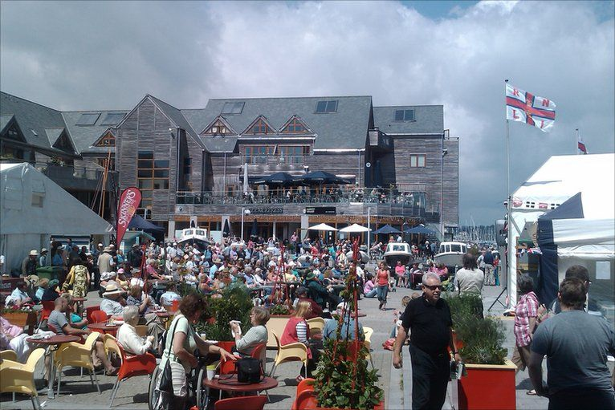
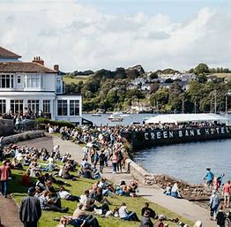
We love a good Festival in Cornwall
Tropical Pressure – July
Falmouth week – August
Tunes in the Park – August
Art festival – September
Sea Shanty – June
Boardmasters – August
Great Estate – May
Notes:
Festivals are a very popular an important part of life in cornwall, there is a festivals for everyone so please keep an our eye out for events taking place throughout the year.

Slide 9
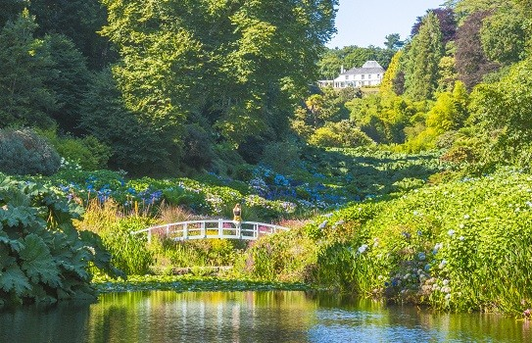
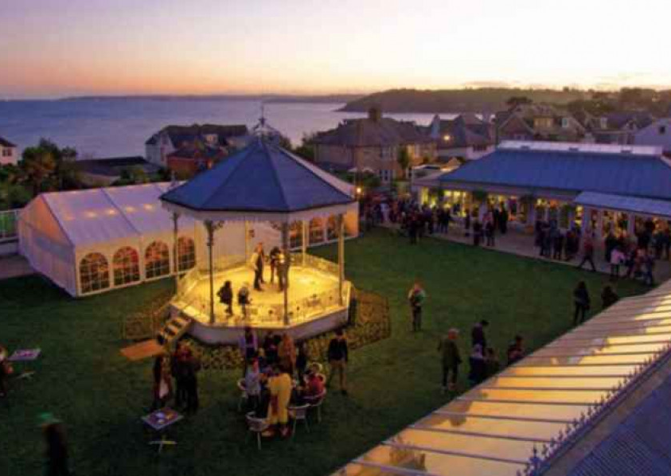
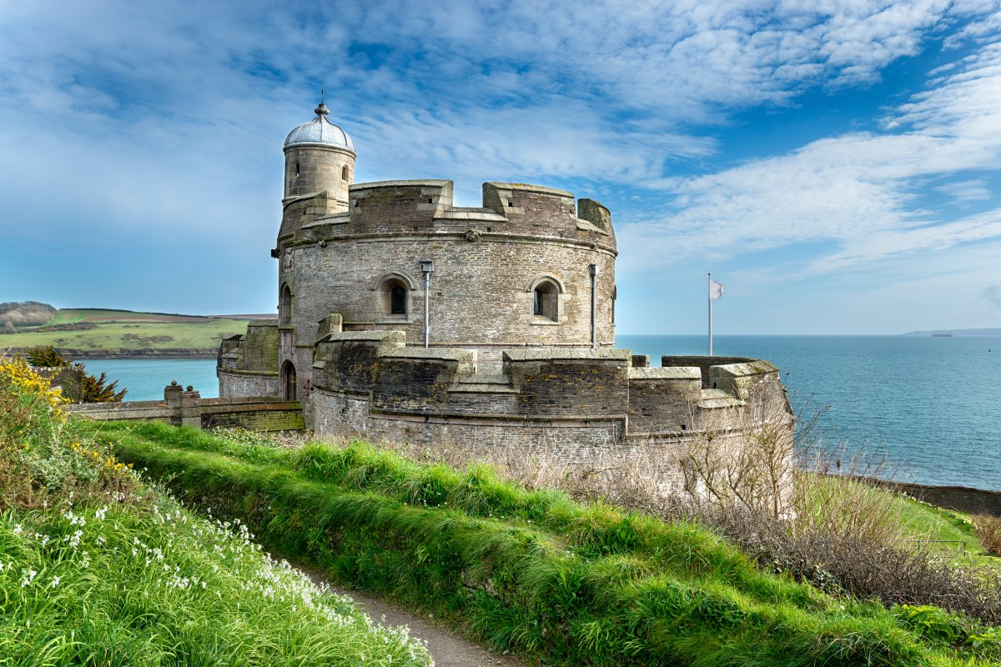
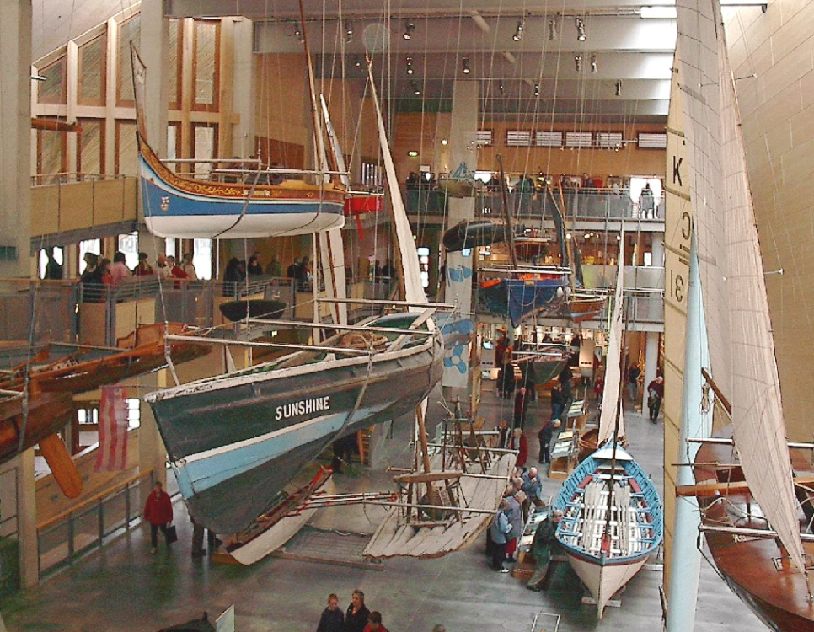
Local places to visit
Pendennis Castle
Trebah gardens
The Cornish Bank
The Princess Pavillion & Gyllyngdune Gardens
Castle Beach Café
Fish Factory
Maritime Museum
The docks
Notes:
We are lucky to have some amazing places to visit on our doorstep!
The ones I have listed on the slide are local to us, and all at the most 20 mins bus trip from campus. Obviously there is so much to see further into Cornwall which you will find out all about in our welcome week inductions.

Slide 10
Top tips for living in Cornwall
Be prepared for rain in winter
Get involved in the welcoming community and try and learn a bit about Cornish history
Embrace beach life!
Buddy up for trips around Cornwall
Notes:
My main tips for living in cornwall

Slide 11
Things to note for when you arrive
Penryn campus is a cashless campus
Truro is the closest city, and can be reached by train or bus in 20 minutes from campus
Falmouth will get very busy in the summer months with tourist and cruise ships arriving most weekends.
We are 5 hours from London, I highly recommend booking onto our airport collection service.
Notes:
Important things to note for when you arrive
Airport collection service Airport Collection Service | International Student Support | University of Exeter insert in the chat box.

Slide 12
Questions!

