Slide 1
Academic Literacy and English
Supporting your continuing academic and English language development

Slide 2

Emma Sweeney
Academic Manager
E.K.Sweeney@exeter.ac.uk

Slide 3

What is Academic Literacy and English?
A varied range of workshops, courses, one-to-one tutorials and opportunities for independent learning to support students who have English as an additional language.
It’s provided to students free of charge.
It’s helped many students gain confidence and do better in their degrees.

Slide 4



Two programmes
Support programme
Subject specific academic English
Reading and Writing Skills
Listening and speaking skills
Language support specifically for doctoral students
Credit-rated programme
15 credit modules available in terms 1 and 2
RQF5 (Second year undergraduate modules)

Slide 5
The Support Programme

Slide 6

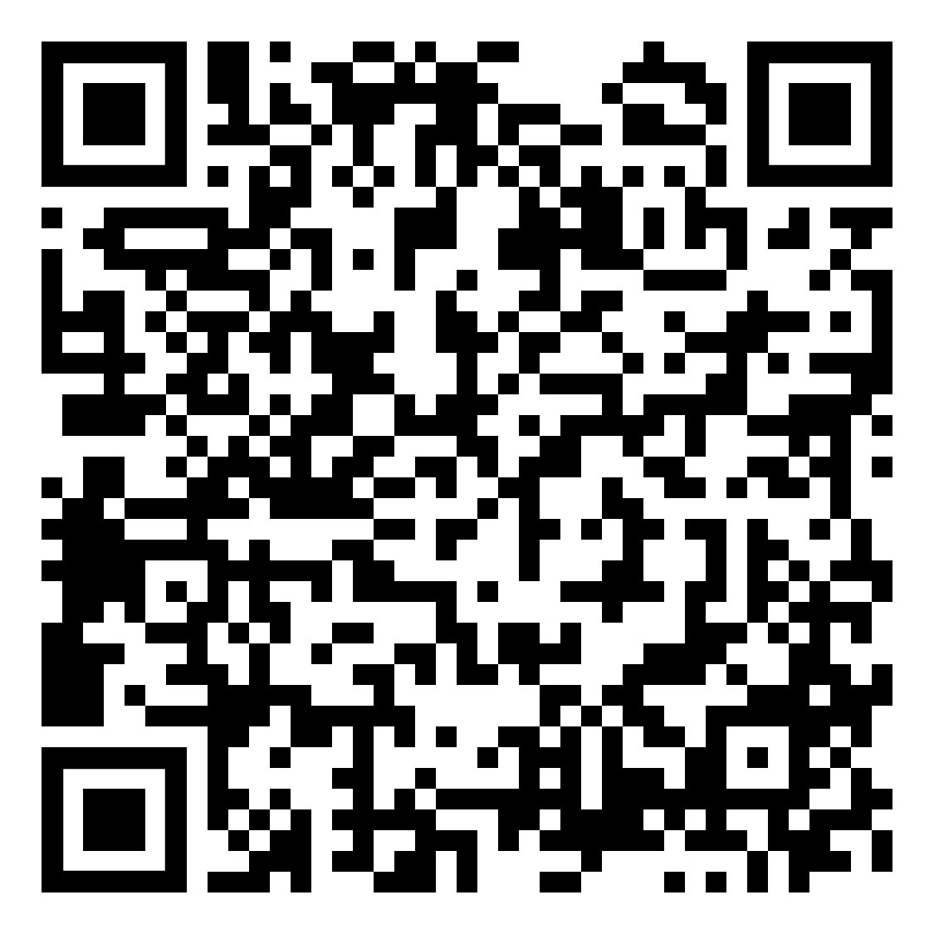

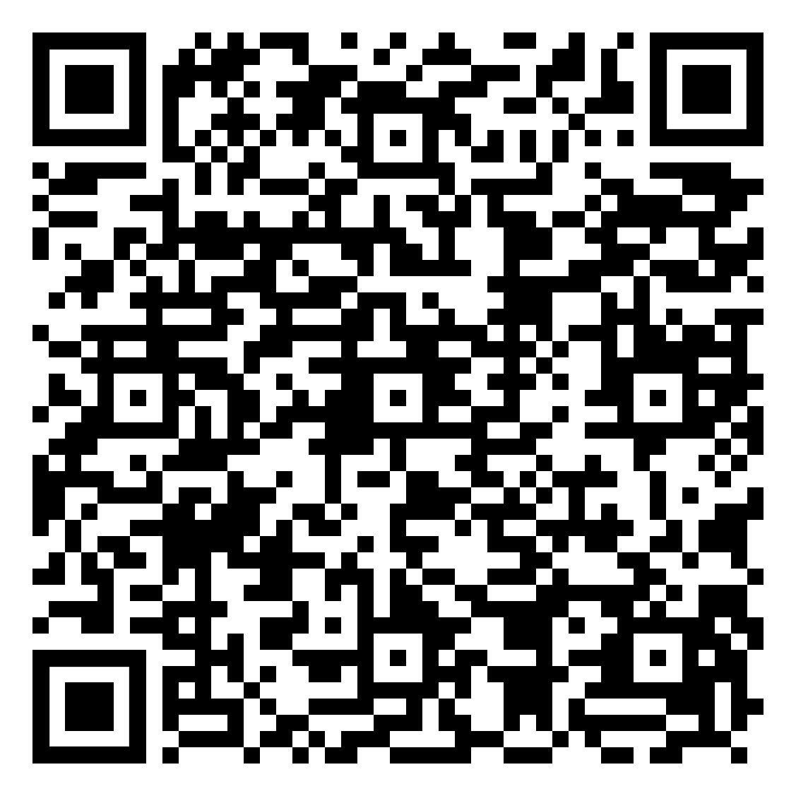
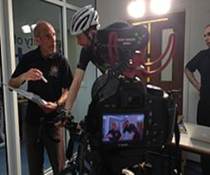
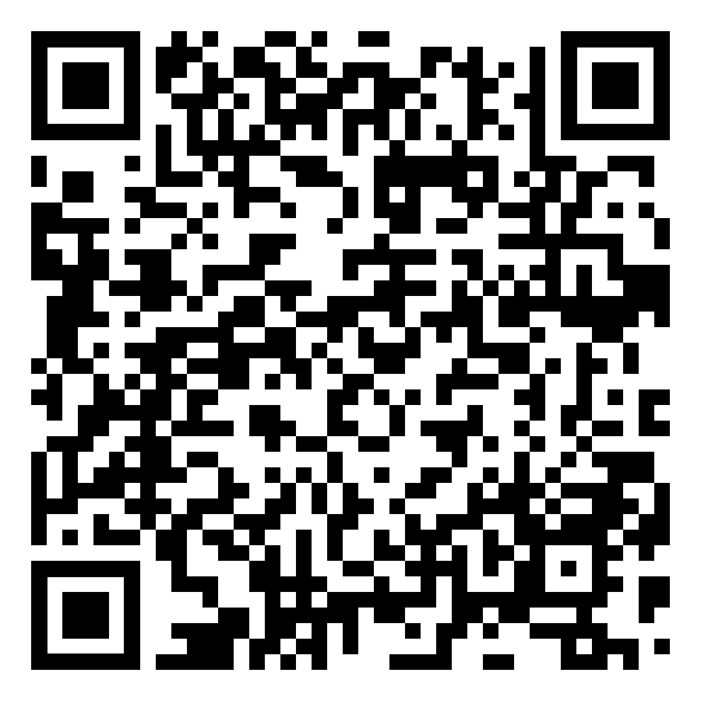

Subject Specific Academic English
Faculty of Environment Science and Economy
Academic English for Engineers
Academic Writing for Science
Academic English for Business
Faculty of Health and Life Sciences
Academic English for Sports and Health Science
Academic Writing for Psychology
Professional English for Medicine and Healthcare
Academic Writing for Science

Slide 7


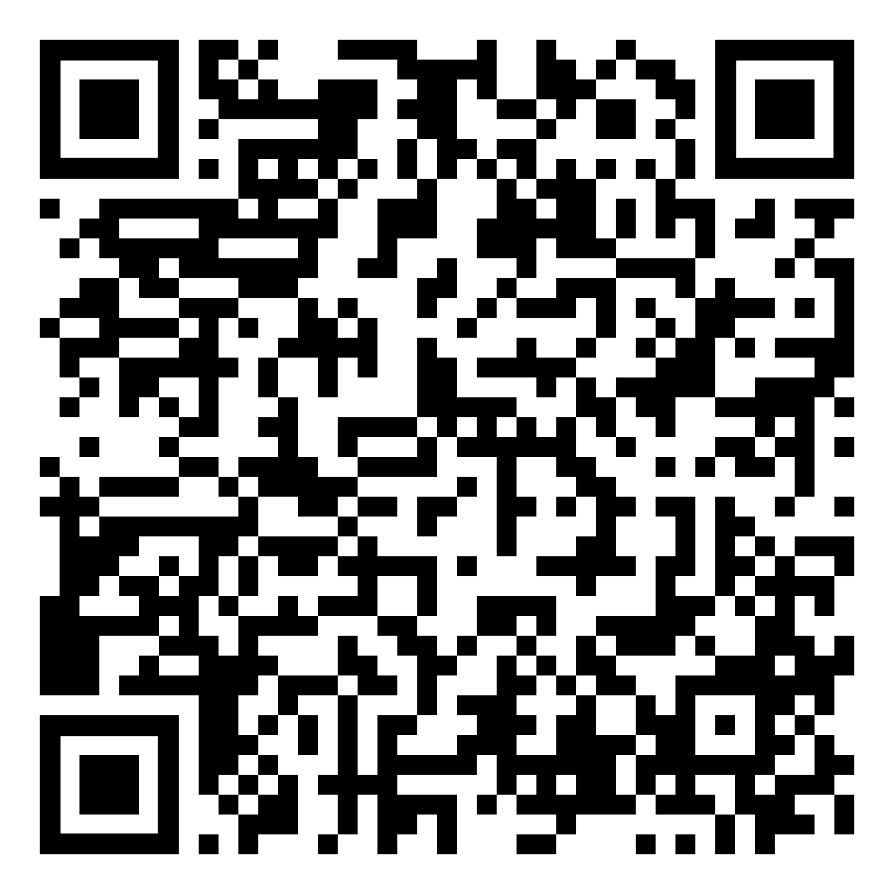

Subject Specific Academic English
Faculty of Humanities, Arts and Social Sciences
LLM, Politics, Sociology, Philosophy and Anthropology
School of Education
Institute of Arab and Islamic Studies
Department of English
Theatre Practice and Creativity, Innovation and Business Strategy
International Film Business
History
Translation Studies and Global Literatures and Cultures

Slide 8
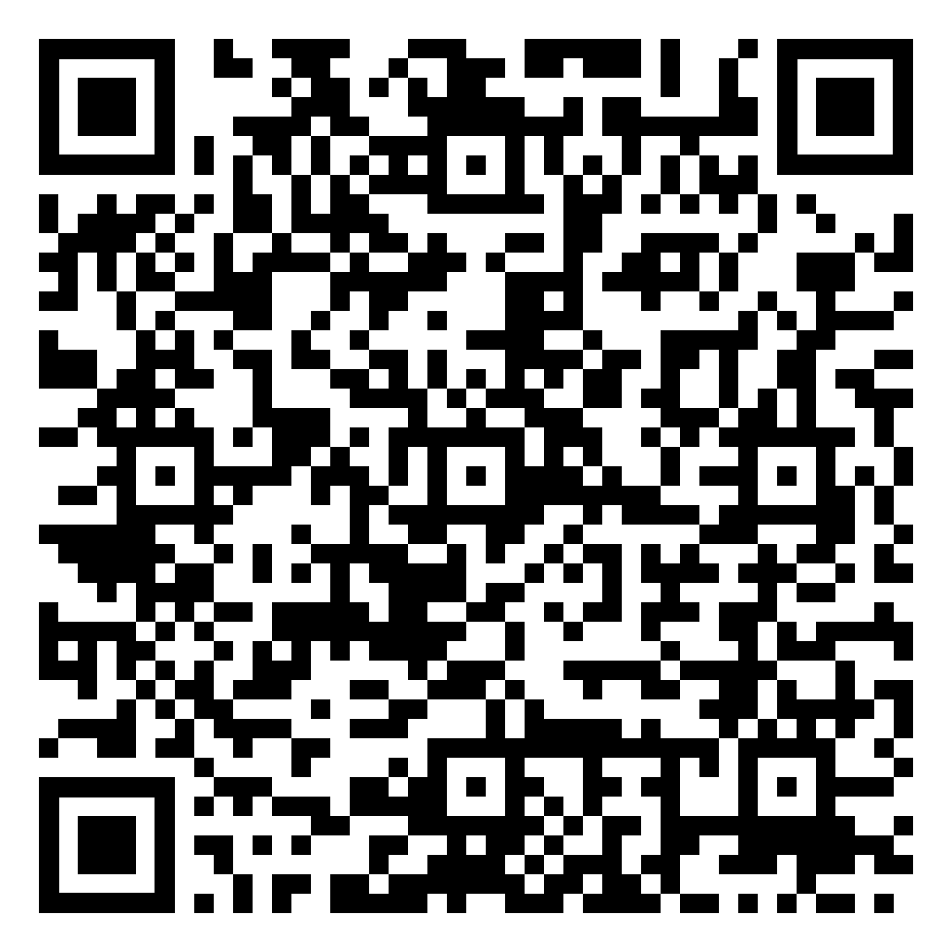
Reading and Writing Skills
Four Steps to Success
One-to-one tutorials and Writing cafes
Guided independent learning
Critical approaches to reading
Incorporating sources into writing
Critical writing
Reflective writing
Doctoral Academic Writing
Writing for Employability
CVs
Cover letters
Application forms
Digital resources

Slide 9

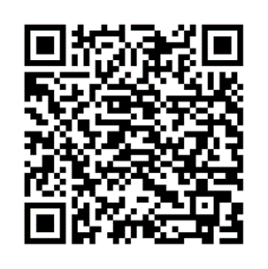

Slide 10
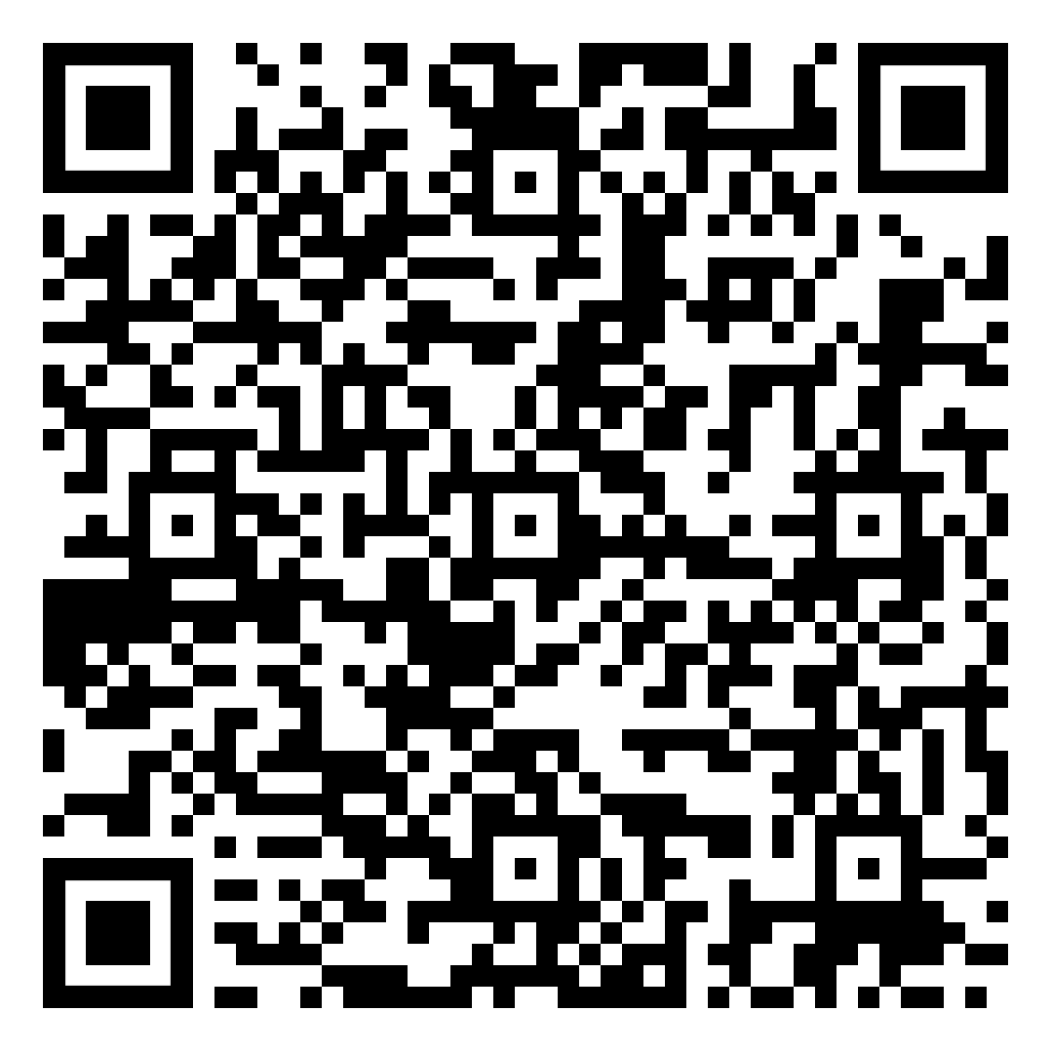
Speaking and Listening Skills
Speaking and Fluency
Oral Communication Skills
Current Issues
Listening Skills
Pronunciation
Intercultural communication
Spoken Skills for employability
Presentation Skills

Slide 11
Student feedback (Comments from the evaluation surveys)
Anonymous evaluation surveys for the support courses consistently show high percentages of students rating the support ‘very good’ or ‘excellent’
“Very useful, it is a good starting point before writing assignments”
“It gives overall picture of the academic writing at masters level”
“These workshops are brilliant. The content is very relevant especially grammar exercises.”
“The teacher will discuss question with us and always encourages us to ask if we do not understand”
“We were highly encouraged to be active”
“I achieved 72% in my first assignment”

Slide 12
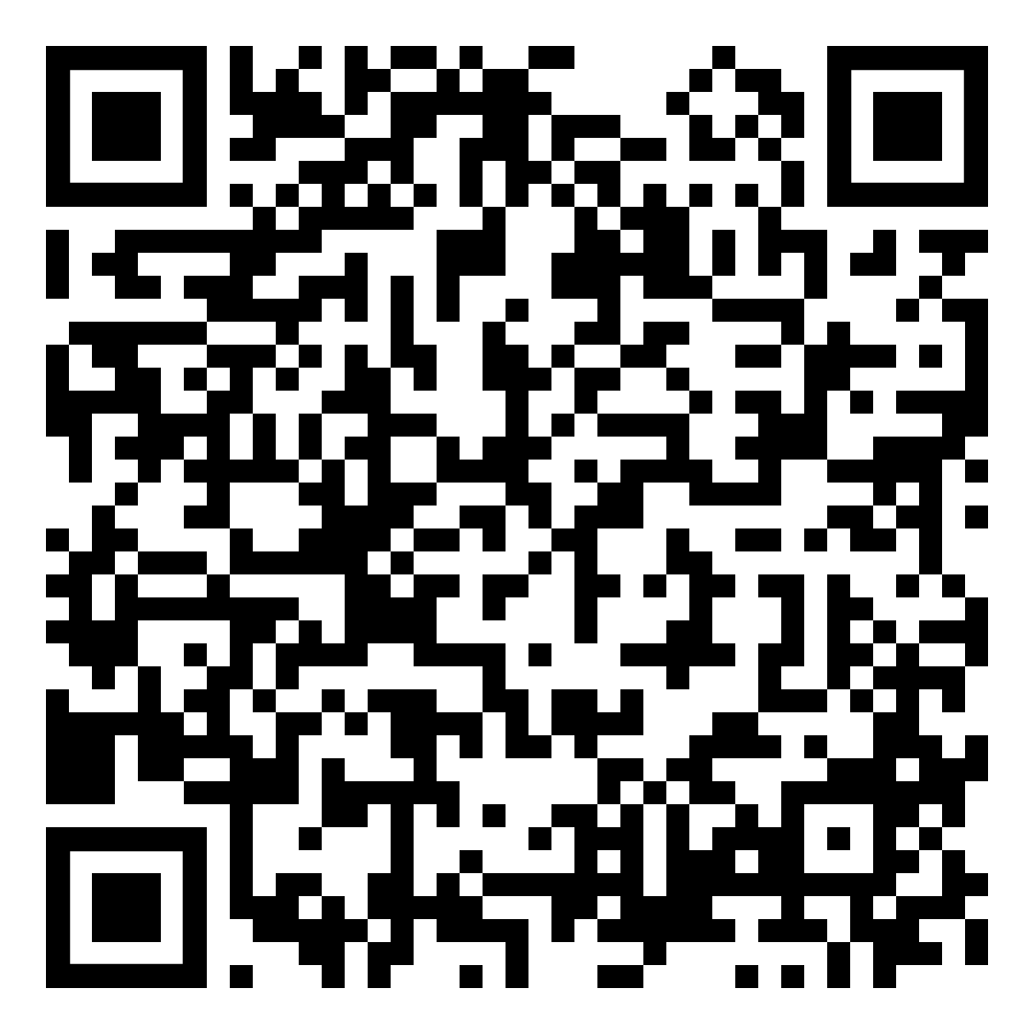
Next steps…
Browse our timetables: https://www.exeter.ac.uk/students/english-language-skills/timetables/timetablessupport/
Sign up for the courses and sessions that interest you
Any enquiries: insessional@exeter.ac.uk

Slide 13
The Credit-rated Programme

Slide 14
Our modules
Term 1 and Term 2:
ELC2727 Academic Listening & Speaking
ELC2728 Academic Reading and Writing
ELC2731 World Englishes
ELC2730 Professional English
All 15 credits (7.5 ECTs)
RQF5

Slide 15

ELC 2727 Academic Listening and Speaking (15 credits) ELC 2728 Academic Reading and Writing (15 credits)
Academic English modules with skills focus
Diverse topics covered in both modules
Seminars with group work
Opportunities for peer and teacher feedback
Develop crucial academic skills that can also be applied to other modules at Exeter and useful for studies at your home university

Slide 16


ELC 2730 Professional English (15 credits)
Benefit from small group seminars & regular feedback
Devise creative solutions to real-world problems
Engage in collaborative work: edit reports & deliver presentations
Enhance your employability & communication skills for future global workplaces
ELC2731 World Englishes (15 credits)
Study diverse varieties of English from around the world
Analyse historical, social, political & cultural factors
Engage with English as a global language

Slide 17
What students say
‘I really appreciated the enthusiasm of the teacher. She was able to give us good vibes. The topics of the module were interesting and challenging as well. I feel more fluent now when I speak in English and I can deal with academic topics expressing my opinion to other people.’
(Academic Listening & Speaking)
‘The best module ever. I feel like I have improved significantly, and I feel more confident about my writing skills. I would make this module mandatory for everyone because it goes very deeply into detail and opens up a whole new level of awareness about writing…’
(Academic Reading & Writing)

Slide 18
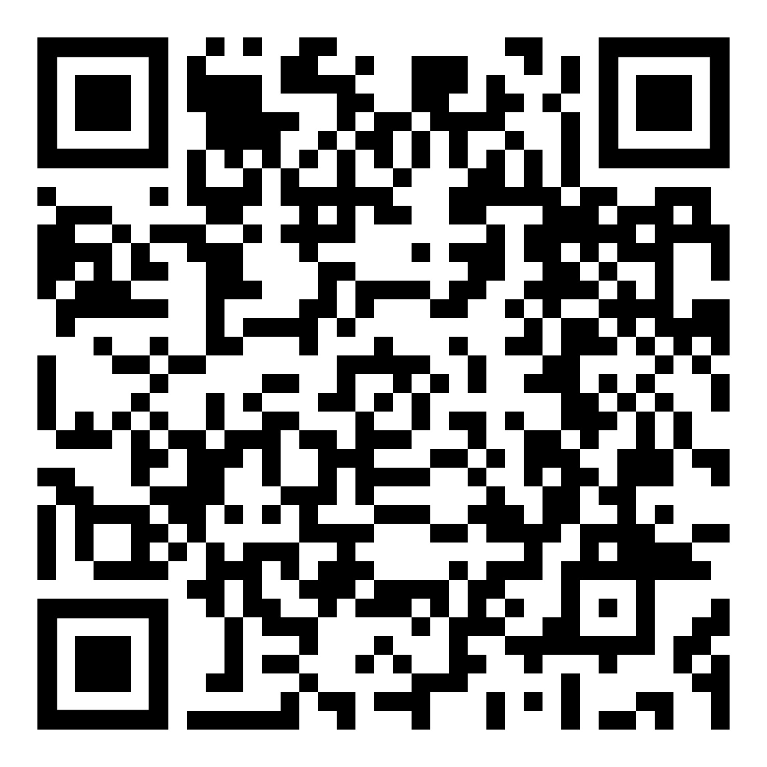
Can I take a credit-rated module?
YES, if …
you have no clashes.
you need the credits.
You are an ERASMUS/ exchange programme/ international student with permission from department to take credits in academic English.
In Exeter up to and including December 13th for exams.
Email E.K.Sweeney@exeter.ac.uk to enrol
Come to our drop in TODAY 4-6pm in the INTO Building 2.08 to find out more about the modules.

Slide 19
We are always here to help! insessional@exeter.ac.uk
https://www.exeter.ac.uk/study/into/englishlanguage/about/

Slide 20

Any questions?

