Slide 1

Getting from Bristol Airport to the University of Exeter
(Streatham Campus)

Slide 2


There’s several ways to continue your journey
Rail
Catch the bus from Bristol Airport, and then the train to Exeter St David’s.
Bus
Catch a direct bus from outside Bristol Airport.
OR

Slide 3
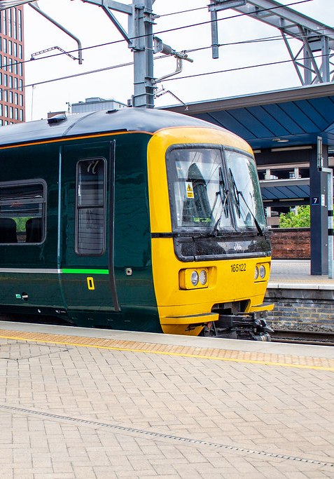
Rail

Slide 4

Travelling By Train
When you arrive at Bristol Airport you will need to catch the A1 bus (also called the Airport Flyer Express) from outside the terminal to Bristol Temple Meads.
The Airport Flyer Express leaves every 12 minutes and is available 24 hours a day, 7 days a week. It takes around 30 minutes and drops you at the railway station.
Trains from Bristol Temple Meads to Exeter St David’s run roughly every hour and the journey takes about 1 hour. There are no changes on the train.
It is advisable to pre-book your ticket due to price and availability. Here is the website for booking your train tickets online: https://www.thetrainline.com/

Slide 5
Handy Flow Chart!
Bristol Airport
From outside the airport terminal catch the A1 bus to Bristol Temple Meads
Board the train to
Exeter St David’s
Get a taxi from outside the train station to
Streatham Campus
You’ve arrived!

Slide 6
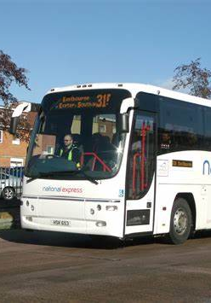
Bus

Slide 7

Travelling By Bus
You can travel with Megabus to reach Exeter from Bristol.
Megabus:
Buses depart outside the terminal every couple of hours
It takes roughly 1 hour 50 minutes to reach Exeter Honiton Road Park and Ride – no changes
Tickets must be bought in advance and are roughly £10
You can purchase tickets here: https://uk.megabus.com/
Bristol Airport
From outside the airport terminal catch the Megabus bus.
Call Apple Taxis (01392 666666) to
Streatham Campus
Arrive at
Honiton Park and Ride
You’ve arrived!

Slide 8
We hope you have a safe journey and we look forward to welcoming you to the University of Exeter

