Slide 1

Getting from Gatwick Airport to the University of Exeter
(Streatham Campus)

Slide 2


There’s 2 ways to continue your journey
Rail
Catch the train from South Terminal to Exeter St David’s.
Bus
Catch a bus from London Victoria Coach station.
OR

Slide 3
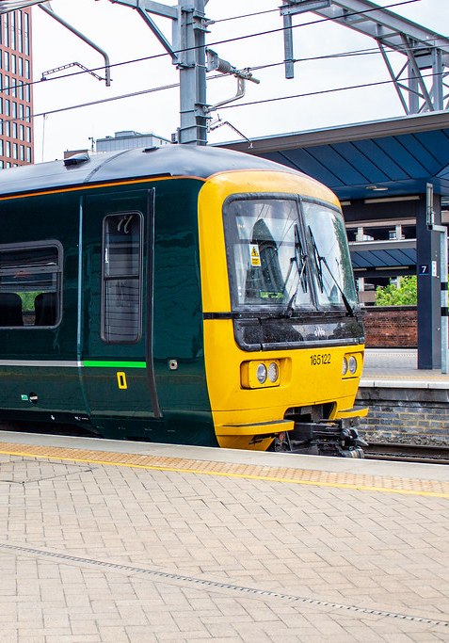
Rail

Slide 4

Travelling By Train
When you arrive at Gatwick Airport you will need to catch the train from the South Terminal. If you are due to arrive in the North Terminal you can catch a free shuttle to the South Terminal.
Trains from Gatwick Airport to Exeter St David’s run frequently every hour throughout the day and the journey takes between 3.5 and 4 hours.
You will have to change at either Reading, Clapham Junction, or Farringdon and London Paddington.
It is advisable to pre-book your ticket due to price and availability. Here is the website for booking your train tickets online: https://www.thetrainline.com/

Slide 5
Handy Flow Chart!
Gatwick Airport
Locate the train station in the South Terminal
Board the train to
Exeter St David’s
Get a taxi from outside the train station to
Streatham Campus
You’ve arrived!

Slide 6
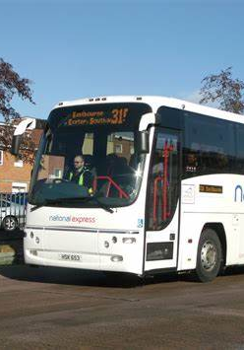
Bus

Slide 7

Travelling By Bus
To travel by bus, you must first make your way to London Victoria Coach station.
Catch the train from the South Terminal to London Victoria Coach station. The journey is roughly 45 minutes long.
Tickets can be purchased from within the South Terminal or online here: https://www.thetrainline.com/
National Express buses to Exeter St David’s take roughly 5 hours with no changes and there are multiple coaches each day.
It is advisable to pre-book your ticket due to price and availability. Here is the website for booking your coach tickets online: https://www.nationalexpress.com/en

Slide 8
Handy Flow Chart!
Gatwick Airport
From the South Terminal, board the train to London Victoria Coach station
Board the National Express bus to
Exeter Bampfylde street
Call Apple Taxis (01392666666) to
Streatham Campus
You’ve arrived!

Slide 9
We hope you have a safe journey and we look forward to welcoming you to the University of Exeter

