Slide 1

Getting from Heathrow Airport to the University of Exeter

Slide 2



There are 4 ways to continue your journey
University of Exeter’s Airport Collection Service
Rail
Catch the Heathrow Express to London Paddington
Bus
Get a bus from Heathrow Terminal 5 or Terminal 2 and 3
Air
You may be able to fly to a closer airport

Slide 3
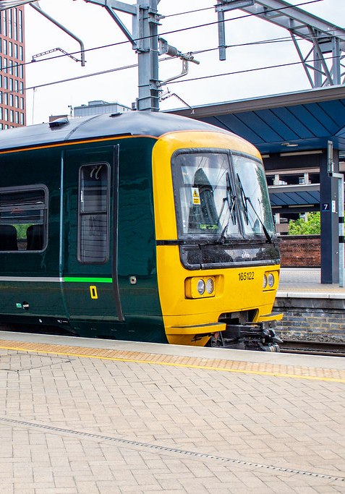
Rail

Slide 4

Travelling By Train
When you arrive at Heathrow Airport you will need to find the train station. Look out for this symbol:
From there, you must go to London Paddington station to get a train to Exeter St. David’s in 2-3 hours.
It is advisable to pre-book your ticket due to price and availability. Here is the website for booking your train tickets online: https://www.thetrainline.com/
Most trains will go straight to Exeter St. David’s train station.
There are 3 train stations at Heathrow airport:
Terminal 5
Terminal 4
Terminal 2 and 3
Heathrow Express trains run every 15 minutes from Terminal 5 and Terminal 2 and 3. They take around 15-21 minutes to reach London Paddington. Trains start from 5am to a bit before midnight.
The Elizabeth line is a slower (30-40 minutes) and cheaper alternative departing every 30 minutes from Terminals 4 and 5, and every 15 minutes from Terminal 2 and 3.

Slide 5
Handy Flow Chart!
Heathrow Airport
From the airport terminal follow the signs for rail connections
Heathrow Express/Elizabeth line
Board the Heathrow Express or the Elizabeth line to London Paddington
Board the train to
Exeter St David’s
Streatham Campus
Get a taxi from outside the train station to campus
You’ve arrived!

Slide 6

Air
It might be possible for you to fly to a closer airport such as Bristol or Exeter
The advantage would be much shorter transfer time to Exeter campuses and quicker to get through customs and baggage.

Slide 7
Travelling By Plane
You may be able to book a flight via a European hub airport (such as Schiphol) to Bristol or Exeter Airports.
Make sure you check luggage restrictions for your onward flight – you may not be allowed as many bags as you are on your first flight!
Bristol airport is approx. 2 hours away from Exeter campuses.
Catch the A1 bus from outside the airport to Bristol Temple Meads and then the train to Exeter St David's rail station.
Exeter airport is approximately 45 minutes from Exeter campuses. Catch Bus 4A from outside the airport to Exeter St David’s station and then find a taxi outside the station to take you to Streatham campus.
It might take you longer than normal to get through any airport checks so make sure you leave plenty of time between connecting flights!

Slide 8
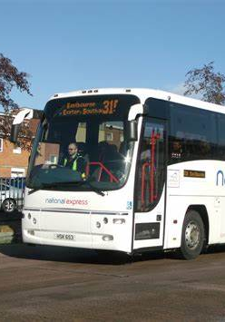
Bus

Slide 9

Travelling By Bus
When you arrive at Heathrow Airport you will need to find the National Express bus stop:
Terminal 5 – stops 13-16 outside the terminal building.
Terminal 4 – stops 13 and 14 outside the terminal building.
Terminal 2 and 3 – at the central bus station. This is a short walk from the check in area and is clearly sign posted around the airport.
Note – If you are arriving to Terminal 1 you will have to travel to Terminal 2 and 3 to be able to board a National Express bus.
It is advisable to pre-book your ticket due to price and availability. Here is the website for booking your coach tickets online: https://www.nationalexpress.com/en
There is strict luggage allowance:
1 x hand luggage and
1 x large suitcase
Buses from Terminal 4 and Terminal 5 often take you to Terminal 2 and 3 to get a direct bus from there. Or they might leave Heathrow and change in Bristol instead.
Buses form Terminal 2 and 3 take 3.5-5 hours and often with no changes.

Slide 10
Handy Flow Chart!
Heathrow Airport
From the airport terminal find the National Express bus stop (Terminal 5 at stops 13-16, Terminal 4 at stops 13 and 14, and Terminal 2 and 3 at the central bus station)
National Express
Board the National Express to Exeter Sidwell Street (City Centre)
Taxi
Call a taxi from the bus station (Apple Taxi’s – 01392 666666) to campus
You’ve arrived!

Slide 11
We hope you have a safe journey and we look forward to welcoming you to the University of Exeter

