Slide 1

Exeter Clinical Trials Support Network
Event 15, Tuesday 1st May 2018

Slide 2
Agenda
10:00 | Refreshments: Coffee & Cake
10:15 | INTRODUCTION & NEWS Shelley Rhodes - ExeCTU Senior Trial Manager
10:30 | Linking routinely collected data for trials research: The experiences of Cardiff CTR Dr Fiona Lugg-Widger - research associate at the Centre for Trials Research (CTR), Cardiff University
11:00 | Questions followed by networking
11:30 | WORKSHOP: Approaches to Data Capture
12:30 | End

Slide 3
Introduction and News
New staff
Lynne Quinn – CTU Operations Manager
Claire Pentecost – INTERTREAD Trial Manager
Sarah Walker – CTU Statistician
New Software –Electronic Data Capture System (Red Cap – Academic License)
currently with the university contracts department.

Slide 4
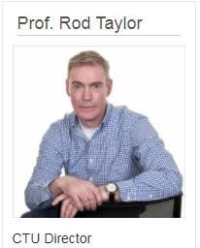
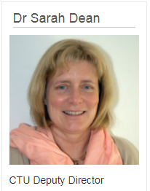
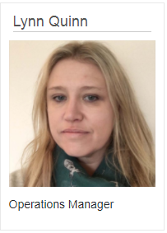
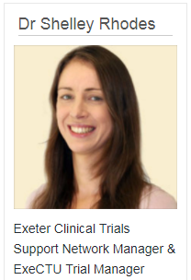
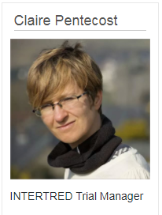
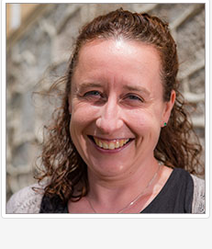
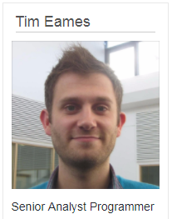
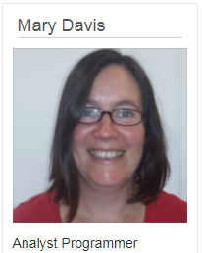
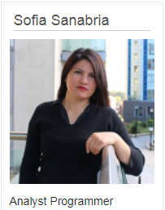
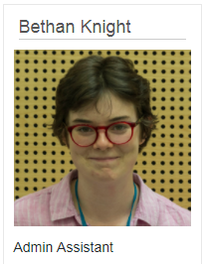
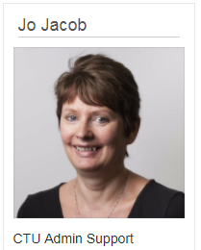

CTU Staff
Sarah Walker CTU Statistician
Notes:
Exeter CTU launched yesterday – nicked the slides

Slide 5
WORKSHOP How to …
Mary Davis - Analyst Programmer
Shelley Rhodes –ExeCTU Senior Trial Manager
Tim Eames – Senior Analyst Programmer

Slide 6
Workshop Questions
Participants to get into groups of 4-6 with pens and flip chart paper.
Choose a trial to discuss ideally a new study still in the planning phase.
What is the primary and secondary outcomes and what are the options for collecting this via routine data sets? Discuss pros & cons. (10 min)
How else may the data be collected? e-PRO, Telephone, Face to face etc. Discuss pros & cons. (10 min)
Discuss the process around data capture; e.g. Scanning paper CRFs, apps, double data entry. (10 min)

Slide 7
Services offered by the CTU
Statistical design
Sample size calculation
Funding application development
Assistance with costings
Protocol development
Case report forms
Automated randomisation
Database management
Trial Oversight Committees
Trial Management
Central and Remote Monitoring
Analysis and Reporting
Quality Assurance

Slide 8
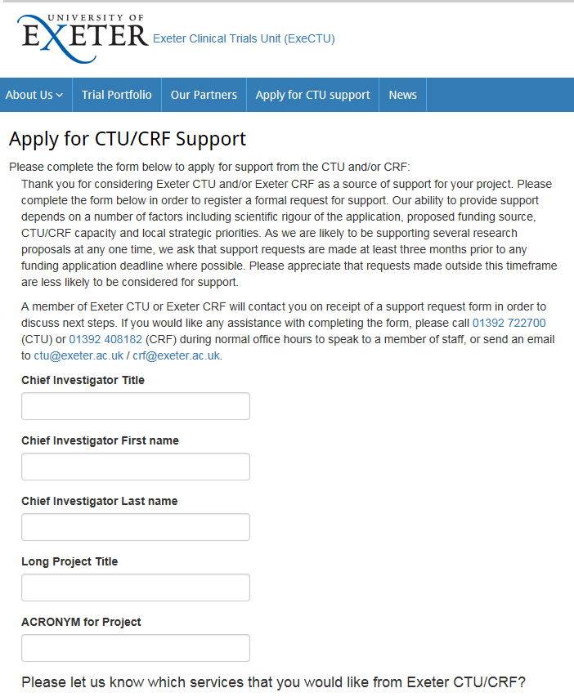
Request CTU support for your proposed clinical trial 3 months prior to any funding application deadline

Slide 9
ANY QUESTIONS?
Email: ctu@exeter.ac.uk for general enquiries
ctudata@exeter.ac.uk for IT/database support
Telephone: 01392 722700
Website: https://www.exeter.ac.uk/ctu/

